Slide 1
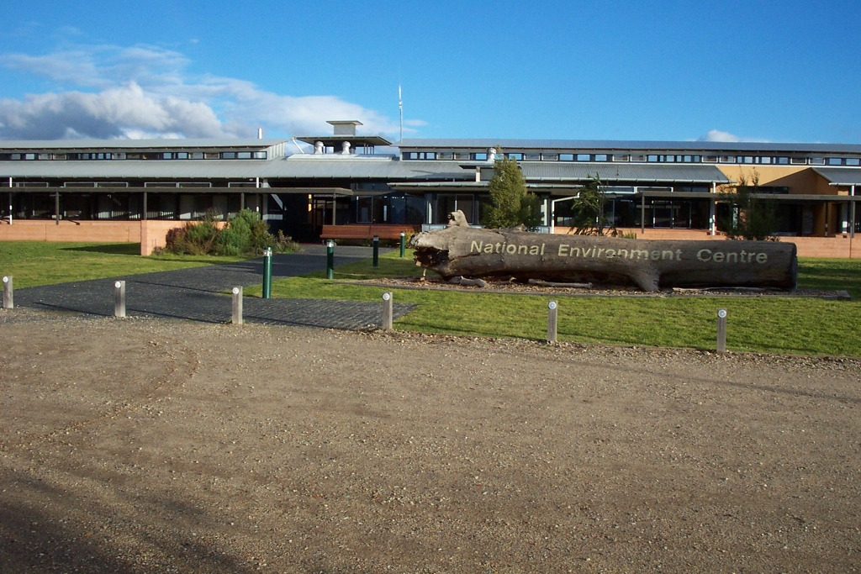

Slide 2
Diploma in Organic Farming
Diploma in Permaculture
Certificate IV IN Permaculture
In 2017….
Diploma in Organic Urban Farming
Bachelor of Agroecology
(as well as conservation land management, sustainability, environmental management)

Slide 3
Two delivery methods;
Online/Distance
Action learning approach using existing farm and developing plans or production supported by a teacher/mentor
(we have a network of teacher/mentors to contextualize the course to industry and bioregion)
2. On Campus
Students do their study based on our Green Gate Organic Farm, as part of the management team of the farm for 1 year and then support to develop food production system in the following year.

Slide 4
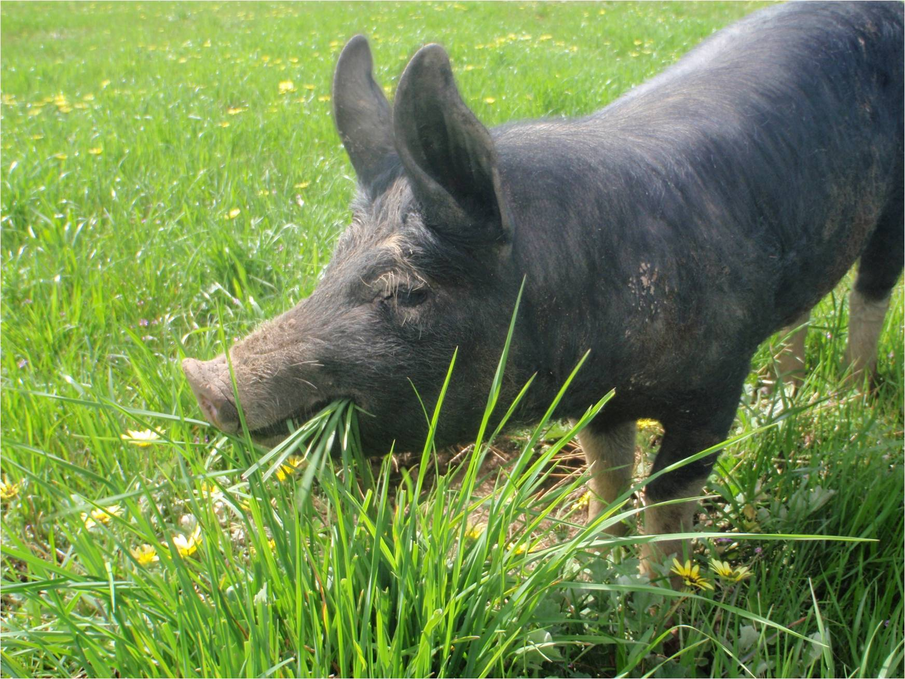

Slide 5
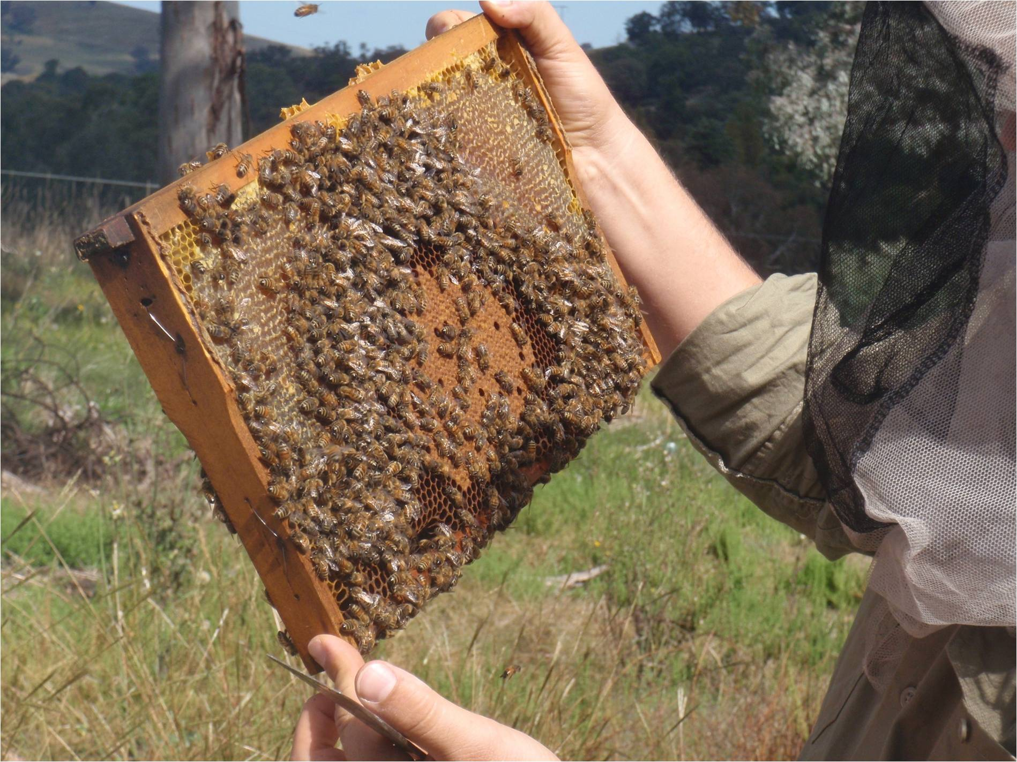

Slide 6
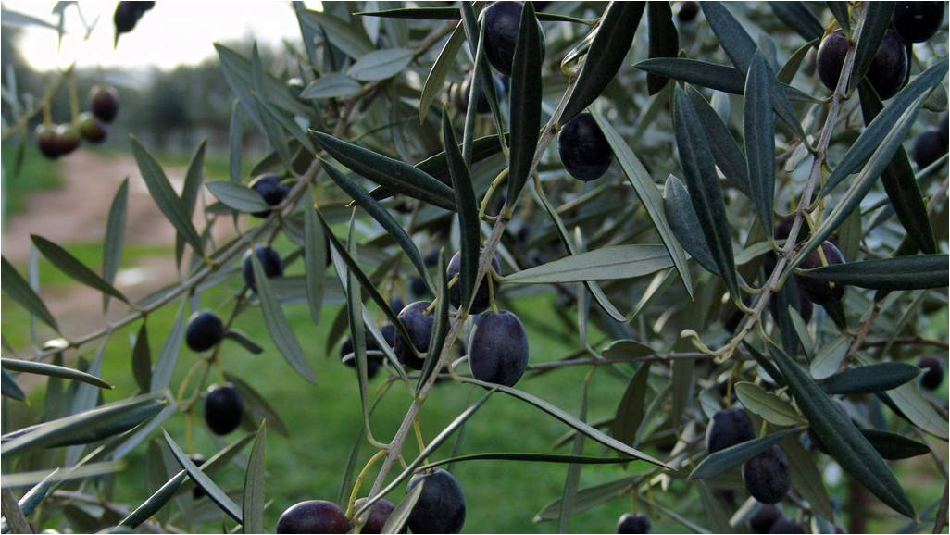

Slide 7
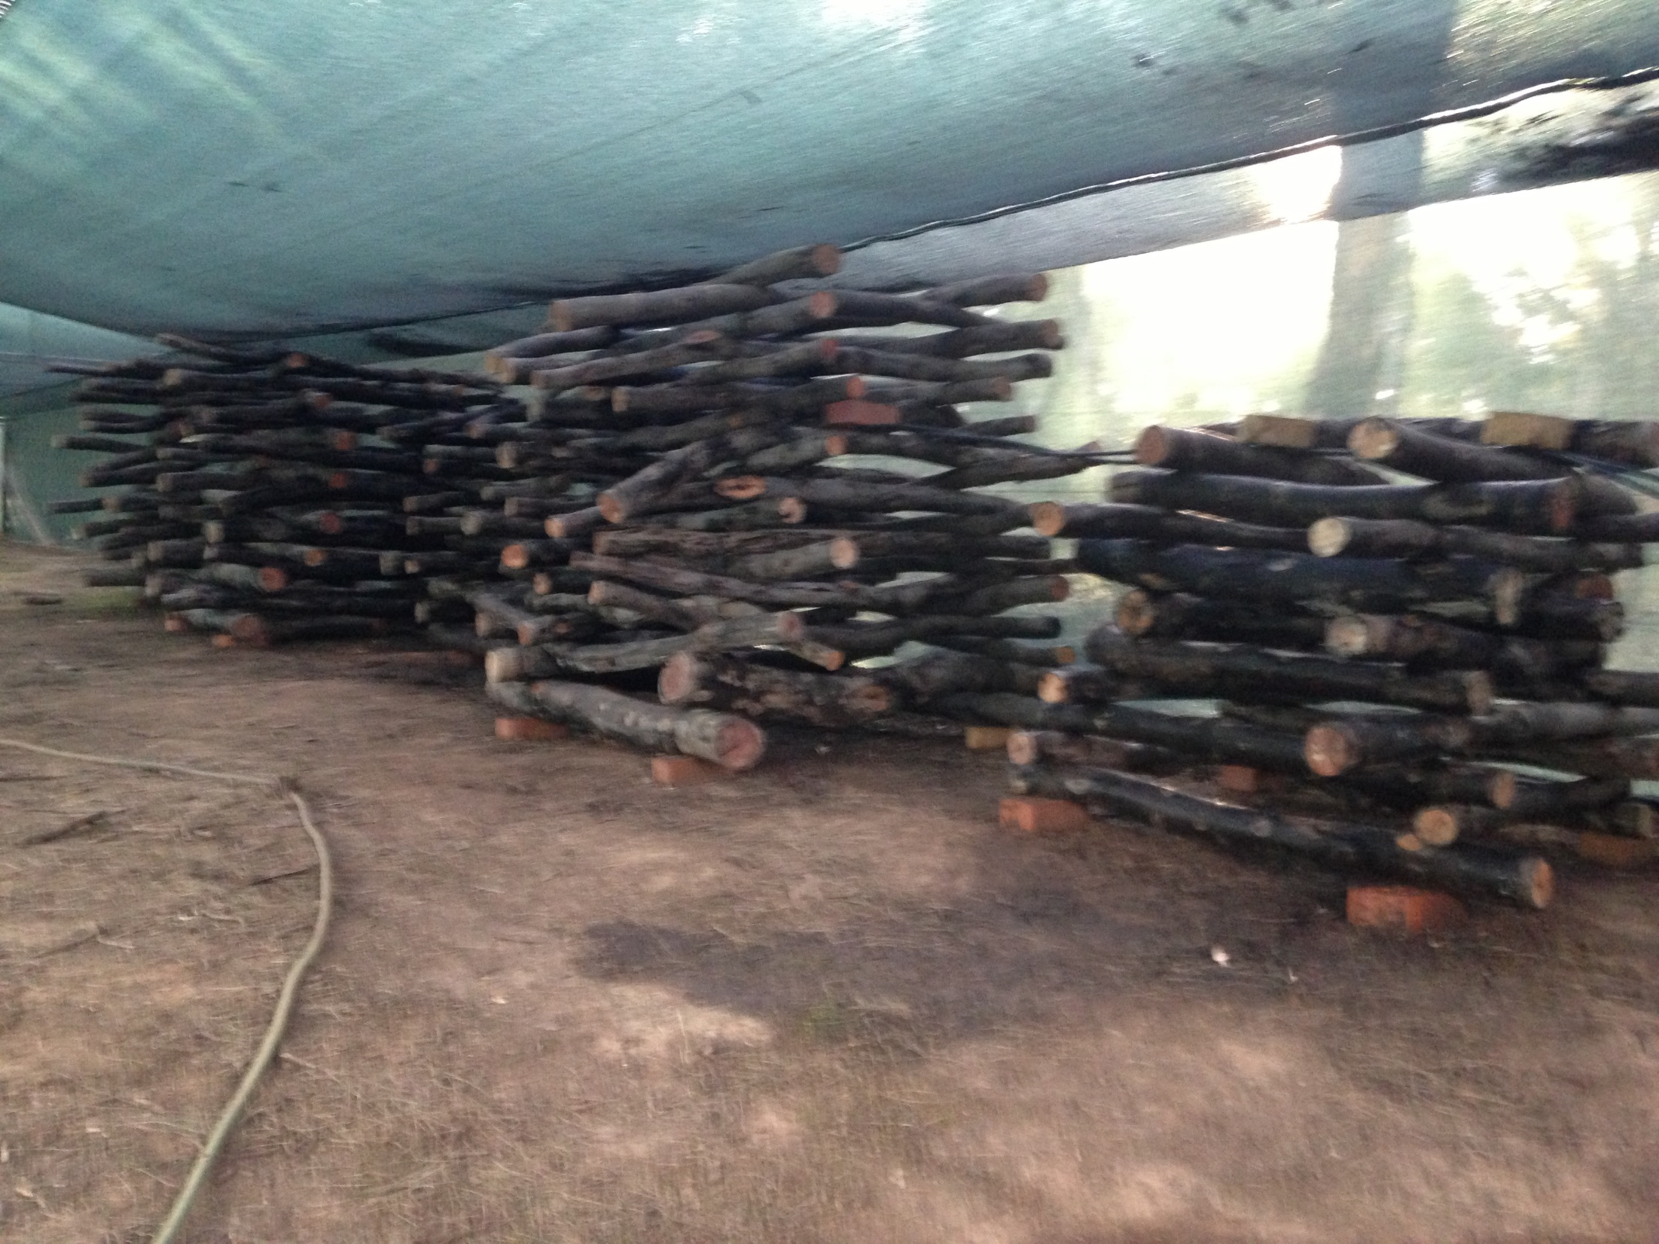

Slide 8
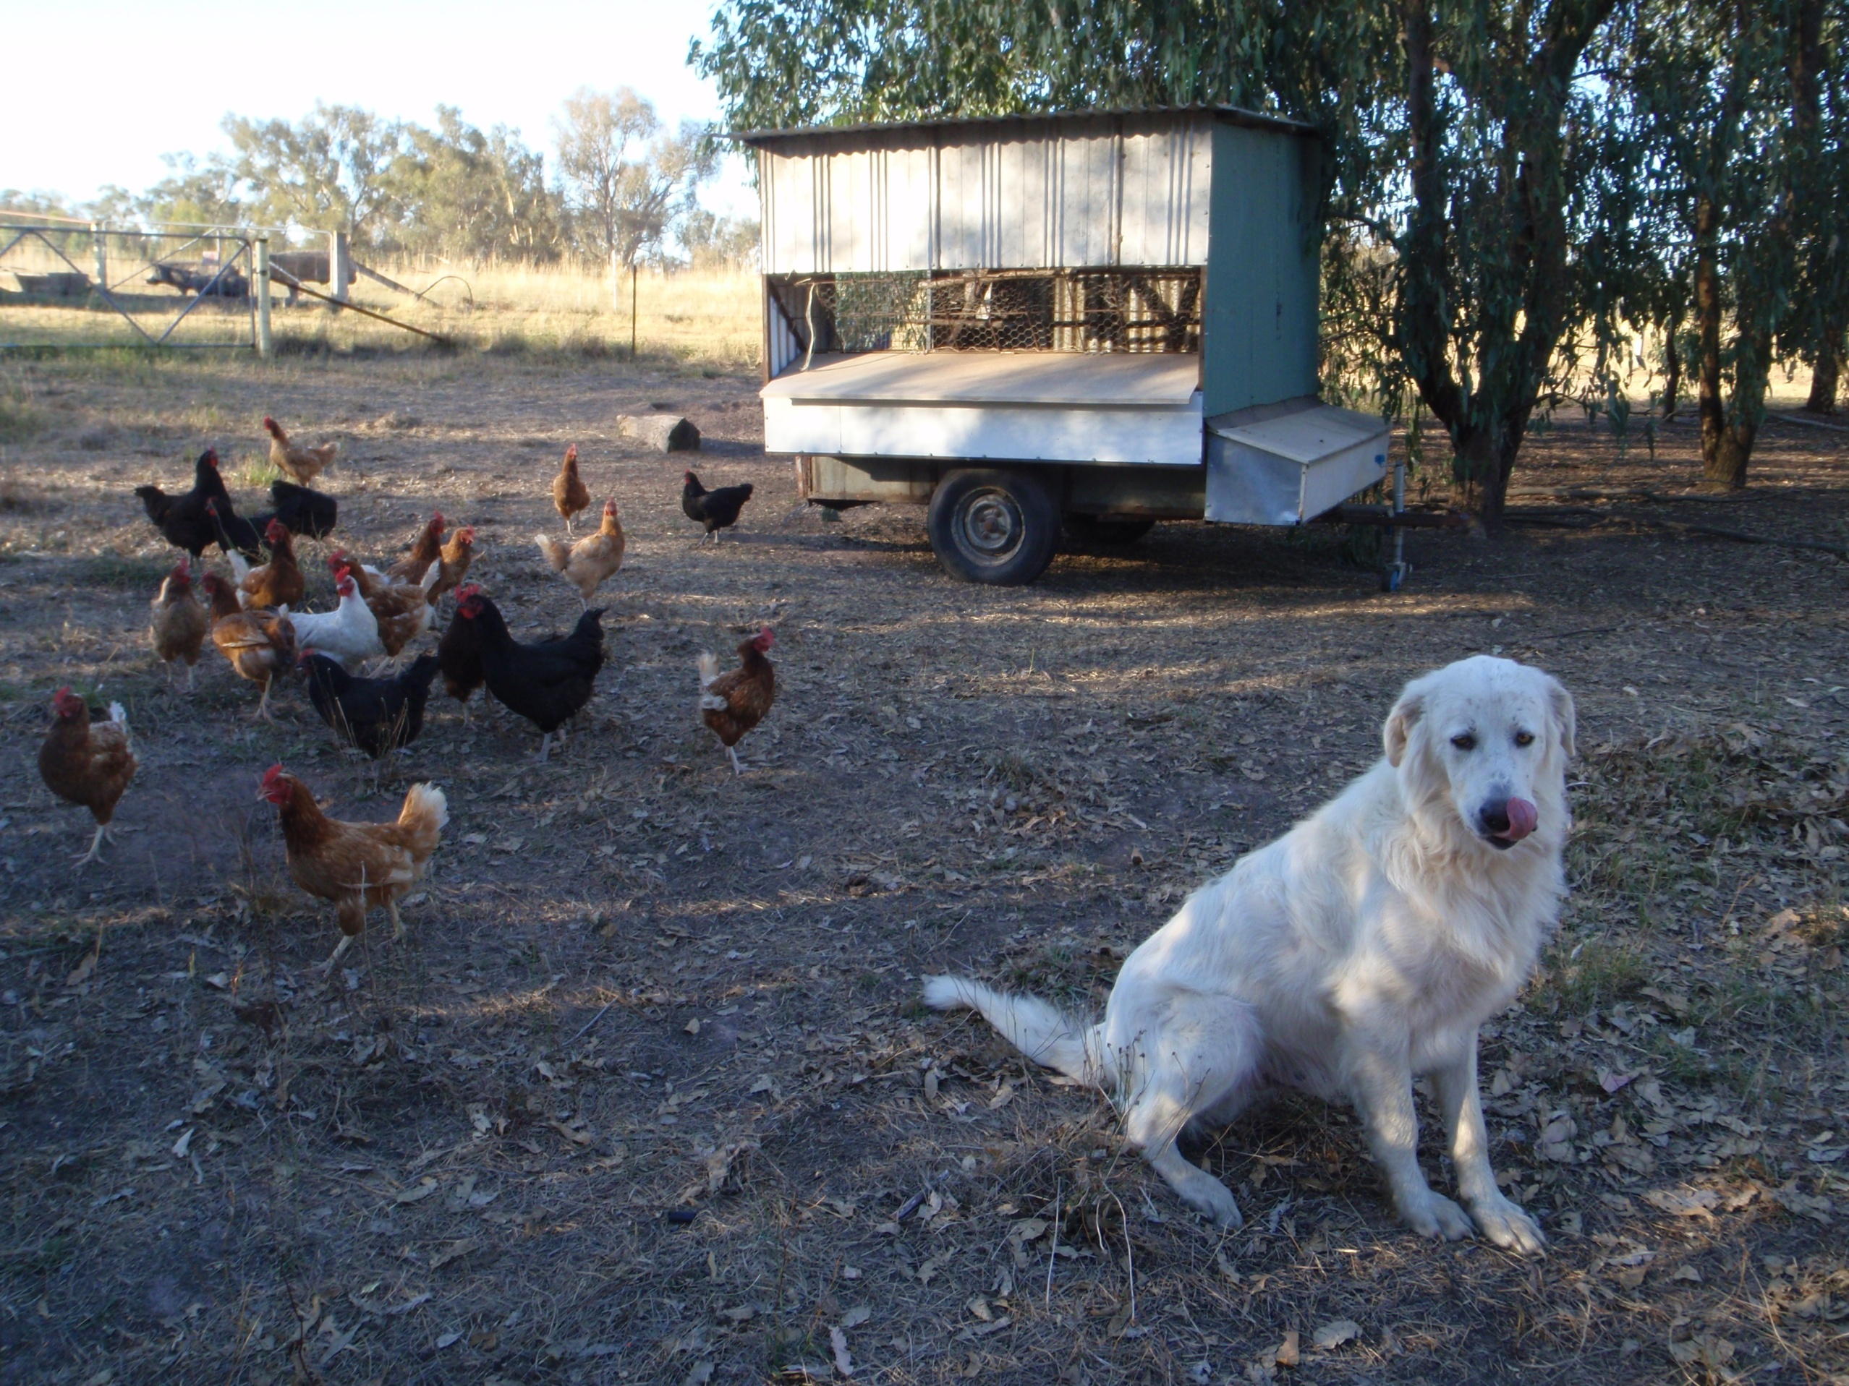

Slide 9
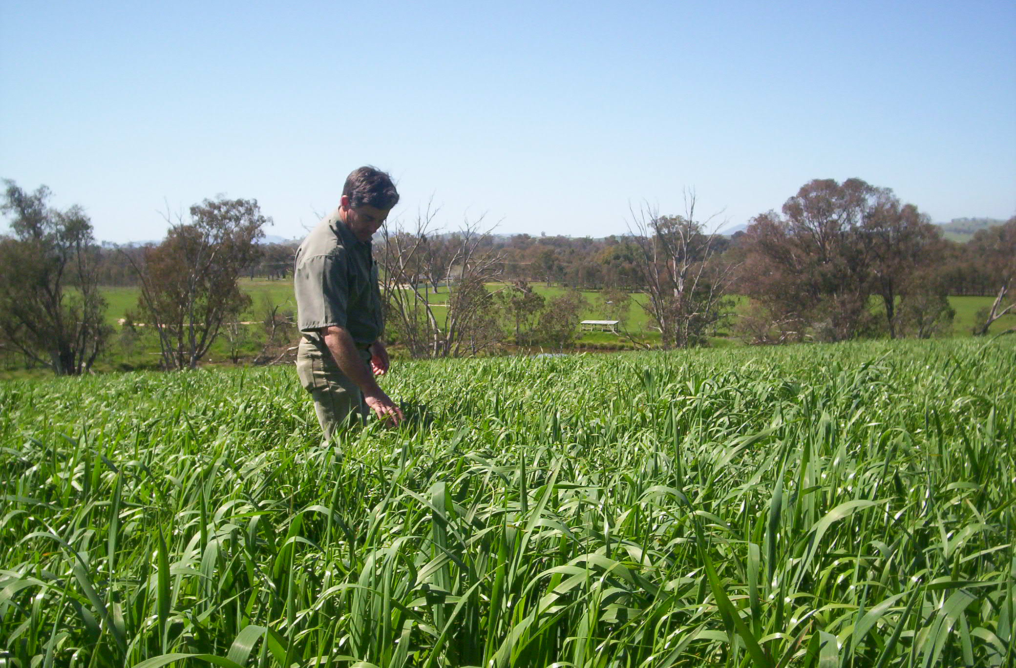

Slide 10
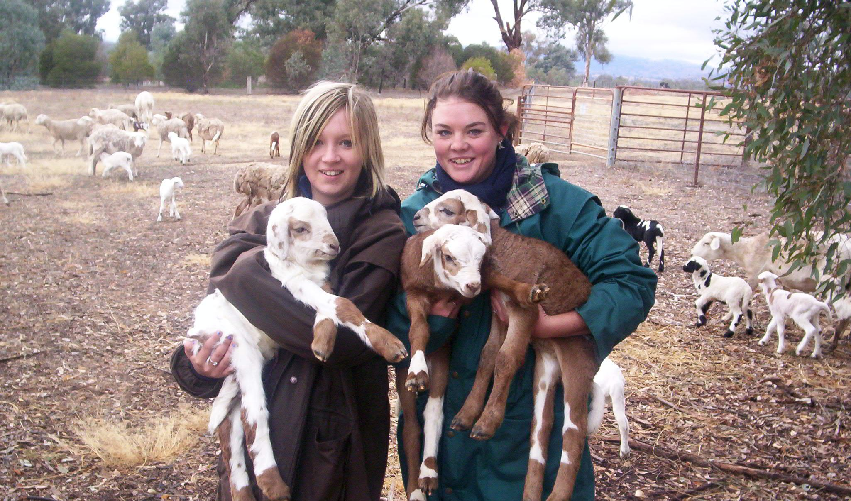

Slide 11
