Slide 1
Low Food Miles Project Evolution
100 mile data base of primary producers created to promote local food benefits to growers, the environment, economy & community .
PARTNER/STAKEHOLDER
Transition Towns -
Mount Alexander
Masters Research Project
Mount Alexander Shire
Community Grant
Notes:
Bubble 1: A Transition Town initiative to ‘reclocalise’ food and reduce the carbon footprint of food miles.
Bubble 2: The 100 mile data base is funded by SV to become a printable booklet for the consumer to use as a who, what, where, when and why guide to purchasing local, seasonal food.

Slide 2
Blackwood Orchard | 111 Chellews Road,Harcourt North, Vic. 3453 | M:0428 570 051 | blackwood@activ8.net.au
Canowindra Orchards - Harcourt - Slavek Ludwik | 384 North Harcourt Road, North Harcourt, Vic. 3453 | T: 03 54742729 | ludwik@harboursat.com.au
Heathway Orchards | Peelers Road, Harcourt, Vic. 3453 | T:03 54742486
Pollard's Orchard | Railway Road Elphinstone, Vic.3448 | Tel: 03 54733241 M:0418 624 710
Chaplin's Orchard | Chaplin's Road Harcourt, Vic. 3453 | Tel:03 54742264 | chappy@impulse.net.au
Malcolm Burrows - Orchard | Chellews Road Harcourt,Vic. 3453 | Tel:03 54742191 M:0418 353 344
Dr Apple | Coolstore Road Harcourt, Vic. 3453 | Tel: 03 54742453 M:0409 434 964 | Dr_apple@harcourt.vicmail.net
Loddon Valley Cod | Joyces Park Newstead, Vic. 3462 | T:03 54762291
Whirrakee Honey Pty Ltd | 67 Woodmans Road, Muckleford, Vic. 3451 | T: 03 54706818
R & E McDonald Bee Hives | 15 Sawmill Road McKenzies Hill, Castlemaine. 3450 | T: 03 54722161 | eileenmc@gcom.net.au
Melita Free Range Eggs | 6 Plantation Road, Barkers Creek, Vic. 3451 | M: 0402 887 947
Maldon Cherry Farm | Cnr Bridgewater & Watersons Road, Maldon,Vic. 3463 | T:54752178
The Orchard of St Francis | Molloys Lane PO Box 469 Guildford, Vic.3451 | T:54764367
Peelers Family Orchard | 3800 Old Calder Hgwy Harcourt, Vic.3453 | T:54743043 | peelers_orchard@hotmail.com
The Little Red Apple | Midland Highway Barkers Creek,Vic. 3451 | T:54742483
Mount Alexander Fruit Gardens | 69 Dann's Road Harcourt, Vic. 3453 | T: 03 54742808 m:0409 706 784 | info@mafg.com.au | www.mafg.com.au
Sprout Bakery | Enterprise Centre, Halford Street, Castlemaine, Vic. 3450 | T:03 54706020 | sproutbakery@bigpond.com
Southern Light Herbs | PO Box 227, Maldon,Vic. 3463 | T:03 54752763 | slherbs@netcon.net.au
Fruit Fetish | RMB 2010, Newstead Hepburn Road, Yandoit,Vic. 3461 | T:03 54764110 | fruitfetish@gmail.com
Holy Goat Cheese | Wooroomook, 112 Redesdale Road Sutton Grange, Vic.3448 | T:03 54748289 Fax:03 54748252 | holygoatcheese@impulse.net.au
Granite Springs Olives | Slopes of Mount Alexander, Vic. 3451 | T: 03 54742601 | anthea_mately@bigpond.com
Duemer's Harcourt Valley Orchard | 3389 Calder Highway Harcourt,Vic. 3453 | T:03 54742181 | adeumer@bigpond.net.au
Henry of Harcourt- Cidermakers | 219 Reservoir Road Harcourt, Vic. 3453 | T:03 54742177 Fax: 03 54743018 | ddhenry@bigpond.net.au | www.henrycider.com.au
Blue Mountain Goat Farm | Lot 74 Faraday Drive Faraday, Vic. 3451 | T: 03 54733541 Fax: 03 54733541 | bluemountainfarm@vic.chariot.net.au
Philip McConach - Biodynamic Lambs | Welshman's Reef,Vic. 3462 | M:0427 487 829
Guildford Eggs | PO Box 54 Guildford,Vic. 3450 | T:03 54734362
Notes:
The genesis of the Local Produce Guide began with the 100 mile data base of primary producers surrounding the Mount Alexander Shire

Slide 3
The McDonald family provide beehives for pollination of Horticultural and Braodacre Crops, also suppliers of honey, beeswax and beekeepers equipment..McDonald's Honey comes from the forest foothills south of Castlemaine producing yellowbox, redgum and messmate. .
Steve Vella runs Melita free range eggs which are locally owned and bred in Barkers Creek. Set on 24 acres with 3600 chickens, breeds include Hyline and Esa Browns. Their diet has been designed by a nutritionist and consists of a mixed feed of wheat, peas, soybeans, meatmeal and mineral supplements.
Cherry orchard growers with a dozen varieties of cherries and apricots grown organically. Season runs from December to mid January.
Produces fine varietal extra virgin olive oils from varieties such as Frantoio, Mission,Manzanillo and Spanish Queen olives from 600-700 aged trees grown,harvested at Guildford and cold pressed at Barfold. Grown using organic principles and sprays certified by NASA.
Sixth generation of orchadists growing apples, pears, cherries, plums, apricots, peaches and nectarines which are picked fresh for the shop on the old calder highway. Peeler's apple shop on the Calder Highway in Harcourt sells their own fresh produce as well as other local produce. Season runs December to April.
100% apple and pear juice, cold pressed using traditional methods from locally grown Harcourt apples and Pears.
Certified organic fruit orchid growing more than 80 varieties of NASAA certified organic fruit including cherries, apricots, peaches, nectarines, plums, apples and pears. Our season is from December to May. For regular updates throughout the season subscribeto our weekly email bulletin at the Contact Us page of our website, and follow our blog.
Locally made sourdough bread using a range of organic and biodynamic flours, including locally grown Powlett Hill flour.
Set in Maldon, Southern Light Herbs produce herb teas and culinary herbs, focusing on Australian organic and local herbs. Some herbs are grown on site.

Slide 4
100 mile data base condensed & converted into a printable booklet to become the Local Produce Guide
for the region of Mt Alexander Shire .
PARTNERS/STAKEHOLDERS:
Sustainability Victoria
Growing Abundance
Masters Research Project

Slide 5
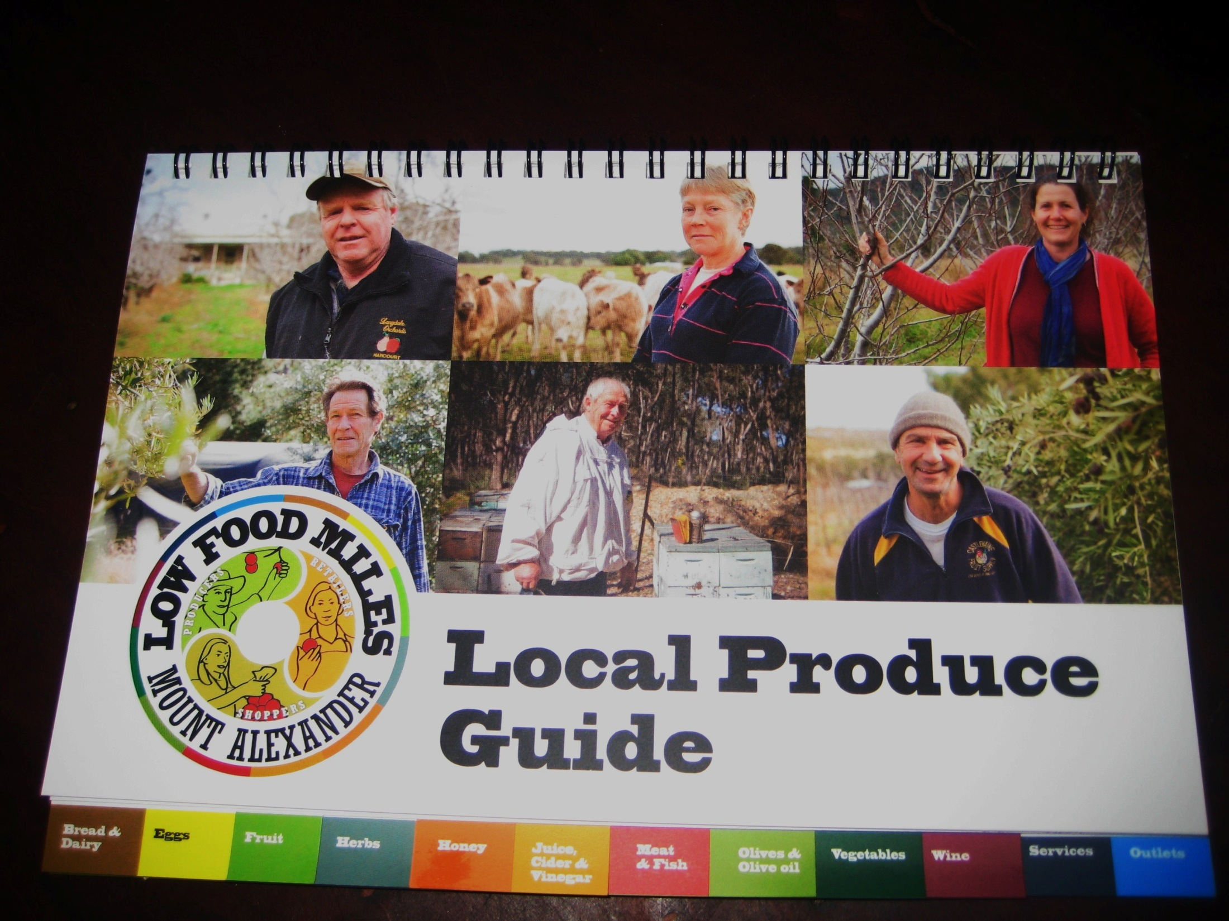

Slide 6
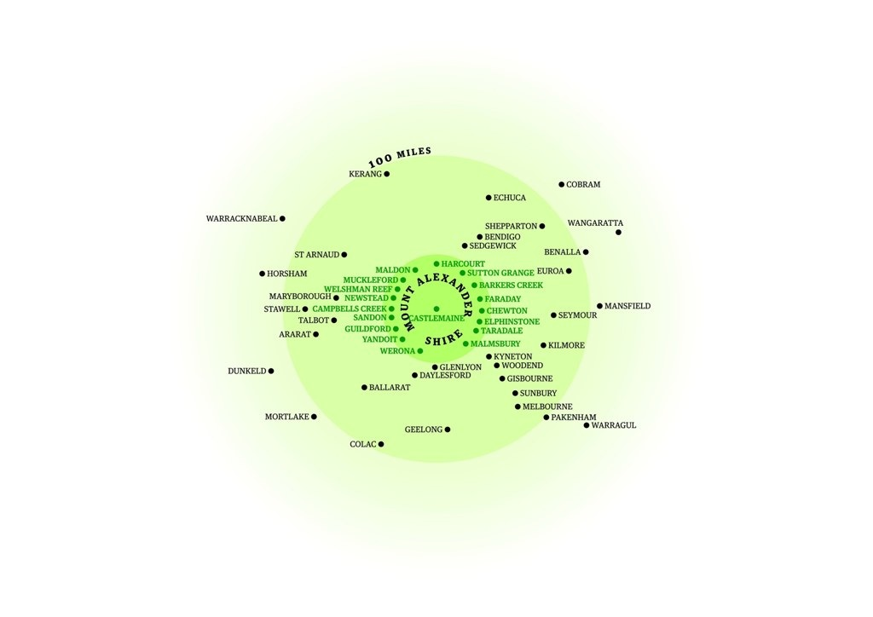
Notes:
The original 100 mile data base includes growers from the pale green region.
The LPG booklet only includes growers from the bright green region representing the Mount Alexander Shire growers and producers.

Slide 7
Nexxxx
Low Food Miles Project Logic
The LOCAL PRODUCE GUIDE becomes part of a larger project rationale :
Local Produce Guide for the head
Farmers Storyboards for the heart
Low Food Miles Logos for the hands
STAKEHOLDERS/ PARTNERS:
Local Produce Guide Printed Booklet:
Sustainability Victoria, Growing Abundance, Masters Research Project, Graphic Art Volunteer, Castlemaine Secondary College
Farmers Storyboards & Low Food Miles Logos:
Maldon & District Bendigo Bank, Growing Abundance, Masters Research Project, Graphic Art Volunteer, 6 Shire Farmers,6 shire Greengrocers, Arts Student Photographer,
Charter Facilitator Volunteer, Proof Reader Volunteers, Green Graphics Volunteer Time.
Notes:
Masters Research Project design integrates the Transition Town philosophy of engaging the head, heart and hands to inspire community action by creating the LPG for the head to access the information

Slide 8
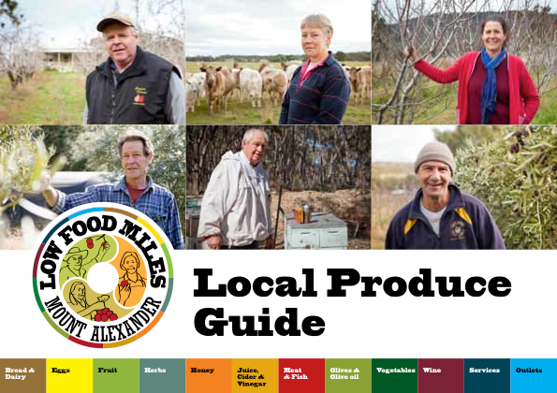

Slide 9
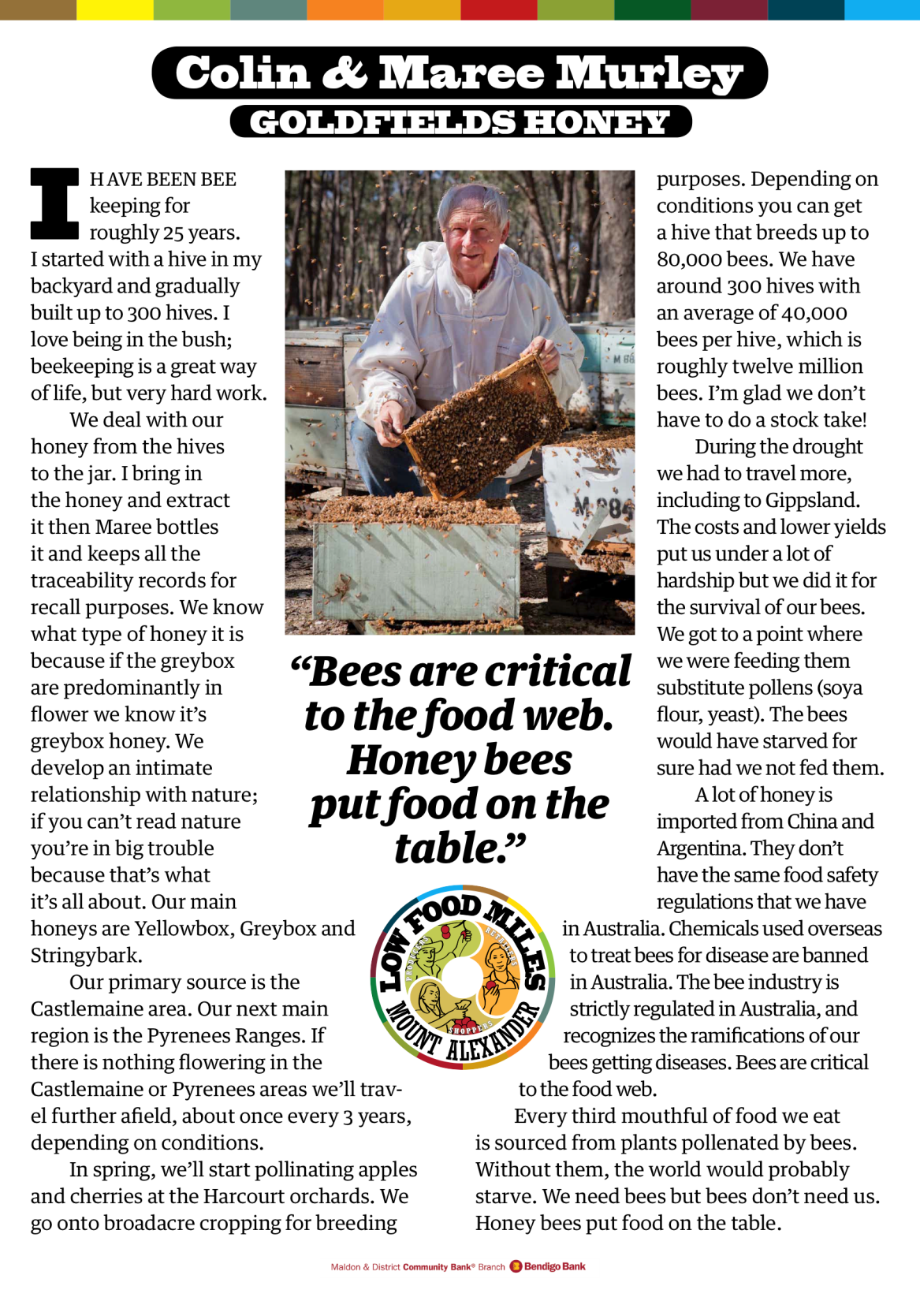

Slide 12
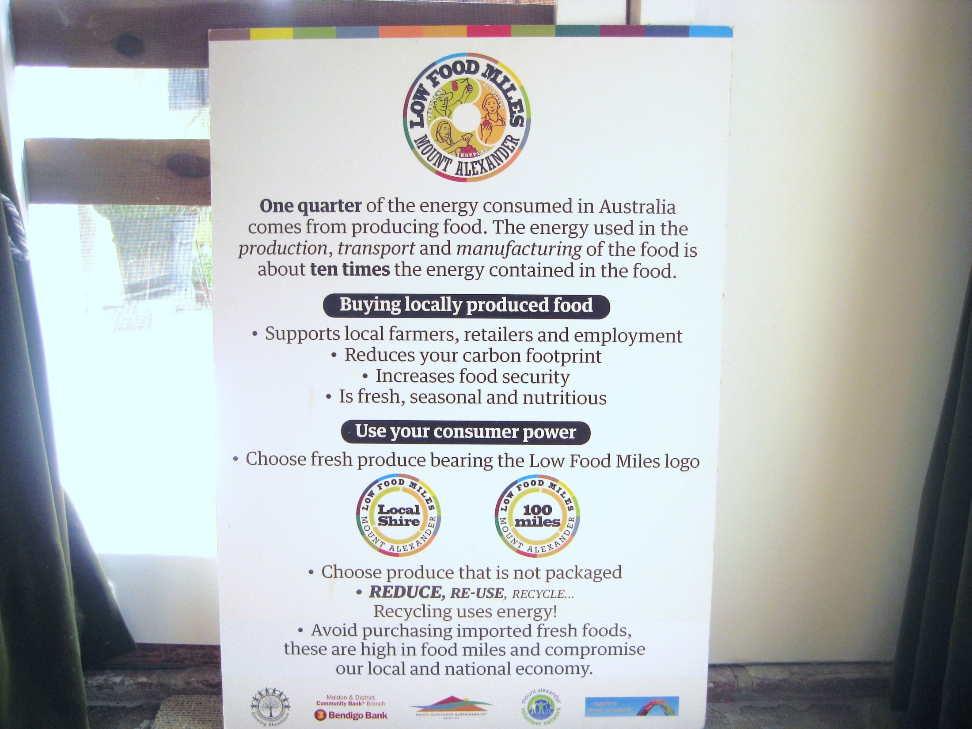

Slide 13
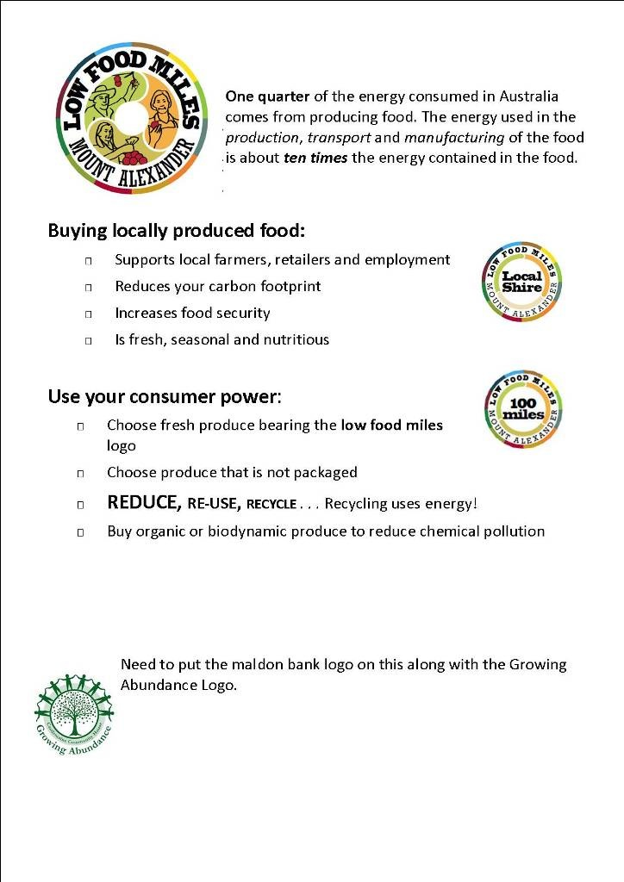

Slide 14
RETAILERS AS ENABLERS
- Six shire greengrocers invited to join the Low Food Miles Campaign as enablers providing local food for local people.
- 6 retailers collectively create the low food miles logos and charter.
Low Food Miles Charter maintains integrity of low food miles logo application. Primary produce and primary processed foods like bread, wine, etc., may bare the logo if 80% of ingredients were grown or sourced locally or regionally (within 100 miles) .
- Third logo created to signify the role of greengrocer as ‘enabler’.

Slide 15
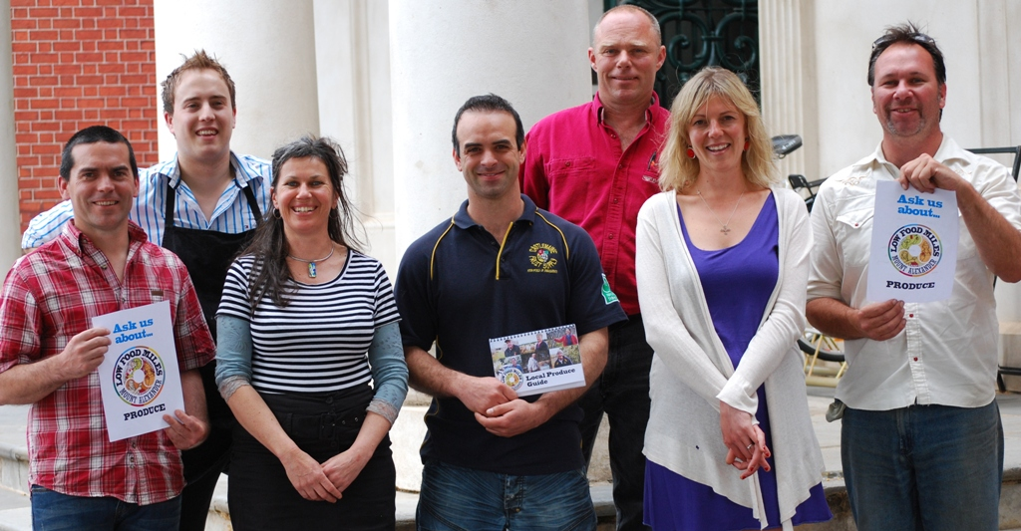

Slide 17
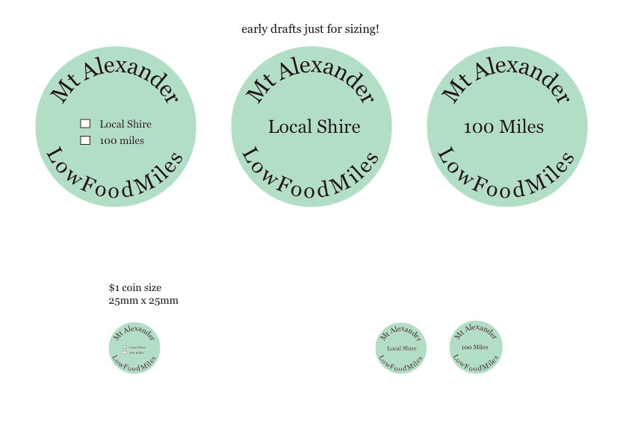

Slide 18
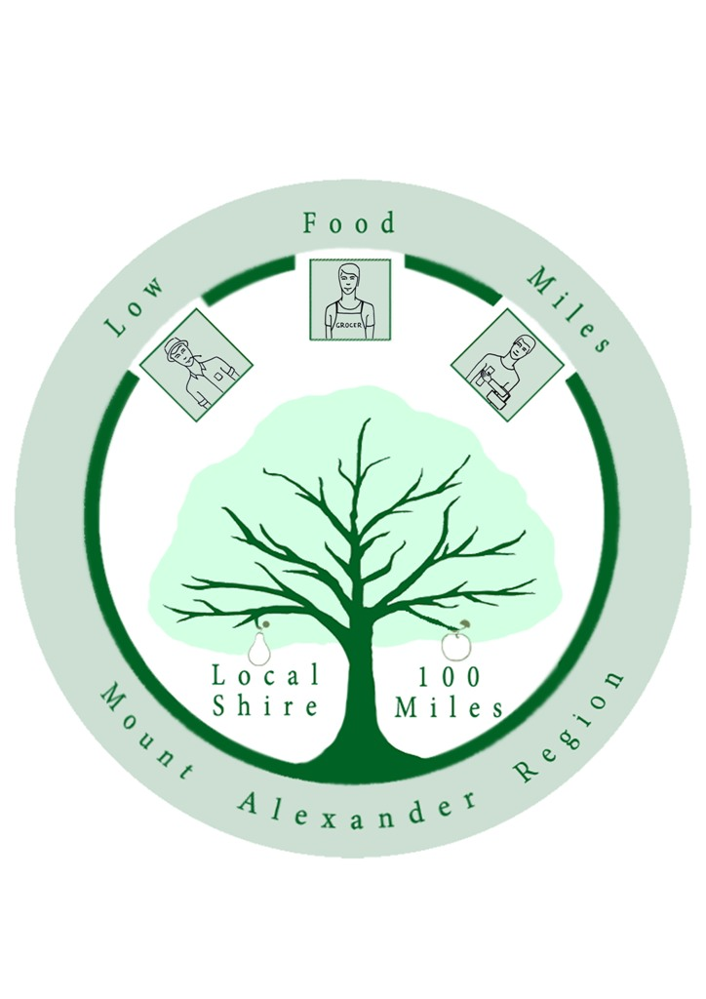

Slide 20
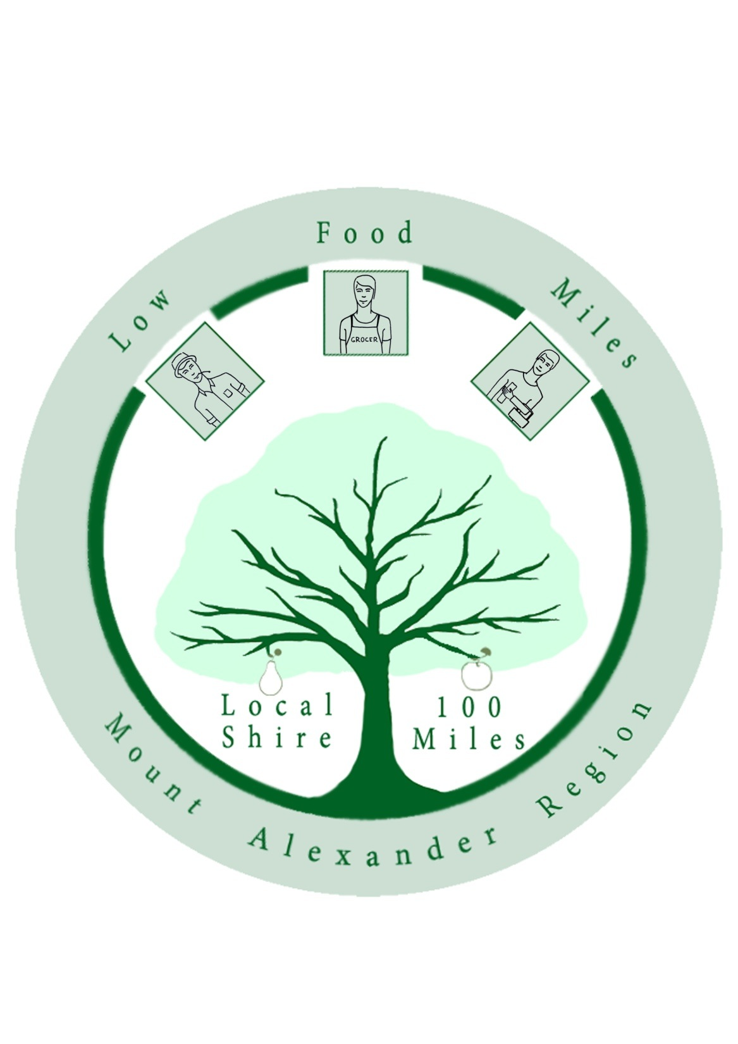

Slide 21
Low Food Miles Project Launch
with
Iron Chef meets Naked Chef Competition
Community event to celebrate & make local food visible, raise farmer profiles & actively promote purchasing local food for the benefit of the environment, local economy and community.
PARTNERS/ STAKEHOLDERS:
- 6 FARMERS ON STORYBOARDS
6 RETAILERS AS JUDGES
3 CAFE/ RESTAURANT OWNERS AS CONTESTANTS
- MALDON BENDIGO BANK, MT ALEXANDER SHIRE COUNCILLORS, CASTLEMAINE SECONDARY COLLEGE, GROWING ABUNDANCE, VOLUNTEERS, COMMUNITY MEMBERS, LOCAL FILM MAKER.

Slide 23
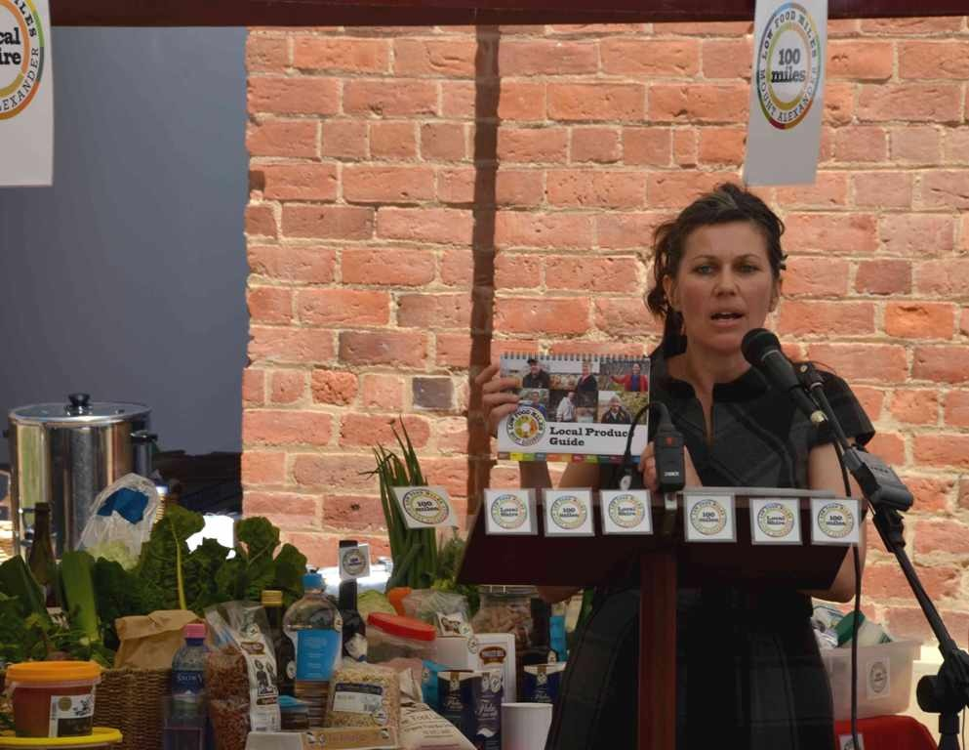

Slide 24
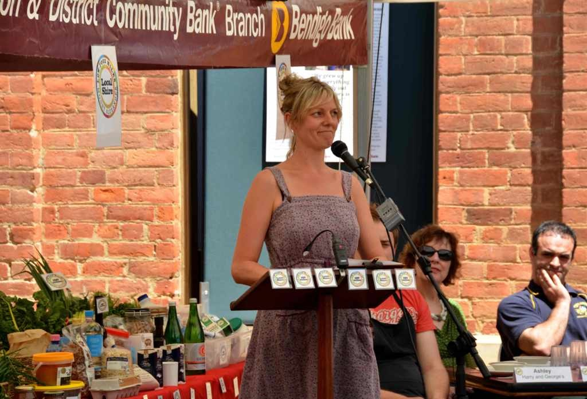
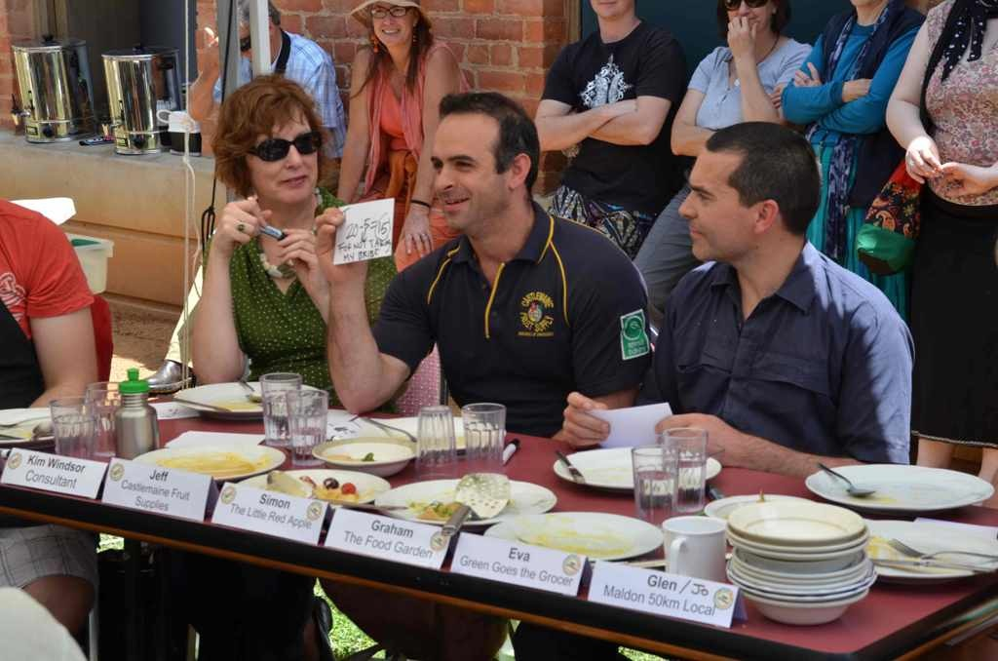

Slide 25
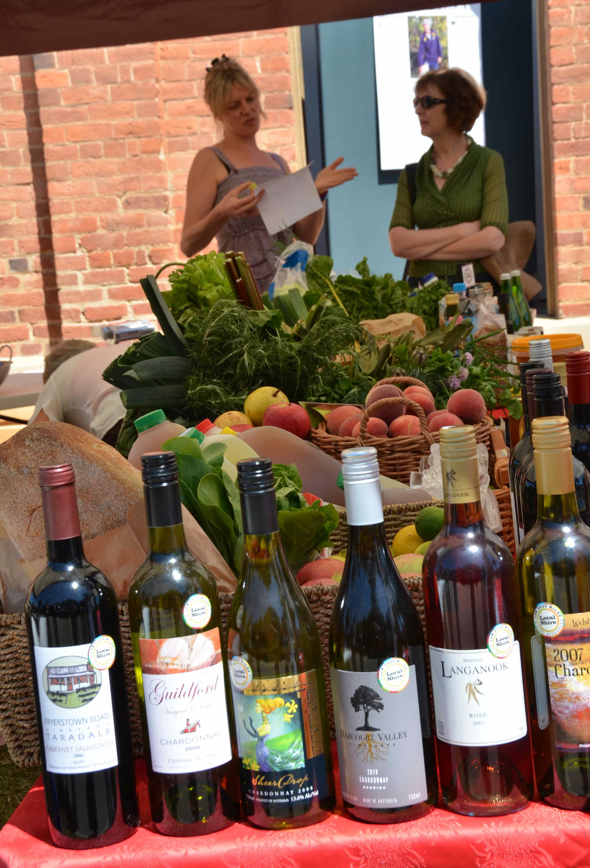

Slide 26
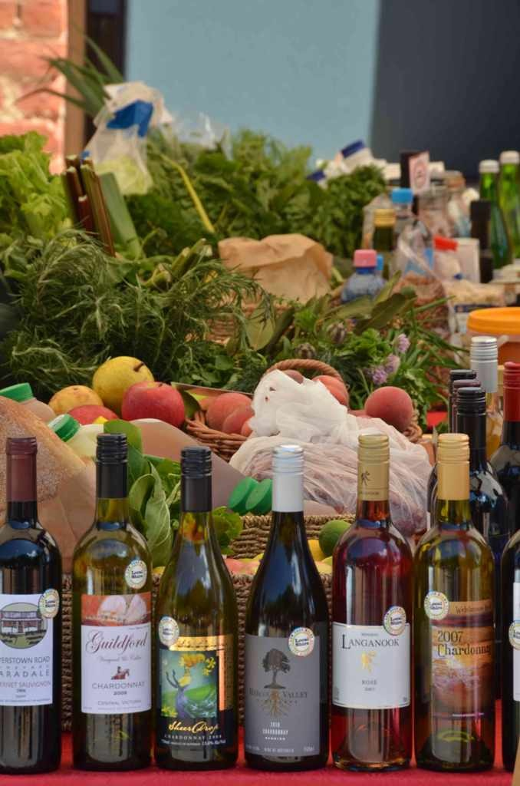

Slide 27
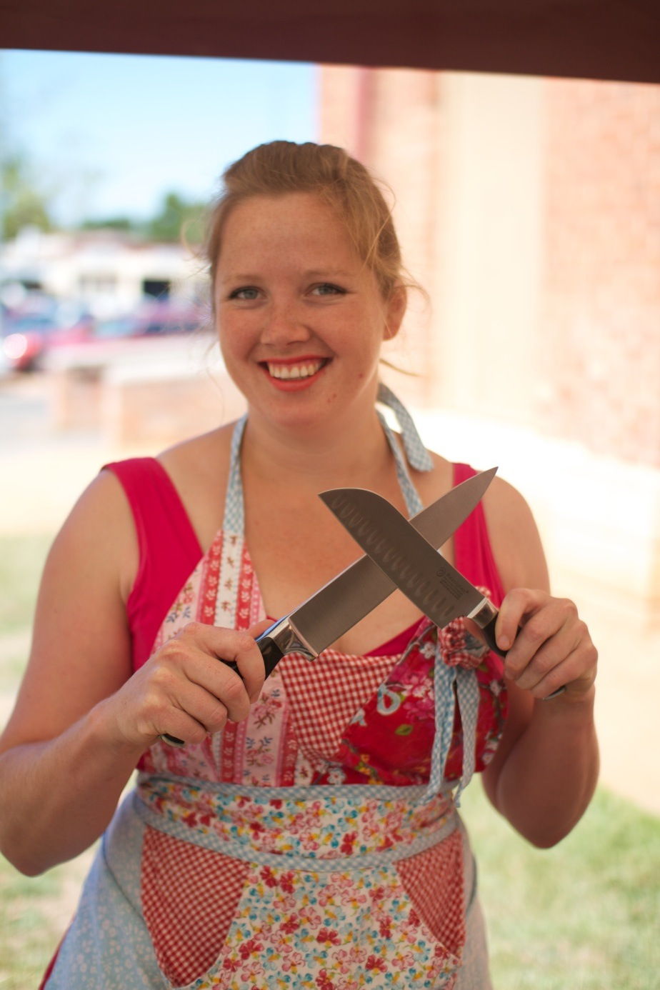

Slide 29
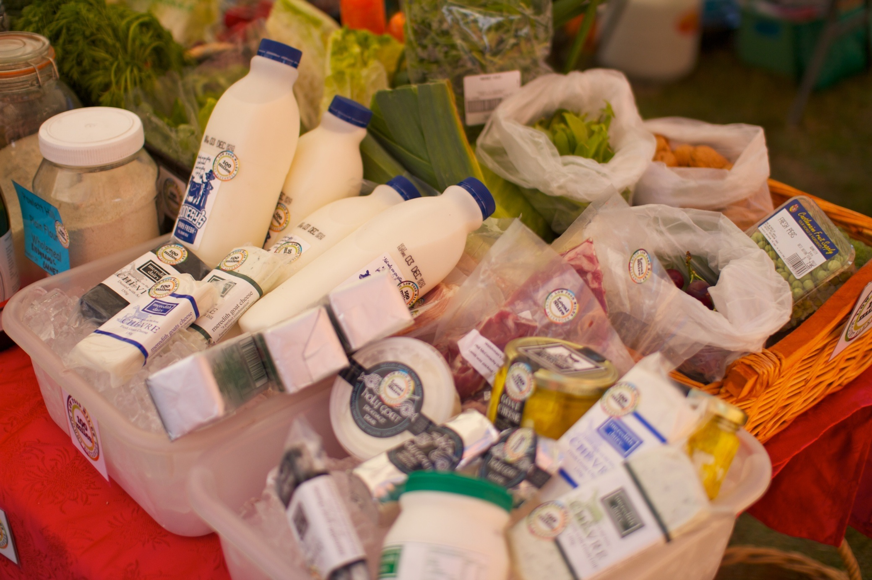

Slide 30
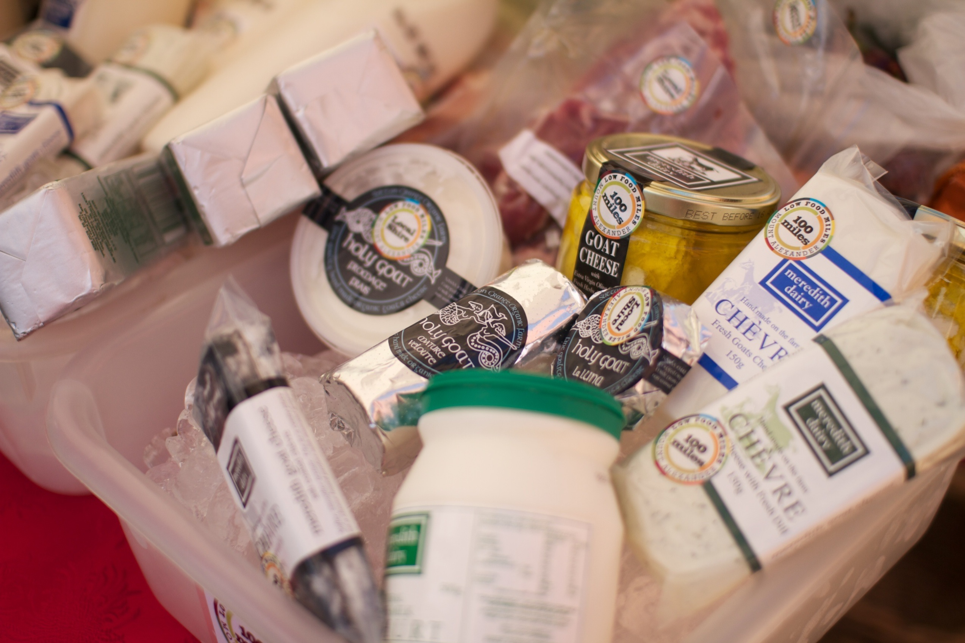

Slide 31
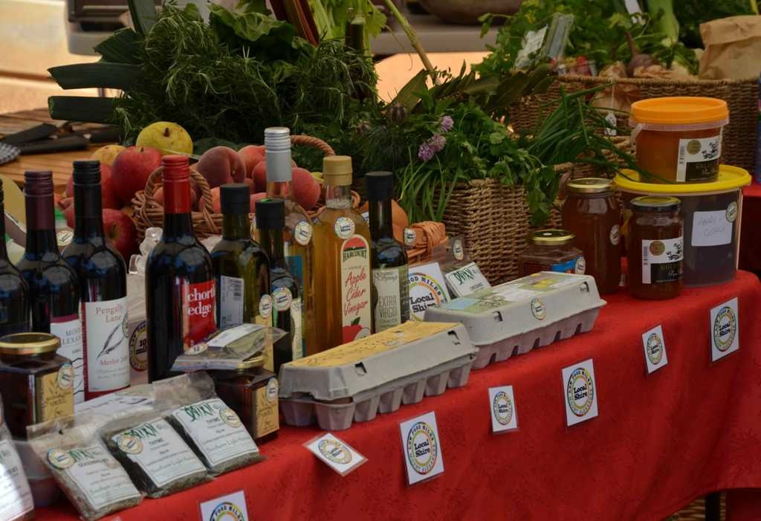

Slide 32
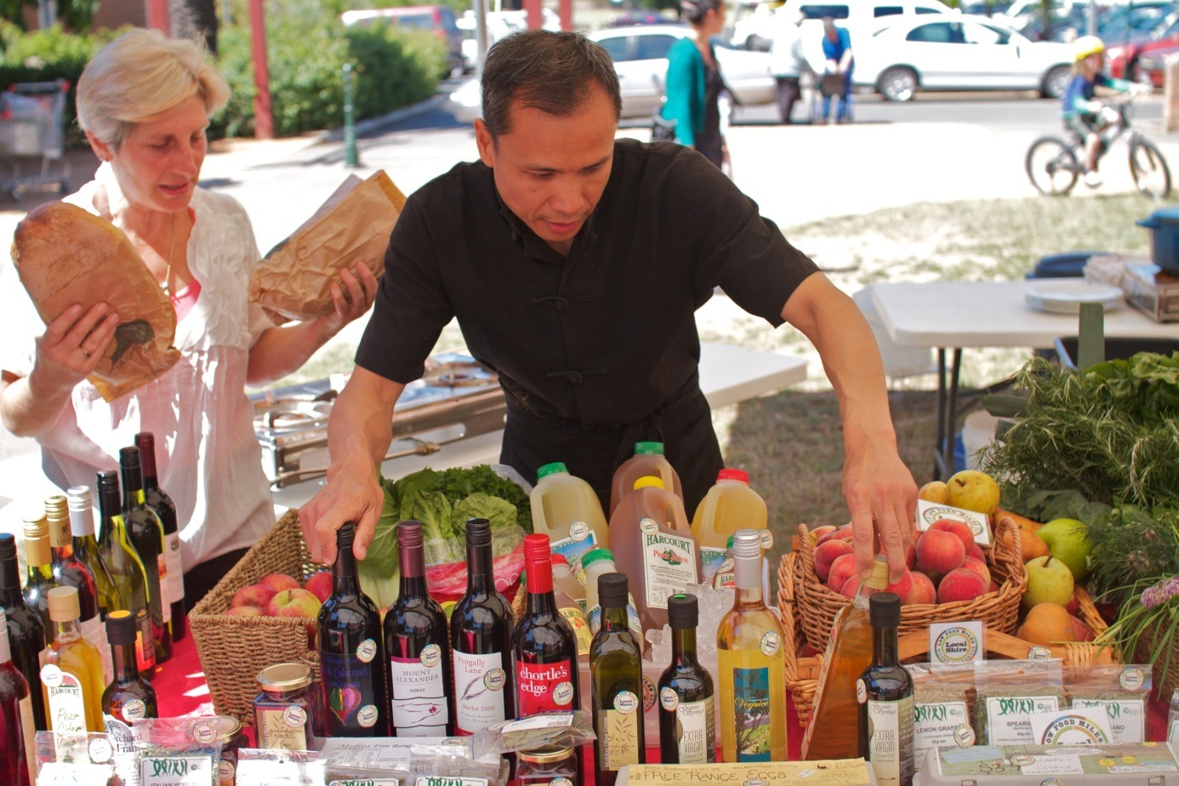

Slide 33
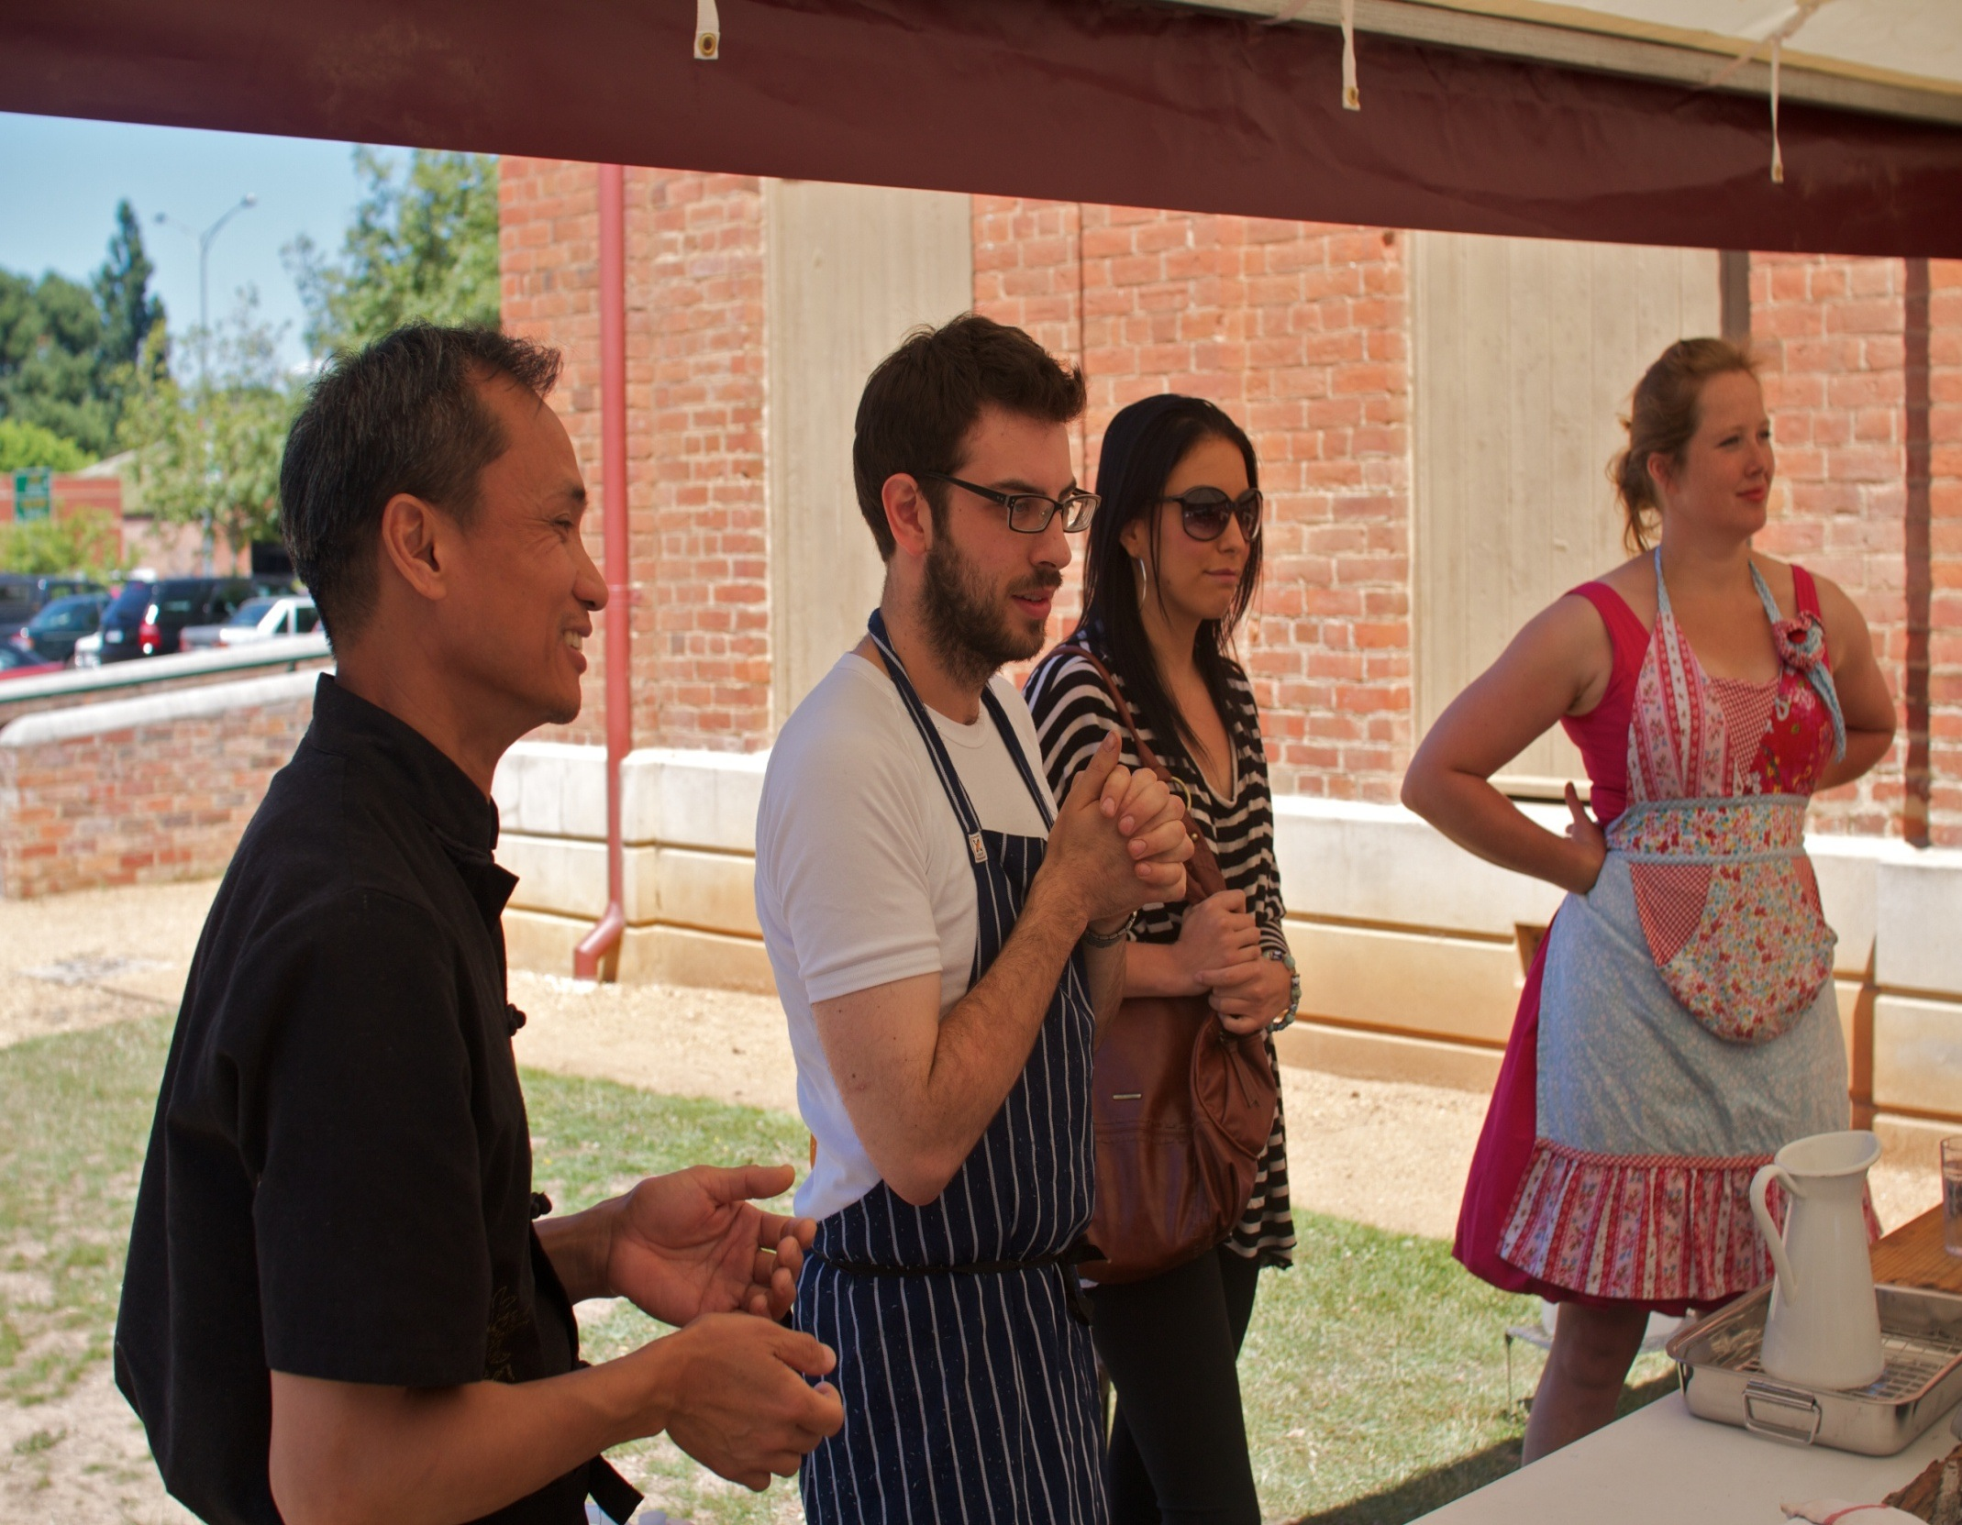

Slide 35
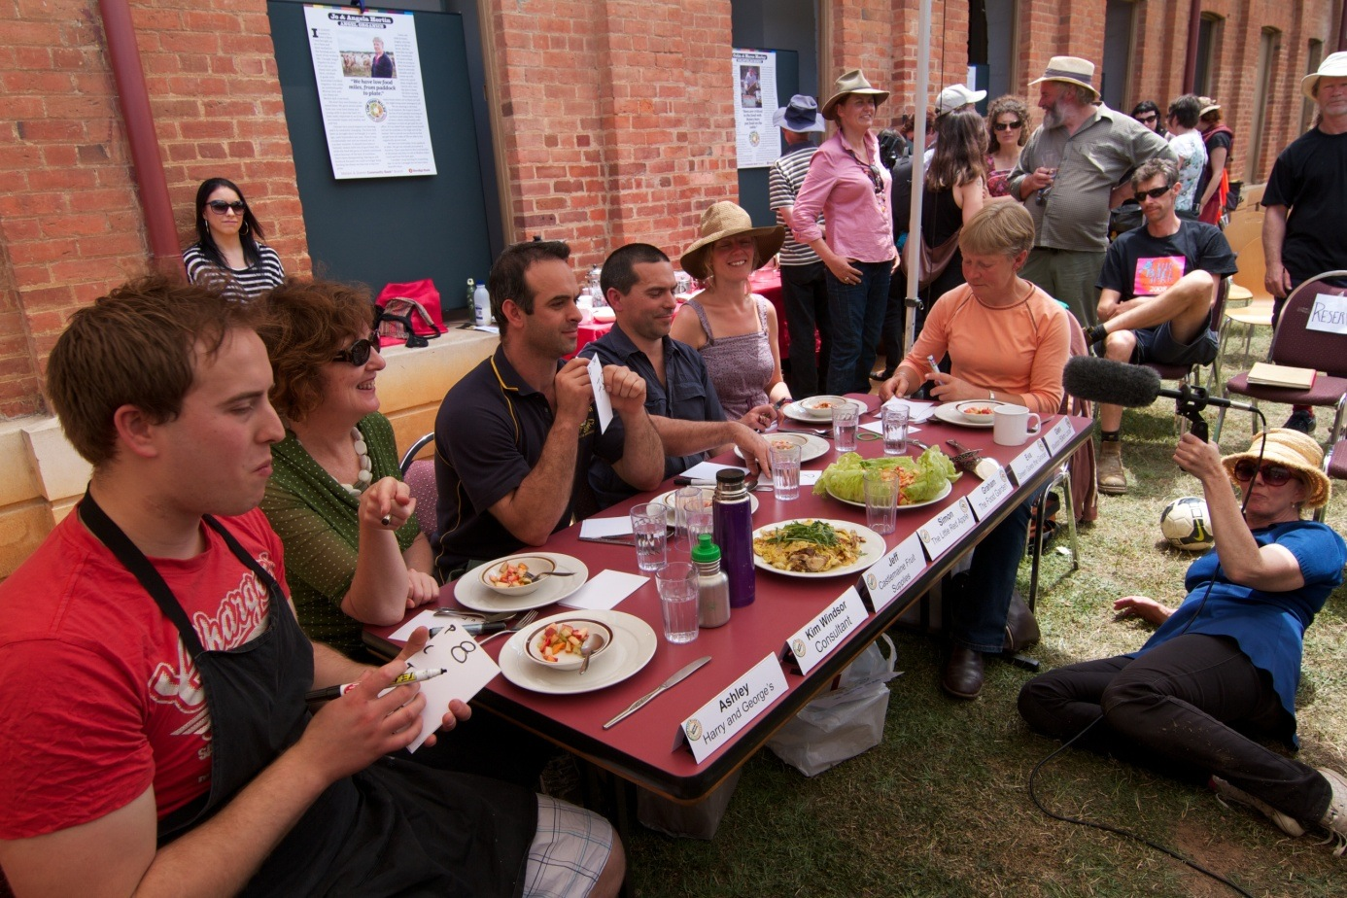

Slide 36
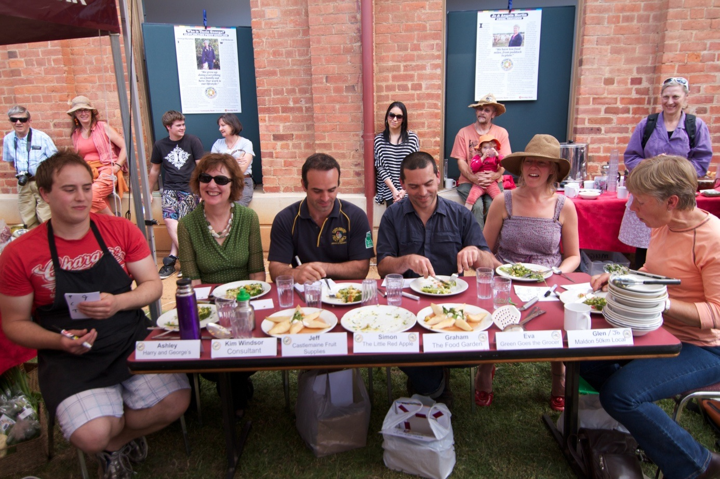

Slide 37
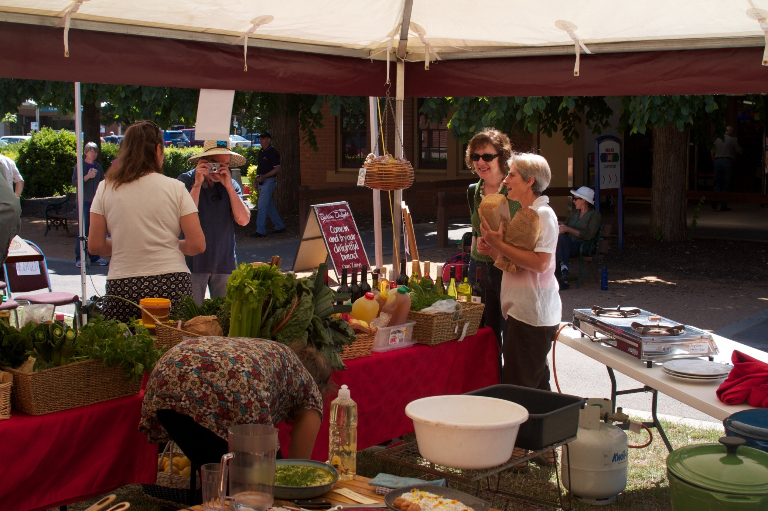

Slide 38
INDIVIDUAL BEHAVIOUR CHANGE
Discreet individual behaviour change project which promoted & exercised consumer power as political power (i.e. buy local food) .
ORGANISATIONAL CHANGE
Social enterprises CAKE Catering & School Canteens offer local food procurement for organisations and an
educational platform to promote social, cultural, environmental & economic benefits of local food.
SYSTEMIC CHANGE
Global food chain dominates our food supply. Creating Local Food Hubs as parallel food systems provides smaller, local & regional growers access to supply chains.

Slide 40
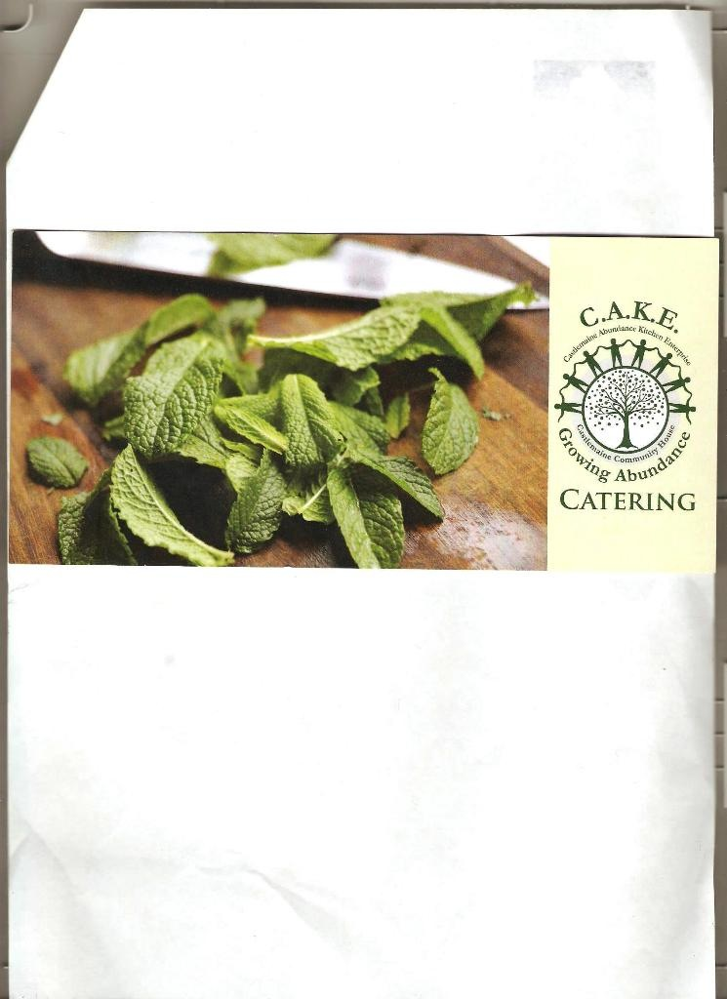

Slide 41
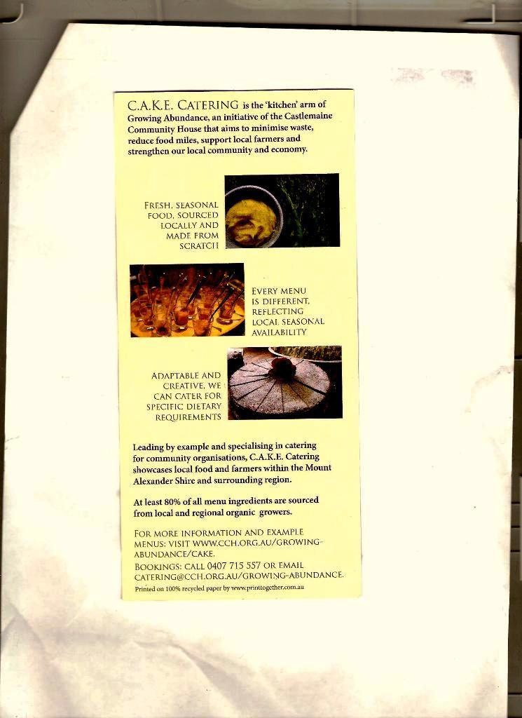

Slide 42
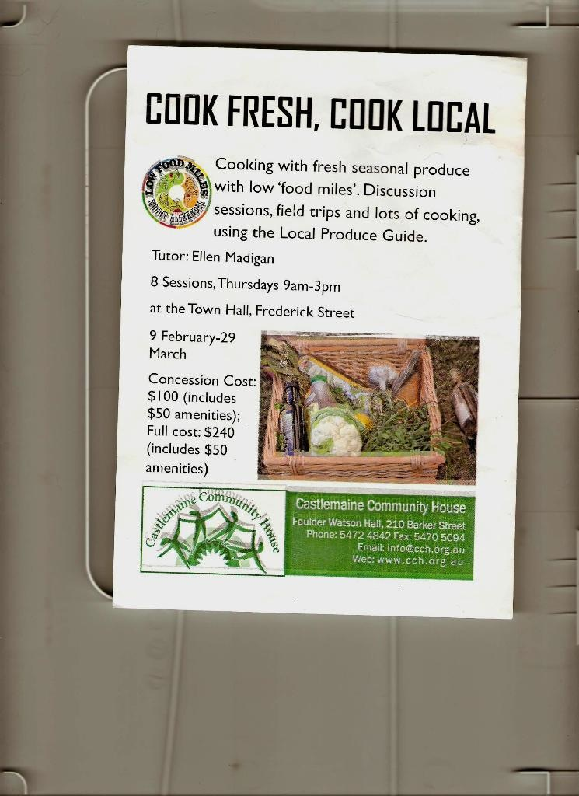

Slide 43
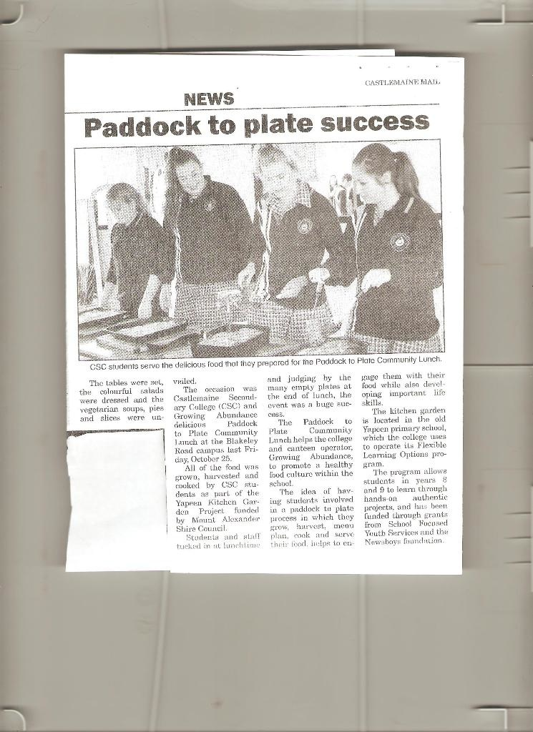
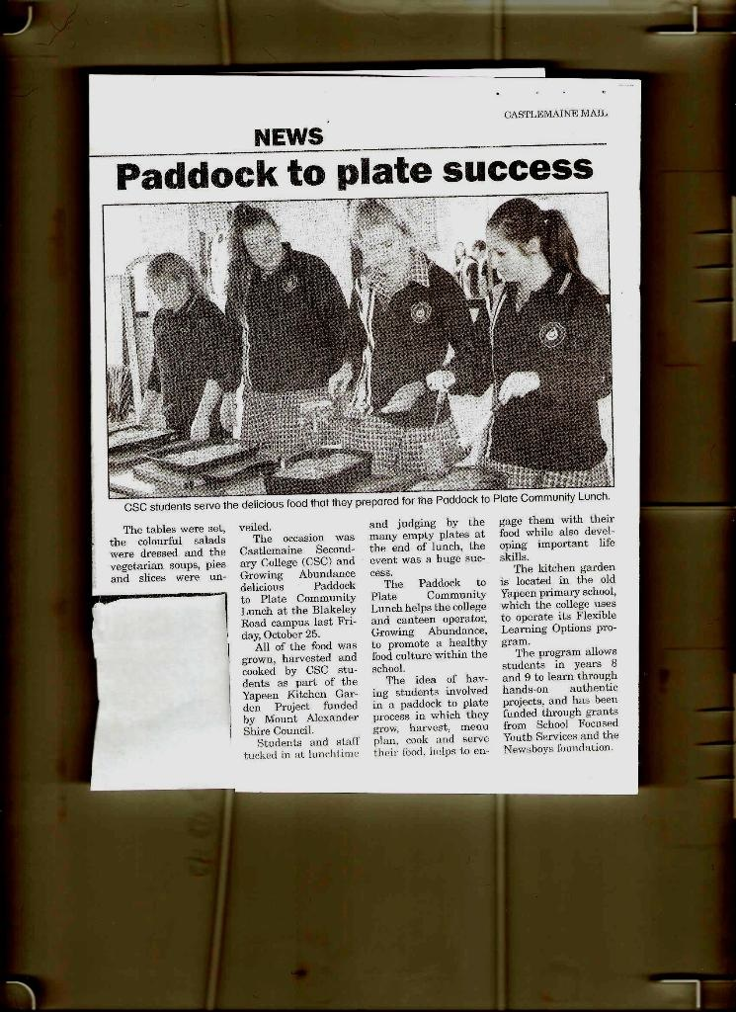

Slide 44
LOCAL FOOD FOR LOCAL PEOPLE
A FOOD HUBS SCOPING STUDY
Research operating LFH models & lessons learned
Identify enablers/drivers/stakeholders/ partners
Invite stakeholders to form a collaborative group
Explore resources required
Explore Opportunities
PARTNERS/STAKEHOLDERS:
Mt Alexander Shire Council
MASG
Project Worker
Growers
Retailer
Community Members

