Slide 1
Good food starts and Finishes with Community

Slide 2
Research – American Inspiration
Vermont USA – Ranked # 1 Locavore State
16 Food Co-ops, 74 CSA’s, 38 Farmers Markets, 50+ Bulk Buyers groups – Farm to Plate initiative was a big influence.
Consciously developed in 2008 by top down and bottom up initiatives which have transformed the State.
In the same paradigm Victoria would appear as number 45 in the states.

Slide 3
Build a Food Co op to leave a legacy
Healthy Food Access
To provide increasing access to high quality local food (Food Co op Bulk and Fresh)
2. Food System Development
Actively collaborate in local and regional food system development
Support the growth of local sustainable agriculture (Grow the Growers and provide a genuine local path to market for small scale local growers)
3. Community Communication and Education
Foster a deep community connection through food and education (Food Co op Living)

Slide 4
Meeting the need for convenience

Slide 5
Kids Corner

Slide 6
Bringing it to life
Members
started 60 now 800
A home
Moved three times in year 1
Stock
Started with 60 now 350
Connection
Started with afternoon tea now deliver 15 learn-to events each year

Slide 7
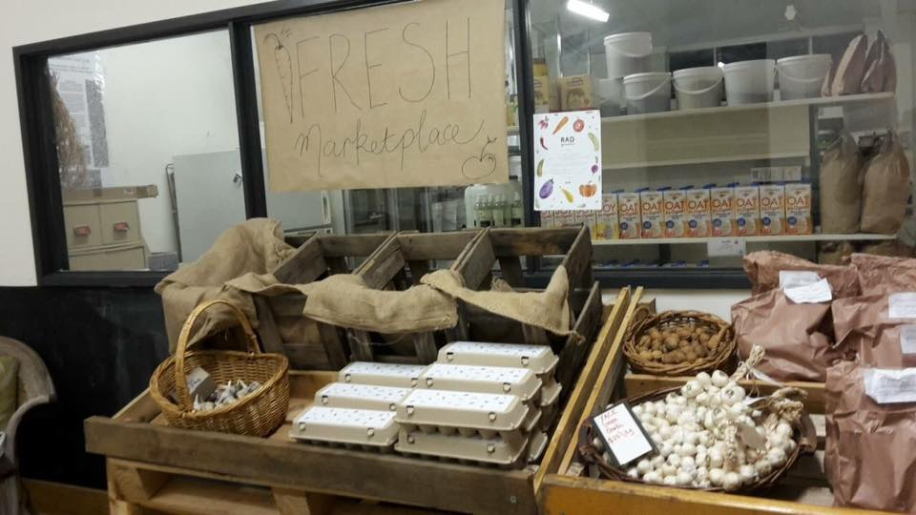
Fresh Marketplace… growing
https://www.youtube.com/watch?v=ENjhs6fNIxY
Six months old

Slide 8
NOW… Food Co Op Fresh
30 Local growers
Utilise the Open Food Network
Weekly Ordering
Top Up of Local food from Melb Market Food Supplied via Wangaratta based private box scheme enterprise
Pilot program of 8 mid week farmers market to build habit and support.
Notes:
Grow membership to increase financial stability
Aggregate and distribute locally grown food as a food hub
Introduce produce swaps
Introduce member workshops
Create recipe library
Member celebrations

Slide 10
Co- Op Living
Creating reasons to bring people together to learn the skills to live a richer, simpler more connected existence.
Permaculture conversations
Gluten Free Cooking
Fermentation 101
Composting
Seed Swaps
Notes:
Grow membership to increase financial stability
Aggregate and distribute locally grown food as a food hub
Introduce produce swaps
Introduce member workshops
Create recipe library
Member celebrations

Slide 11
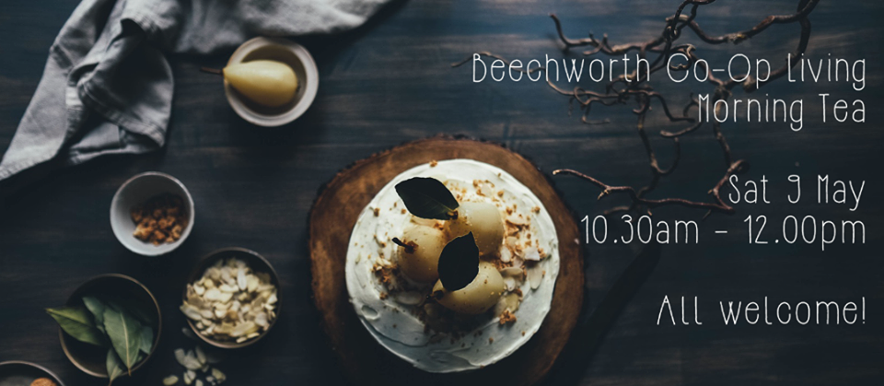

Slide 12
Membership Growth Initiative

Slide 13
Seasonal Morning Tea – Winter Soup

