Slide 1
Lessons from the South East
South East Food Hub
&
Regional Activation
Jodi Clarke
Notes:
So that farmers and producers can sell their produce locally at fair prices
So that local people can access fresh, locally grown, healthy food
To increase local employment opportunitie

Slide 2
Phases of the South East Food Hub
2011 - 2013
1. Scoping & Design
2014 - 2015
3. Scale to stand-alone?
2015 - Now
4. Connect & Review
2014
2. Pilot
By early 2015, the Hub worked with 16 farmers, provided over 110 varieties of fruit and vegetables, and had paid almost $60,000 to participating farmers
In Nov 2014 $2,320/month was paid to farmers. By Sept 2015, it grew to $11,380/month
Supported 14 community buying groups, including schools, community centres, independent food enterprises and wholesale co-ops
Notes:
Scoping & Design: [key points]
2 parts; initial scoping study and the first part of the action research project
Pilot
Sept 2013 – July 2014
Partnerships: with Avocare, Cheffields, Cafresaco etc – keep costs low and try things out
Wholesale buyers and two community buying groups
Scale to Standalone?
Can the hub be scaled and run better to reach a point where it is independently viable?
Move to packing and logistics from Cafresco Organics in Koo Wee Rup
Focus on community buying groups and some local wholesale
Connect and Review
Collaborative logistics – opportunity for networking hubs in the south east to improve viability of all of them
Where is SEFHub at – can it continue and how?
Share learning

Slide 3
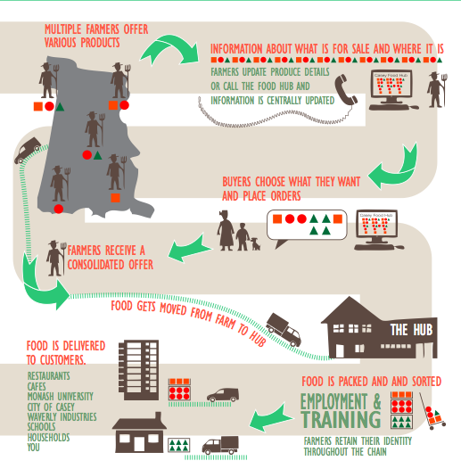
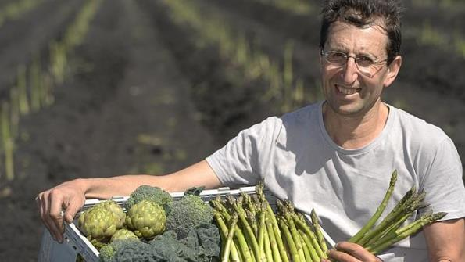
Model: Online Food Hub https://www.vichealth.vic.gov.au/media-and-resources/video-gallery/food-hubs-video
1. What’s fresh on the farms this week?
2. Customers place online orders
3. Farmers get one consolidated order
4. Employment: Packing
5. Delivery and Collection

Slide 4
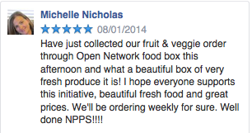
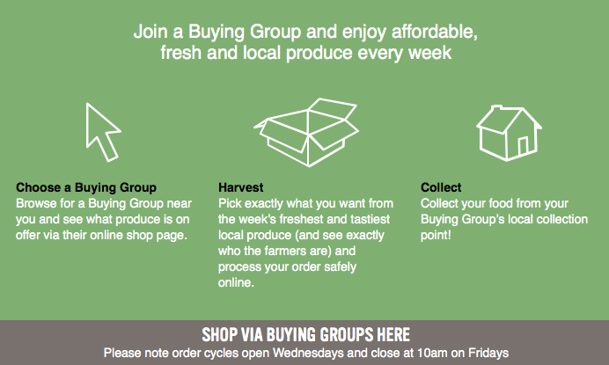
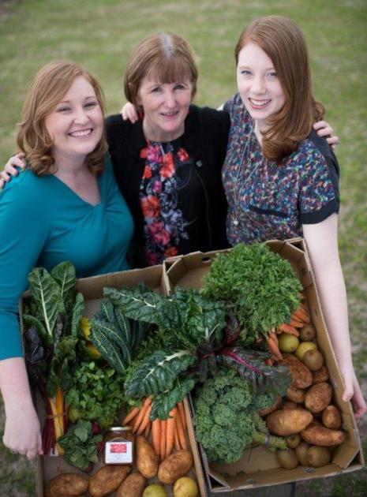
- Potential to service local businesses & other food hubs, buying groups and community enterprises... - Opportunity for cross-subsidisation strategies
-
Notes:
promising new approach to access / supply f&v; opportunity for cross subsidisation strategies eg as per c/f

Slide 5
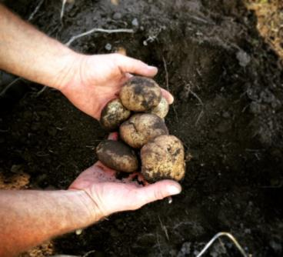
Lessons: 1. Producers and Produce
Relationships: the golden glue!
Who and What
Who? Scale of operation, local, values… “Anchor” farmer
How? production systems . . organic?
Product range throughout season
Limited range during late Winter challenging
Strong staples . . Preserves, juices, bread and dairy!
Getting it right
Scale – the sweet spot? Committed to early small orders?
Quality and reliability
Honesty and transparency

Slide 6
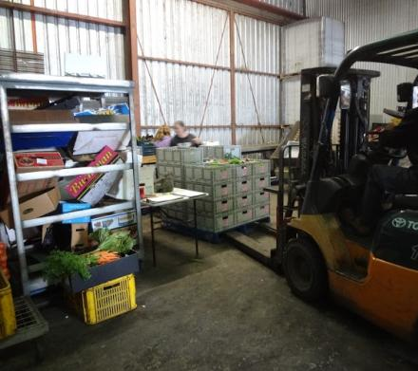
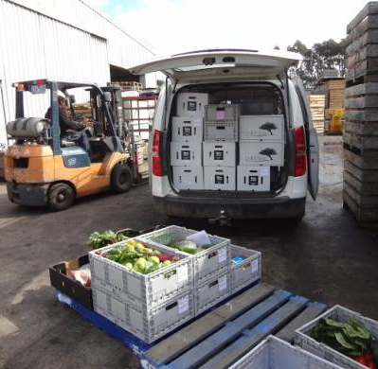
Lessons: 2. Operations Staffing, Online System, Packing and Distribution
Staff:
Need ops ‘manager’
Co-location - team communications
Clear decision-making responsibilities
Operating System: Open Food Network
co-evolved with Hub, added functionality tested through hub
Packing & Distribution
‘Piggy-back’ vs dedication and autonomy
‘choose-your-own’ box / order adds complexity
Customers like the choice
Tyranny of distance
Access: no ramp access (little things!)

Slide 7
Lessons: 3. Wholesale Customers Institutions, Food Service (Restaurants / Cafes), Wholesale Buying Groups
Getting the Orders in
Our ability to deliver didn’t match their need
Cut-throat!
Marketing kudos worth more to some than the food?

Slide 8
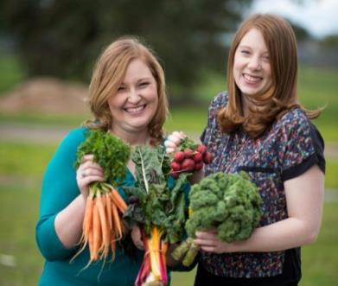
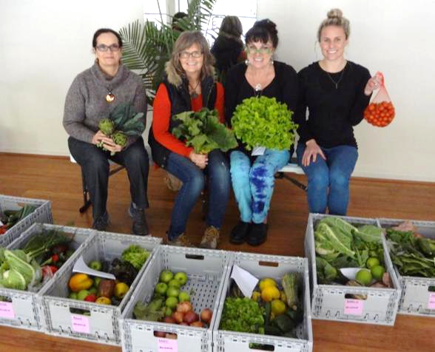
Lessons: Community Buying Groups
People want community and connection
Invisible?
The buying groups that fostered connections and had a committed coordinator were the ones that worked best
Commitment and Buy-In
Need committed coordinator
many people thought we were bigger – high expectations
Refining the model
Central place / pick ups only? (e.g. Baw Baw Food Hub Warragul
Or distributed community model (e.g. Food Connect Brisbane)
More autonomy: bulk purchasing, arrange packing?
Price?
Set boxes? Surveys showed people preferred choice
Notes:
Overall people very supportive of the Hub, however:
Is frustrating when produce is missing, occasional quality concerns
Limited range at times (e.g. Winter) affects regular ordering
Large quantities (e.g. 1kg snowpeas etc.) deters some people
Possible changes to retail model
Most prefer to choose what they get in box vs set boxes
Option of signing up for a season wasn’t popular
People forget to order – setting up regular orders popular
In general, people are open to:
Fewer pick up points
Fortnightly order cycles
The concept of collecting produce (but few volunteers!)
Incentives (e.g. to refer a friend)

Slide 9
Lessons: Ownership, Governance and Management
Who’s responsible?
Enablers: Initiated externally (active research) & auspice arrangements, partnerships (OFN etc.)
Governance: no clear responsibility for strategy, deliverables etc?
Staffing ‘bitsy’ and under-resourced for what we were trying to do
Built up core ‘committed’ group of farmers, buying groups, staff
To continue, ownership and management needs to be local and stakeholder-led. Has to be energy & demand for this… is a food hub the right model?
Notes:
On last point

Slide 10
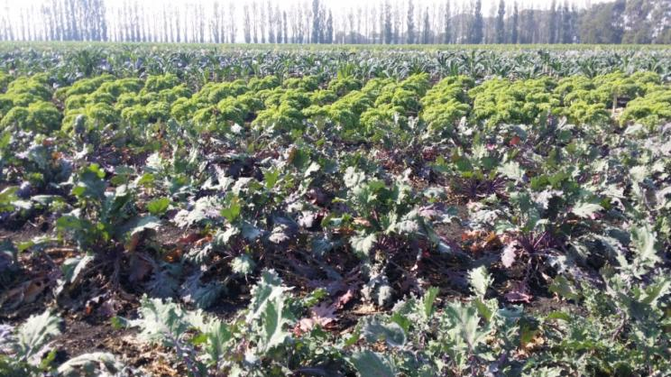
Connect and Review
South East Food Hub not independently viable. Suspend, share learnings and assess future opportunities
Work with regional food hubs identified common barriers and opportunities – connect, share, inspire
Challenges
Supply
Demand: access Vs viability
Resources: small margins
Time: aggregation + community engagmt
Opportunities
Shared resources and learning
Need for physical regional produce aggregator – support food hubs
Sharing produce ‘wants’ and ’offers’
Apply strengths in other models e.g. Baw Baw Food Hub, Grow Lightly and Pensinsula Fresh
Notes:
Ok to say costs exceeding sales by >$2,000 a month

Slide 11
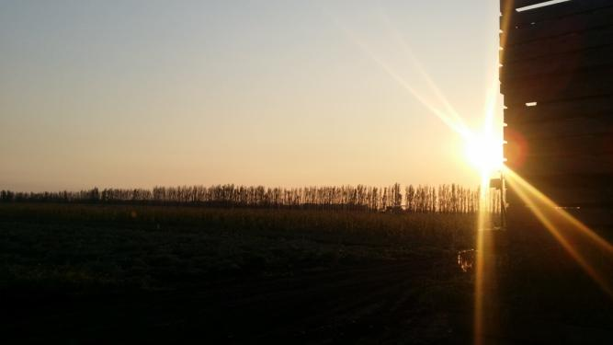
More info and questions?
jodi@openfoodnetwork.org.au
www.openfoodnetwork.org.au/learn
Chat to Baw Baw Food Hub – Lynda & Rob here (Visit in Warragul!)
Grow Lightly Food Hub (Korumburra)

Slide 12
Supported by:

