Slide 1
Food at a Local Level
The City of Whittlesea Experience

Slide 2
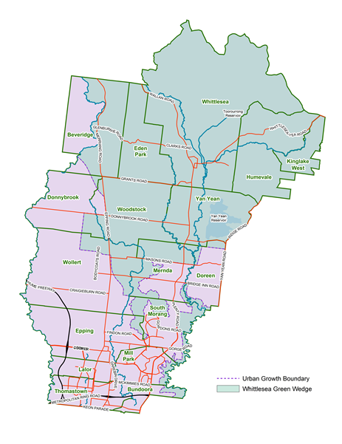
The City of Whittlesea
20 kms north of CBD
Current population 194,000 residents
333,700 persons by 2036.
Australia’s fastest growing suburb - South Morang.
60% rural
15,000 Ha potentially productive agricultural land
Melbourne Wholesale Markets relocation to Epping

Slide 3
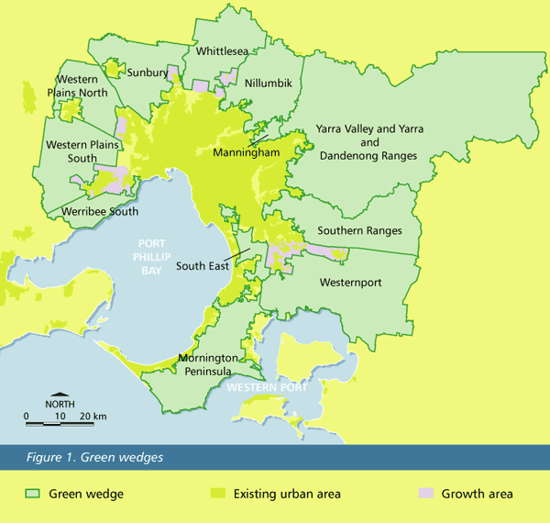
The Green Wedges
Notes:
Whittlesea is home to one of the 12 green wedges, often described as the lungs of Melbourne.
The green wedges concept has been part of Melbourne's planning history for over 40 years, the intent being to protect natural attributes of non-urban areas by channelling urban growth into corridors centred on transport networks.
Purpose of the Green Wedges –
agriculture
rural landscapes
conservation
water catchments
infrastructure that supports urban areas (such as airports and sewage plants)
sand and stone extraction
tourism and recreation.
They are protected by the Urban Growth Boundary. This was last realigned in 2010.

Slide 4
Council Food focused projects
Cross council food systems approach
  Healthy Together Whittlesea – Food Systems Background paper
  Health Planning – Community gardens and food insecurity (eg Food Justice Truck)
  Thrive project – Farms to Families
  Sustainability Outreach Whittlesea (SOW) program
  Plenty Food Group
  In house catering program
  Green CoW - Good Food project, Edible gardening group and staff produce swap
Notes:
Many different areas of Council area involved in food. Council is in the process of developing a systematic approach to supporting this work.
Healthy Together Whittlesea – Food Systems Background paper and policy development – worked with Nick Rose and Kathy McConnell from Deakin’s Food Alliance on developing a Food Systems Background paper. Also incorporated the Circles of Sustainability assessment tool as developed by Prof Paul James from the University of Western Sydney.
Health Planning – Community gardens and food insecurity – which I won’t dwell on given the previous speaker.
Sustainability Outreach Whittlesea (SOW) program – tailored sustainability education programs according to the groups interest. Previous programs have included low waste/ low cost cooking from scratch, edible gardening and composting and worm farming
Plenty Food Group - The Plenty Food Group was established in conjunction with industry and the Cities of Whittlesea and Hume in 2004. Our region has over 160 food manufacturers and employs in excess of 7,000 people. With the demise of the car manufacturing sector, our Region’s food sector will become the largest manufacturing employer and growth industry. PFG’s covers export promotion, national growth, R&D, waste reduction etc.

Slide 5
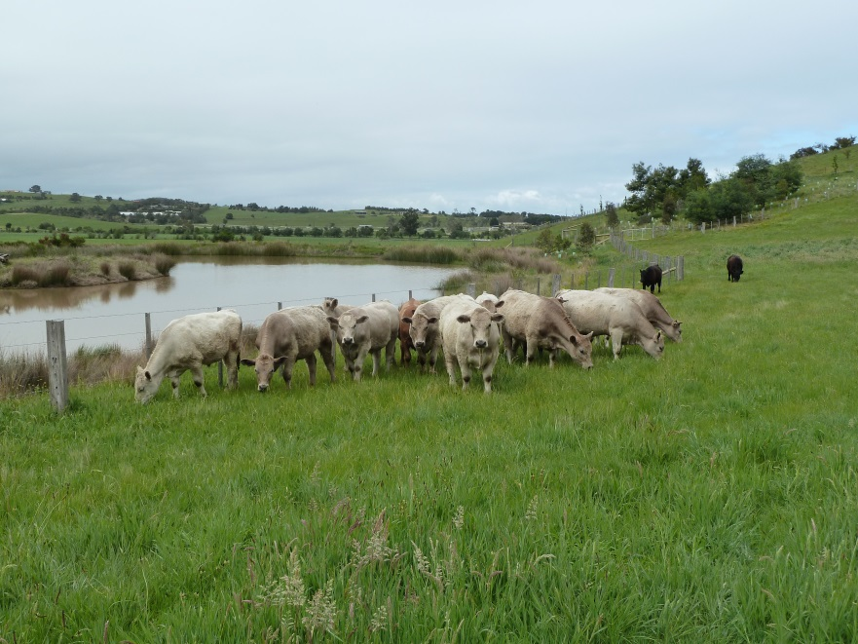
The Agribusiness Program
– Agriculture on the edge
Established in 2013
  Green Wedge Management Plan
  action.
Benefits of peri-urban farming
  The ‘edge’ effect
    proximity to markets
    established infrastructure
    decreased transport costs of inputs and produce
    access to resources
      recycled water,
      compost and nutrients through urban waste streams
      human resources
Notes:
“To secure and promote the ongoing productive capacity of the Whittlesea Green Wedge for sustainable agriculture and resource utilisation into the future.”
The Parliament of Victoria Outer Suburban Interface Services and Development Committee Inquiry into Sustainable Development of Agribusiness in Outer Suburban Melbourne identified that ‘From less than 4% of the land, agriculture in this (peri-urban) region produces 16% of the state’s agricultural wealth’.
It is helpful to think of the peri-urban space in ecological terms, particularly in relation to the concept of the ‘edge effect’ - an ecological phenomenon that you would all be familiar with – where there is a greater diversity where the edges of two adjacent ecosystems overlap. A classic example of this is estuarine areas, but there are an infinite number of examples of how nature exploits this edge effect.
We can learn from nature in terms of exploiting the edge. Peri-urban agriculture and horticulture has a number of obvious advantages, including proximity to markets and established infrastructure, decreased transport costs of inputs and produce and access to resources such as recycled water, compost and nutrients through urban waste streams. There are also benefits in increasing community food security, reducing food miles and access to fresh food, and greater access for agricultural enterprises to local human resources, as employees, skilled support services and, importantly, customers.
Recycled water is of particularly interest in our area, as Whittlesea has a glut of recycled water that will continue to grow in line with the population – this is currently earmarked for a $300 million trunk drain. Given that water is a key limiting factor to local agricultural industry and to land use diversification especially with an uncertain climatic future, we are hoping to advocate for a better, local use of this water resource.
The City of Whittlesea is endeavouring to capitalise on this competitive advantage offered by the rich and diverse peri-urban space in our municipality through on ground support programs and three key strategic projects.

Slide 6
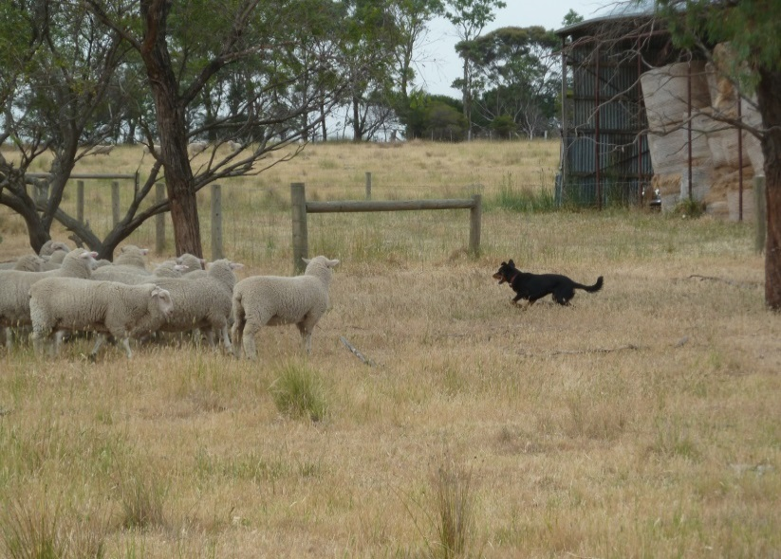
The Agribusiness Program
– Agriculture on the edge
On ground support
  One on one advice
  Education program
  Community reference group
  ‘Rural News’ and new landholder information packs
Strategic support and development
  Peri-Urban Agriculture Literature Review and Municipal Profile
  Rural Rates Review
  Community Orchard
  Farmers Market Feasibility Study
  Land Capability Assessment
Notes:
On ground support
One on one advice – farm visits, information support, crop reporting
Education program – workshops and large events – Joel Salatin
Community reference group – consistent and ongoing community consultation
‘Rural News’ and new landholder information packs – RN quarterly
These three projects will collaboratively offer a strategic approach to supporting agricultural development in the City of Whittlesea.
The Community Orchard project, acting as a proof of concept model, coupled with the parallel project, the Land Capability Assessment will form the basis of an advocacy plan for a broader reticulated recycled water irrigation supply for suitable soils in the Whittlesea municipality. It will also showcase land use diversification, involve the community in local agriculture and food production and offer youth training / employment opportunities.
The Land Capability Assessment will underpin the development of an Agribusiness Prospectus which will showcase CoW competitive advantage to the broader agricultural industry. There is real potential to attract growers to the region given the proximity of Melbourne Markets, provided we can solve the water issue and give clear information about the agricultural potential of the area. This study will deliver this information and support our water efforts with clear mapping of soils suitable for irrigation.
The Rural Rates Review will support the development of appropriate policy settings to capitalise on the edge, attract new producers and retain existing business by showing that Council is serious in its support of a thriving local agricultural industry.

Slide 7
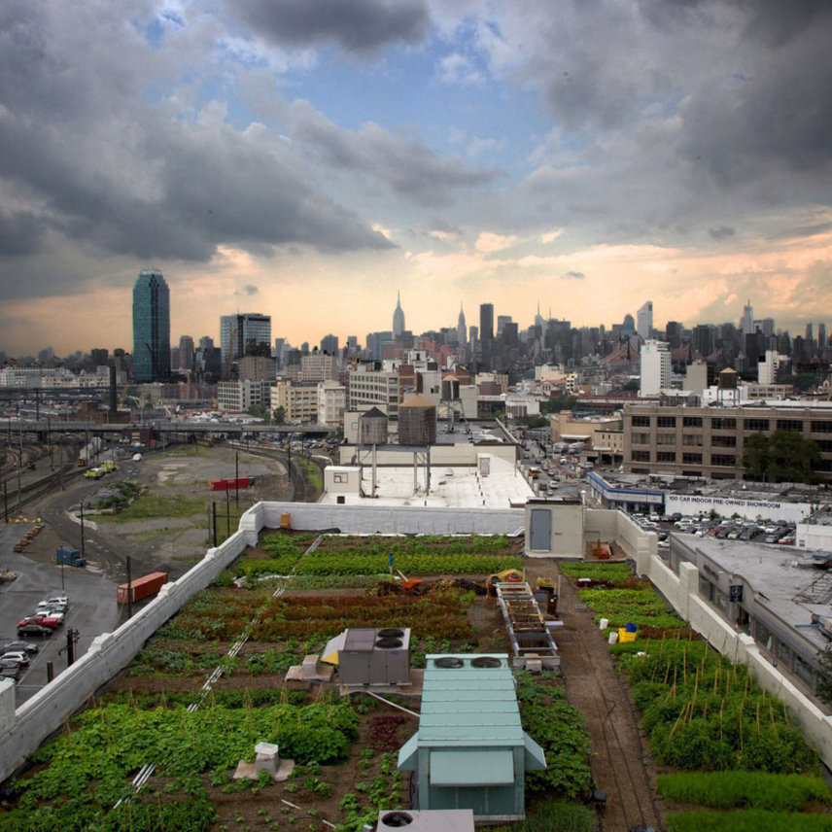
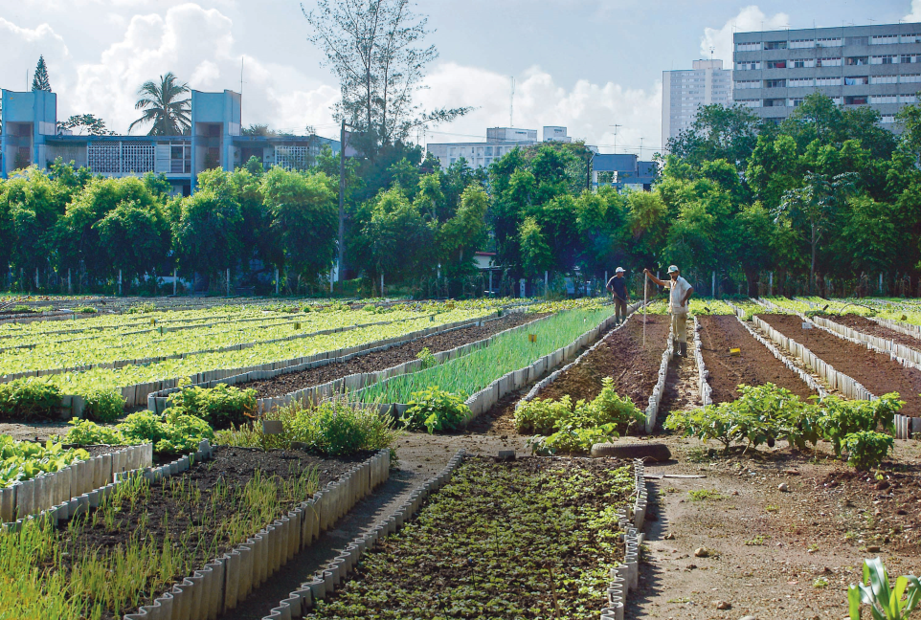
The Agribusiness Program
– Agriculture on the edge
Peri-Urban Agriculture Literature review and Municipal Profile
  Review of national and international best practice
  Local context
Notes:
The Lit review and profile allows us to identify our strengths and weaknesses, giving direction to our program

Slide 8
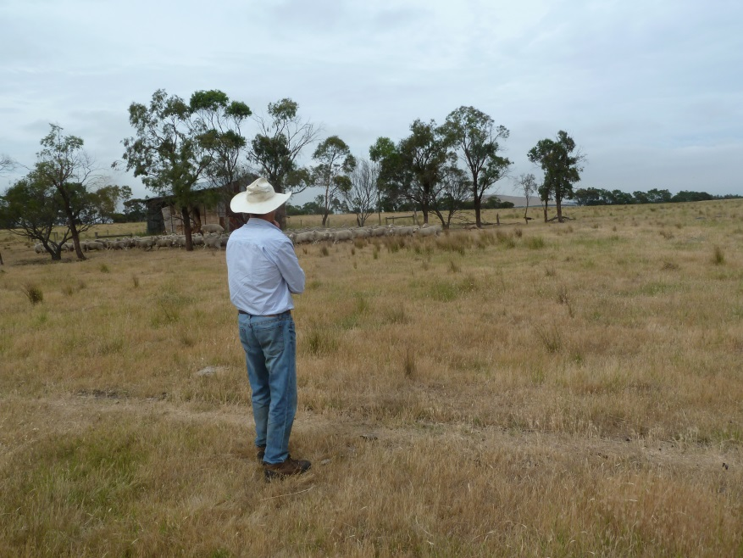
The Agribusiness Program
– Agriculture on the edge
Rural Rates Review
  Targeted financial support to encourage commercial farming enterprise
  Extended to farms within the Urban Growth Boundary
  Opportunity to engage with the farming community
Notes:
Rural Rates Review By reducing economic barriers to farming, Council can encourage economic development through the establishment of new agricultural enterprise and the continuation / expansion of existing businesses. There are a number of policy settings that can assist in this area, and structuring the rate concessions to agribusiness in a targeted manner is a crucial element to these.

Slide 9
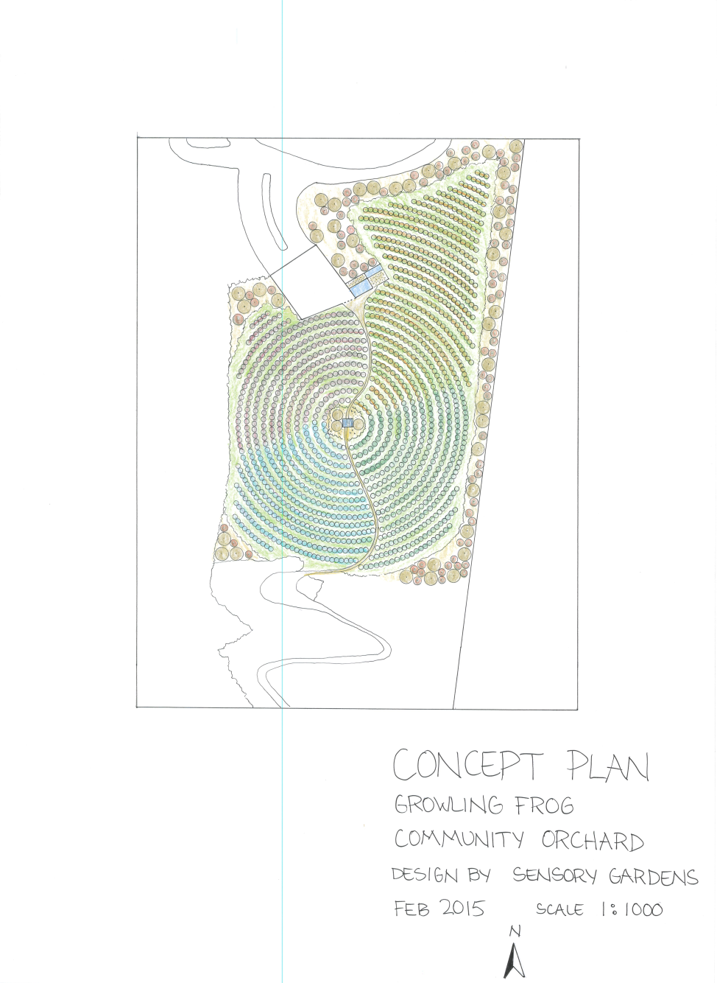
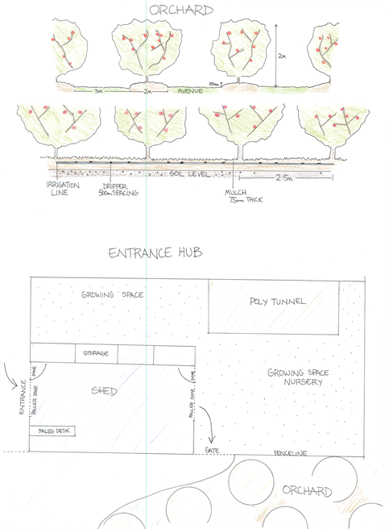
The Agribusiness Program
– Agriculture on the edge
Notes:
Community Orchard (click through to next slide) - The project will establish a two hectare orchard on the Growling Frog Golf Course. The proposed location of the orchard has established access to recycled water supply. The Orchard will act as a research and demonstration site, showcasing the benefits of using the growing local recycled water resource and its potential to reinvigorate the City of Whittlesea’s agricultural industry.
Sustainable agriculture / recycled water use research and demonstration site.
Provides part of the advocacy basis for reticulation of recycled water to revitalise the City of Whittlesea’s agricultural industry, supporting farming business and job creation.
Disadvantaged youth employment and training pathway (through Work for the dole programs, Avocare and Melbourne Polytechnic).
Offering food security and accessibility to local community.
Community education.

Slide 10
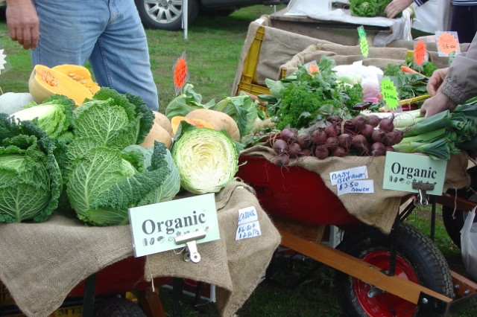
Farmers Market Feasibility Study
Currently no accredited Farmers Market within the municipality
Project will consider
  the economic feasibility
  the best location
  How best to support the market to ensure longevity
Partnership funded through RDV and Council
Working with the Victorian Farmers Market Association and Compass Consulting Services

Slide 11
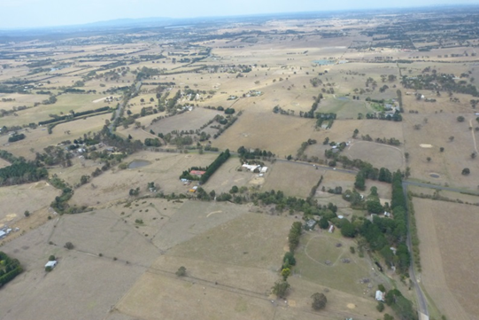
The Agribusiness Program
– Agriculture on the edge
Land Capability Assessment
  Industry Research Scholarship - Deakin University
  3 year PhD – commencing April 2016
  Soil, hydrology, climate, novel resources, markets etc.
  8+ crop profiles
  Agribusiness Prospectus
  ‘Jobs on the ground’ potential.
Notes:
Land Capability Assessment –
The LCA project is a vital step in the Agribusiness program. It will also inform land management and planning processes. It is a short term priority of the Green Wedge Management Plan and offers the other element to the advocacy for a reticulation of recycled water.
It will offer Council, industry and the community an understanding of the potential of the region to build a sustainable agricultural industry, capitalising on its strengths and working within its natural constraints.
The project will support better productivity and environmental decisions to mitigate the risks and maximise the opportunities created through climate and urban growth challenges.
Solid land capability data and analysis is needed to fully assess the potential of and advocate for the development of reticulated recycled water supply for irrigation, including extent and location of suitable soil types, how much water can be utilised productively and the risk of exacerbating any salinity issues.
The LCA will also form the basis of the development of an Agribusiness Prospectus, which can be used to attract agricultural businesses, investment and employers to the area by showcasing the opportunities offered by such competitive advantages to agricultural businesses such as excellent road and rail links, proximity to Melbourne, the recently relocated wholesale markets, employment and skills resources and alternative income streams, such as agritourism, farm gate sales, farm stays and direct marketing of value added, locally produced product.

Slide 12
The Agribusiness Program
– Agriculture on the edge
Thrive Project – Farmers to Families
https://www.youtube.com/watch?v=r6YAWJAYddU

Slide 13


The Agribusiness Program
– Agriculture on the edge

