Slide 1
Mount Alexander Local Produce Network (MALPN)
Notes:
Hi, I’m Katie Finlay and I’m here today to tell you about the MALPN, a network of farmers and producers in the Mount Alexander Shire, which is about half an hour down the road from here around Castlemaine.

Slide 2
Mount Alexander Local Produce Network (MALPN)— How Did We Get Here?
Mount Alexander Local Produce Network (MALPN)
Launched 2014
Mount Alexander Shire Council
2012
Growing Local Food Economy Forum
Sustainable Food Network

Slide 3
PURPOSE: Promoting sustainable local food production and consumption.
Promote our local agricultural community
Research and respond to supply and demand for local food
Connect participants in local food system and provide a collective voice
Attract investment in the local food economy
Participate in land use planning
Advocate for sustainable food production
Education and discussion about local food sustainability
Notes:
Had a lot of discussion about what “sustainable local food system” means, and came up with this purpose, and an 8 point VALUES statement as well.
That took about 6 months.

Slide 4
Mount Alexander Local Produce Network (MALPN)— WHO CAN JOIN?
Anyone who grows or sells sustainable food, or demonstrates an interest or activity that relates to a sustainable food system in the Mount Alexander Shire.
Notes:
Pretty much anyone….

Slide 5
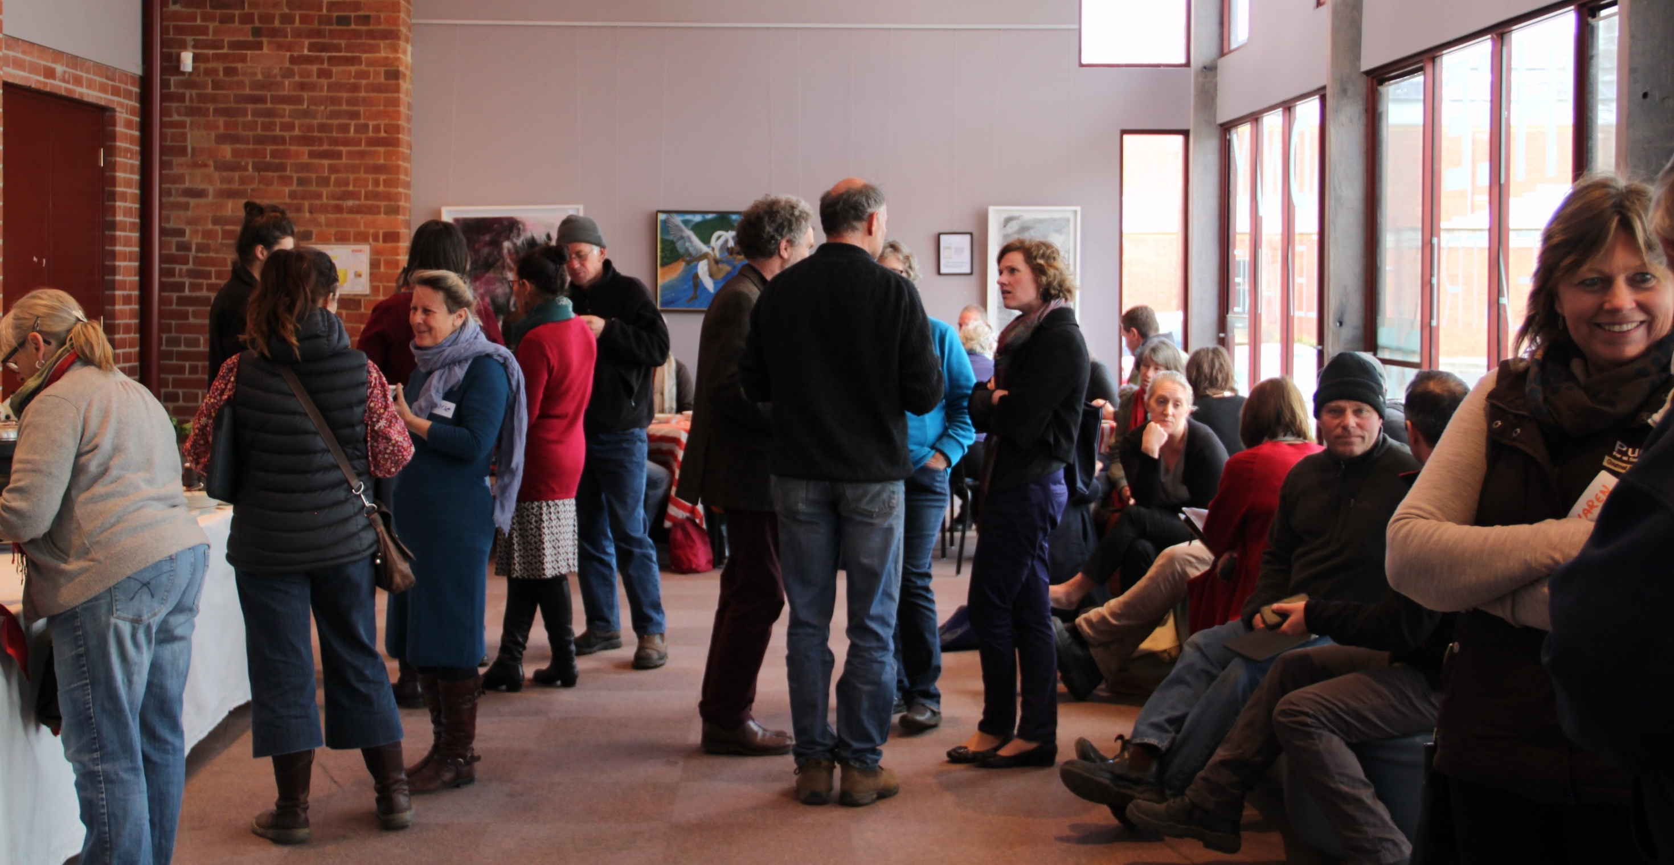
THE LAUNCH
Notes:
THE LAUNCH
We decided that our first activity would be to take the Local Produce Guide – which was out of date – online. We collaborated with the OFN, raised some money from a range of sources to list all our producers on the OFN. One of our collaboration partners was Castlemaine Farmers Market.
LAUNCH the network inviting everyone to an event to see how the OFN works, and hear about the possibilities for their businesses.
It was a great event, lots of excitement, quite a lot of producers turned up.

Slide 6
Mount Alexander Local Produce Network (MALPN)— WHAT NEXT?
Notes:
Well, nothing! It’s stalled, for two main reasons:
No champion - Lack of capacity in MALPN committee and on the Farmers Market committee
The FM committee is willing and keen, but it’s just a bit outside the farmers market “normal business”. Not much, but enough to need dedicated resourcing.
2. We haven’t made the farmers a good enough offer
Farmers, on the whole, are good at growing stuff
Most of them have also got their marketing sorted. (Not necessarily happy with it and probably complain constantly about it – price takers, commissions, bureaucracy)
To get farmers to try a new system, it has to be substantially better than their existing arrangements. Think about this from their point of view: even if their current arrangement isn’t ideal, at least it’s familiar. Farmers are almost universally underpaid, overworked and as a population they’re ageing, and sometimes even reading an email about an exciting new opportunity is beyond them.
A new offer needs to involve more money going direct to the farmer (or at least not less money) for less hassle (or at least no more hassle) – as a farmer, I feel like this is the big elephant in the room with some of the models that have been talked about, but not all of them.
Anthony nailed this problem in his presentation yesterday when he pointed out that the business model of “buy high, sell low” - or in other words trying to increase access to affordable food to consumers and at the same time increase the return to farmers - that’s a big problem to solve.
However I think MALPN is a really good demonstration of “low-hanging fruit” in this space, and what I mean by that is that this is a project that just needs some money thrown at it to start shifting towards being able to achieve some of the objectives of a food hub.
The farmers market is willing to help its producers learn how to use the OFN to increase the value of the offering to the farmers, and to their customers
They’ve surveyed their farmers, and more than 60% of them think it would be valuable
The FM has done some training with the OFN
And without extra funding, they don’t have the capacity to take it any further
Anthony also said “start with what you’ve got”, and what we’ve got in Australia at the moment that’s working well is farmers markets. That’s means they’re a great place to start looking for where the farmers already are – farmers markets, which have done a fantastic job of making farmers a better offer than they previously had (disclaimer: I’m on the board of Melbourne Farmers Markets)
So I guess that’s my message today – I think we should heed Anthony’s warning, don’t try to reinvent the wheel. I would suggest that if you’re thinking of starting a food hub, then as a first point talk to your local farmers market – or if you don’t already have one, start one because it’s a proven way of getting farmers on board.

