Slide 1
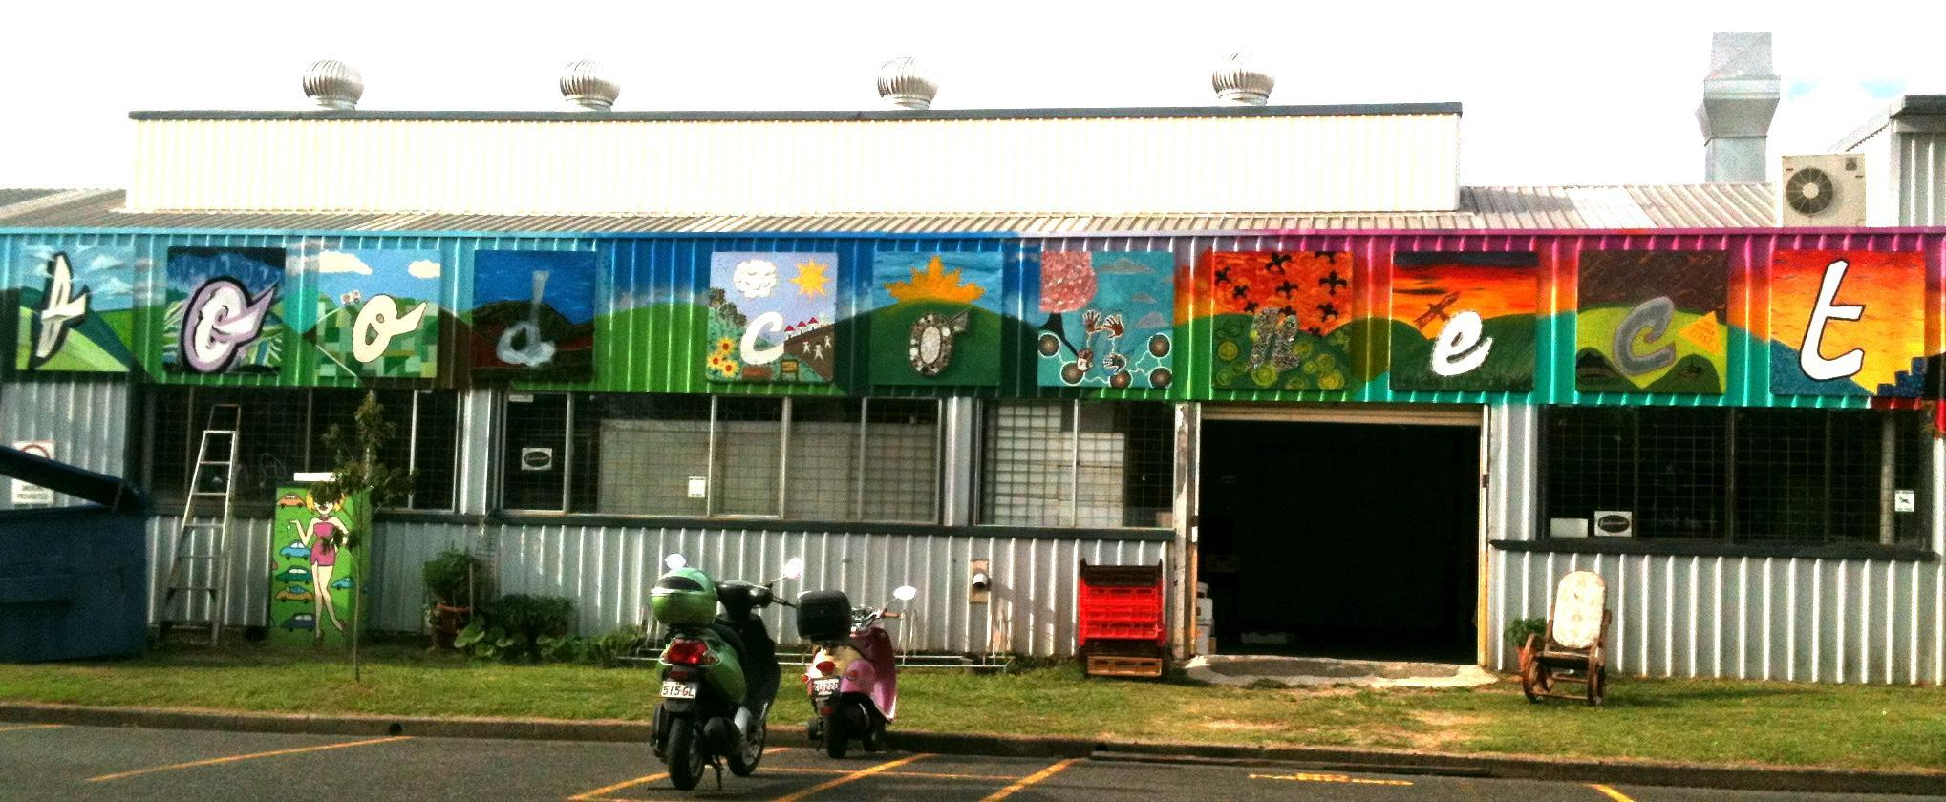
FOOD CONNECT’S VISION:
A WORLD WHERE ALL AUSTRALIANS CAN ACCESS HEALTHY, FRESH, ECOLOGICALLY GROWN FOOD THAT’S FAIR TO GROWERS, MAKERS AND EATERS.

Slide 2
1,500 323,722 | HOUSEHOLDS FED AFFORDABLE, NUTRITIOUS, SEASONAL FOOD BOXES DELIVERED | 140km | AVERAGE FOOD MILES TRAVELLED PER WEEK (National Ave = 1200km)
45 | RESTAURANTS, CAFES & BUYERS GROUPS SUPPLIED | 80 40 $22M | FAMILY FARMERS ENGAGED FOOD MAKERS / VALUE ADDERS REVENUE INTO LOCAL FOOD ECONOMY
75% | WEEKLY FRUIT & VEGETABLE CONSUMPTION MET (AS PER DIETARY GUIDELINES - Australian average = 38%) | 95% | PRODUCTS FULFIL ECOLOGICAL STANDARDS
6,500 | COMMUNITY MEMBERS ATTENDED FARM TOURS & EVENTS | 1% | OF ANNUAL TURNOVER DONATED TO COMMUNITY GROUPS, SCHOOLS & FOOD RESCUE PROGRAMS
50% | OF RETAIL PRICE RETURNED TO FARMERS (Australian average = 10%) | 201 23 | EMPLOYEES SINCE LAUNCH LOCAL PEOPLE EMPLOYED
$1M | PAID IN RENT | 25% | MARGINALISED PEOPLE EMPLOYED

Slide 4
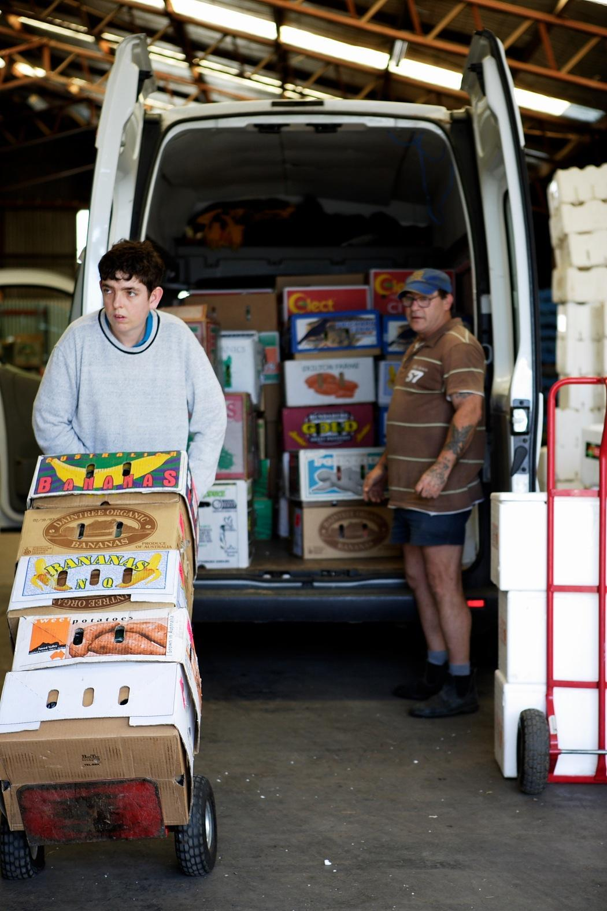
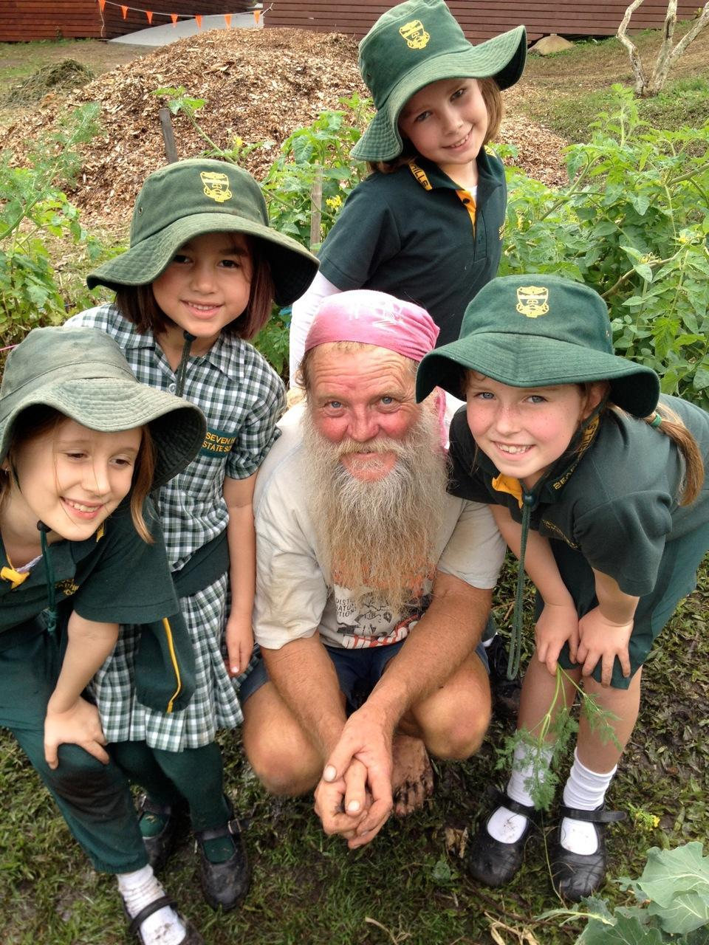
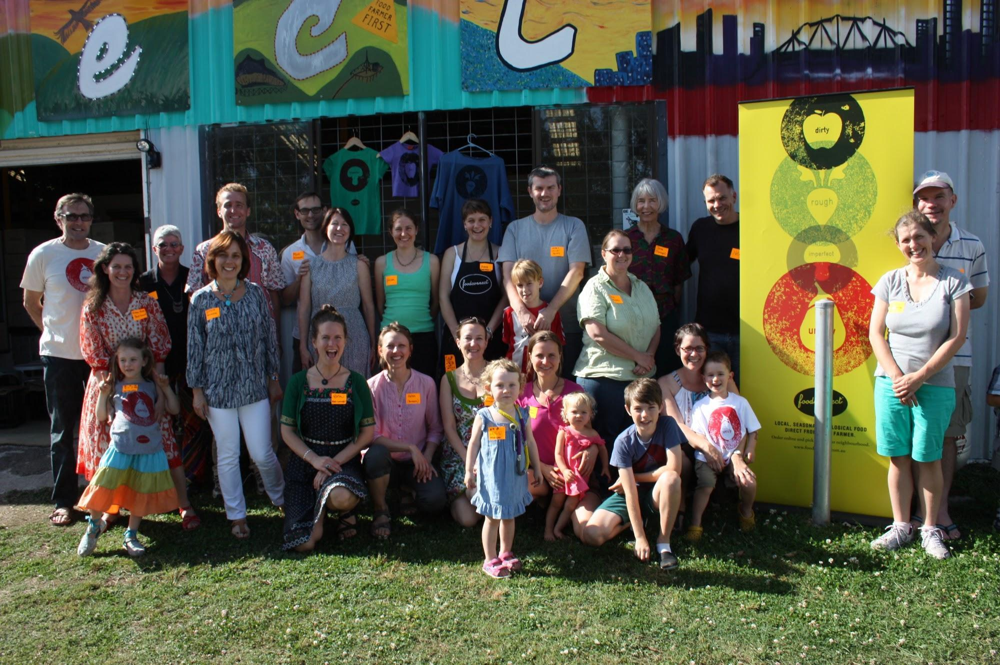
2005 - 2007
Hybrid CSA box system
Distribution, stable market & connection to eaters
2004 Trial with Rob, a group of mums and 30 farmers in SEQ
City Cousin network was formed
May 2005 - Launched with start up capital of $4,000 to secure some shared warehouse space
$14,000 in forward subscriptions within 2 weeks of launch
10 part-time staff & Rob’s heart / sweat
Revenue
2005 - $246,000 (70%)
2006 - $734,000 (92%)
2007 - $1.4 million (100%)

Slide 6
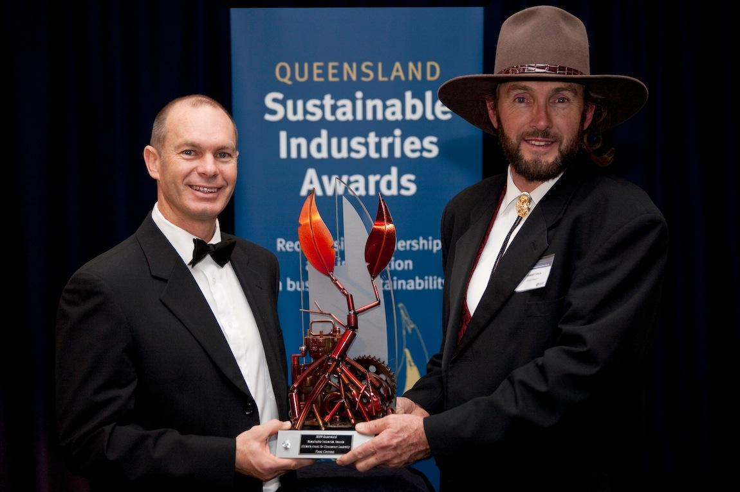
2007 - 2009
No longer an ‘experiment’
Constitution written - Pty Ltd with NFP articles
Relocated to more suitable premises - crowd funded bond
Social Enterprise Intermediaries took notice & took hostage
Lab rats for social scientists
Won awards
Education team formed
Piloted ‘Local food for all’
Trialled governance model - dynamic self governance
Growing pains and people problems
Initiated PGS with farmers - rating system
2009 formed FCF to share IP / open sourced the model to dozens of groups / enterprises, beginning with Coffs Coast & Bellingen Shire
REVENUE now $2.6 million - difficulties managing cashflow
sydney
adelaide

Slide 8
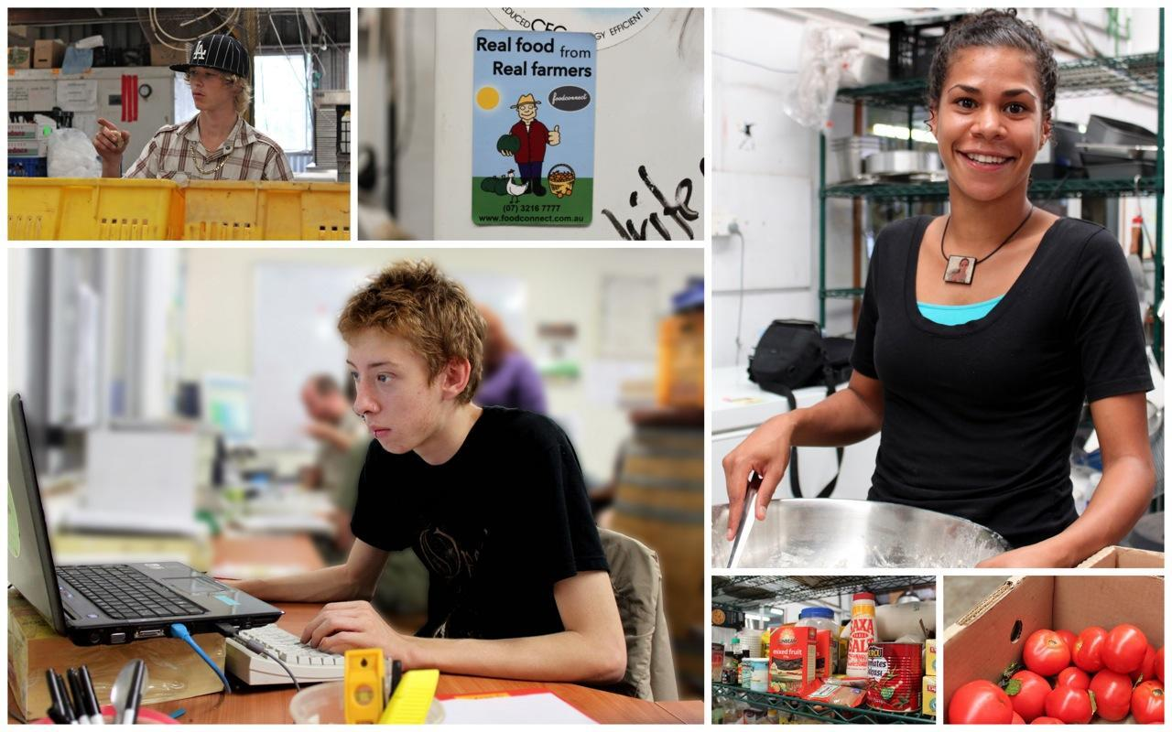
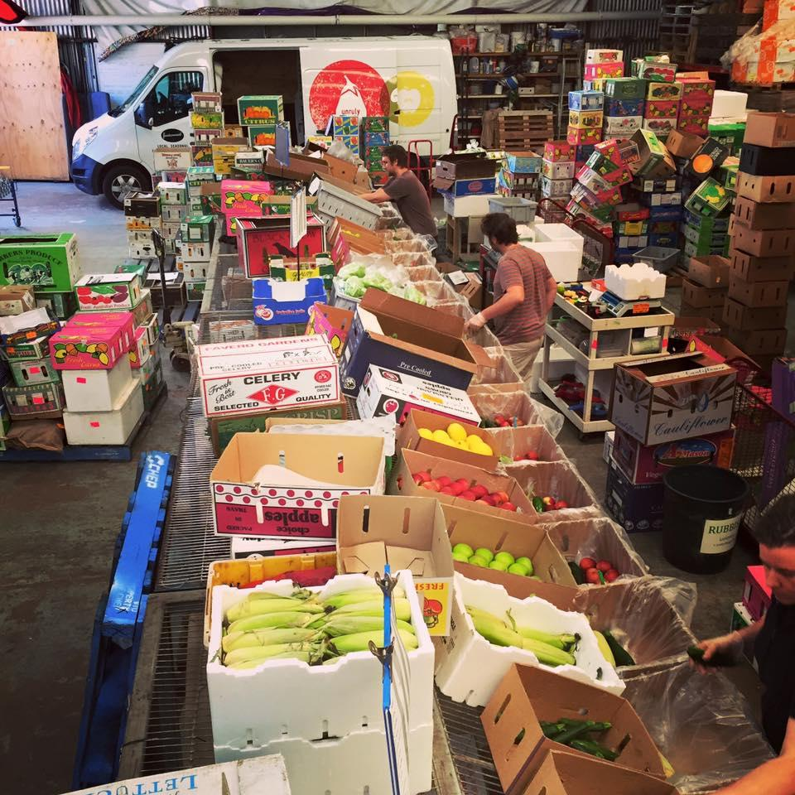
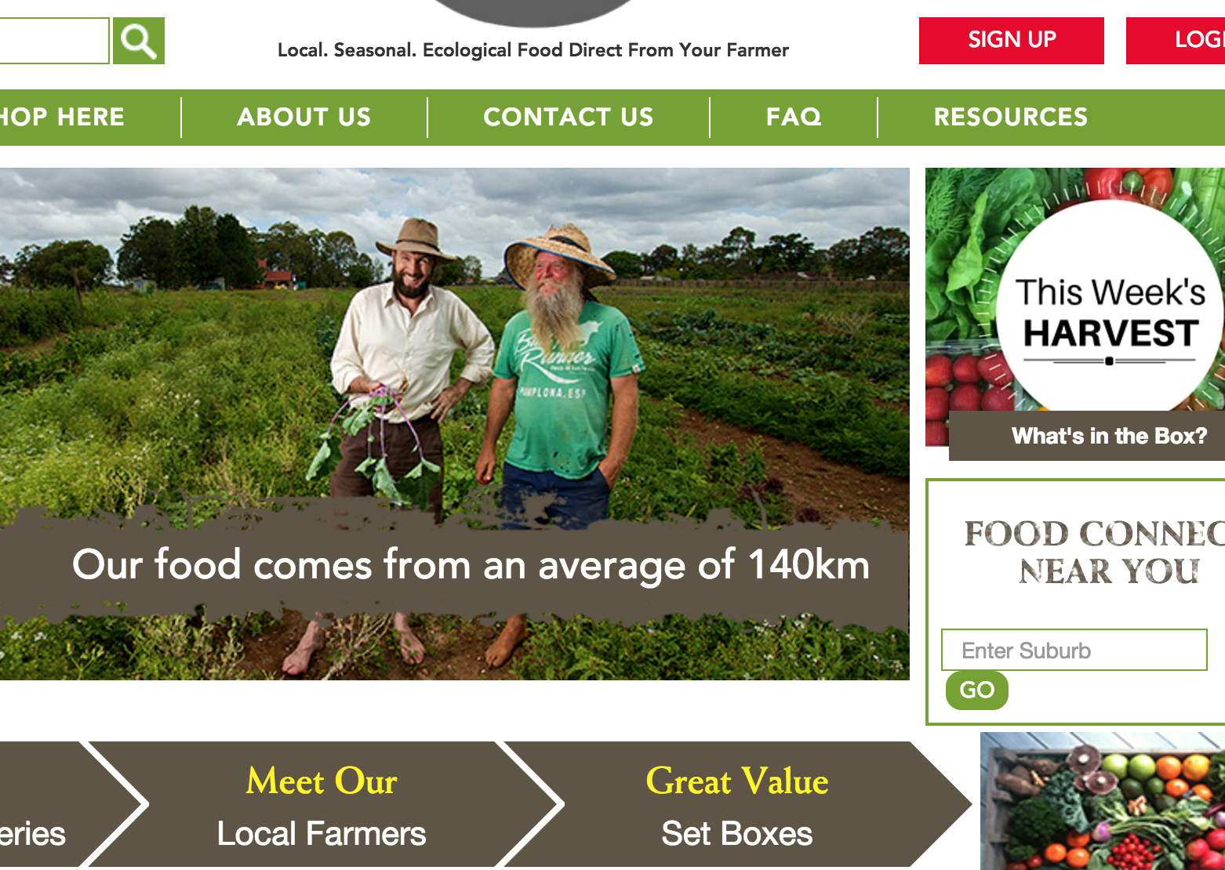
2010 - 2014
AFSA, Slow Money, Think Food consultancy, food hub research
Federal Jobs Grant - Processing Kitchen installed & marginalised youth employed
Wholesale arm initiated with plans to supply institutions
Social Return on Investment assessed
Tension between movement building and core business
External advisor engaged to reset the internal culture and restructure the business
Paused the Kitchen & FCF
2011 Floods
Retail box system feeling the competition
New marketing strategy -> FIZZER
New e-Commerce system -> FAIL

Slide 9
$1 invested = $16.83 of social value is created for our stakeholders
Stakeholder Real outcomes due to Food Connect Brisbane
Farmers Increased revenue for producer
Increased self-esteem, optimism and sense of community
Subscribers Improved access to local high quality organic food
Increased ability to support local farmers directly
Increased consumption of healthy food
City Cousins Increased sense of community
Increased ability to support local farmers
Increased convenience of boxes delivered to doorstep
Food Connect Profit generated
Successful establishment and ongoing operations of the FCF
Food Connect Foundation
Inspire others to replicate business model to create diverse and healthy regional and local economies - 10-15 replications between 2009 - 2011 across Australia & New Zealand
Federal Government
Increased savings from welfare payments - employment outcomes
Increased financial benefits via increased tax contributions - employment outcomes

Slide 11
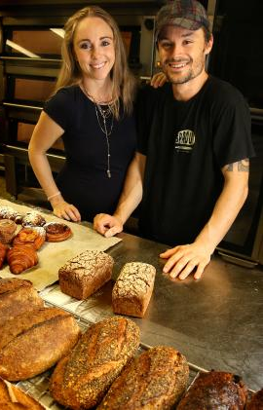
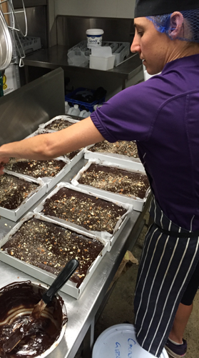
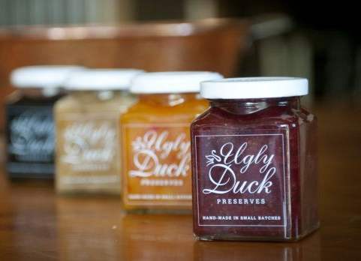
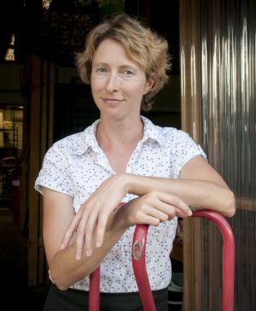
2010 - 2014
Still feeling the pressure of ownership & responsibility to farmers - more burnout & forgetting boundaries
2014 Kitchen Leased - catering business, artisan bakery, two other small food makers
Enterprise has pivoted to 50% retail boxes, 50% wholesale
Slow and steady
WHAT’S NEXT?
Talking with Landlord & community - Friends of Food Connect & FFUN
Transition fully to Aggregator - retail box, retail shopfront, wholesale, kitchen leases
FCF Running events - Buyers Clubs
Fair Food Chefs
Brisbane Food Plan

Slide 13
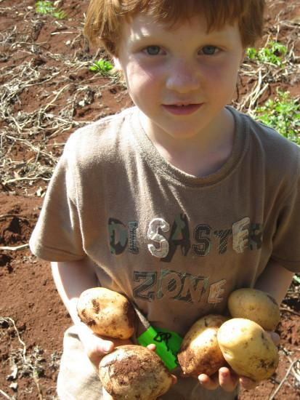
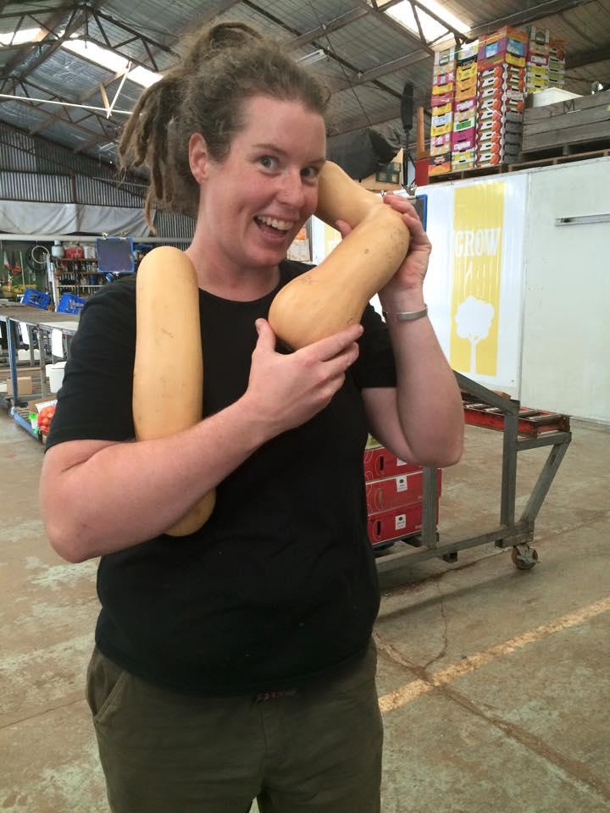
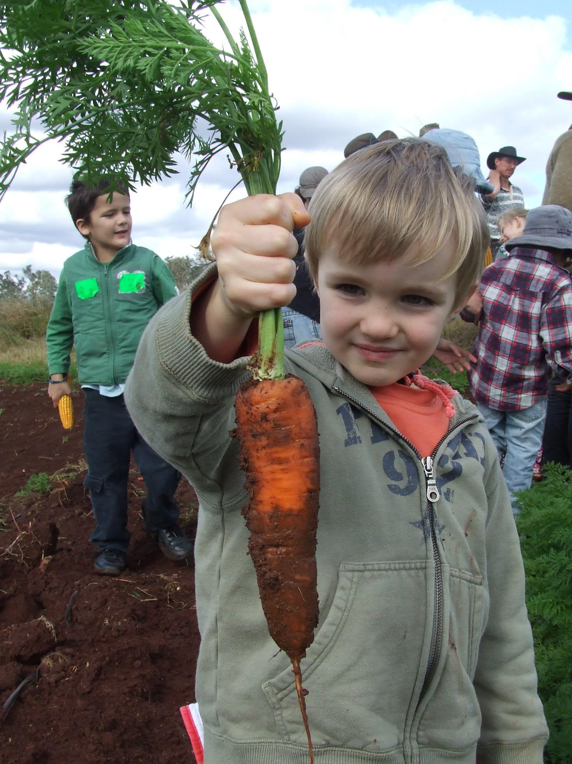
THANK YOU!

