Slide 2
What is FareShare?
Our vision
A society where food is not wasted and no one goes hungry
Our mission
-Rescue food that would otherwise be wasted
-Cook and distribute nutritious meals to people in need
-Inspire and empower action on food rescue and hunger
Picking and sorting
Transportation and manufacture
Markets, supermarkets, businesses
(Images FAO 2015)

Slide 3
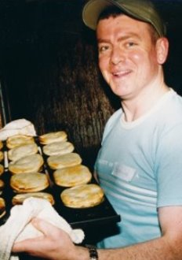
FareShare
Began late 2001
2001, 2002 ‘Good Samaritan Law’
First of its kind in Australia, replicated
FareShare 2016: 16 FT staff, >800 volunteers, >1 million meals
Notes:
Our History
FareShare began as a vision shared by two groups of people.
In 2000 a pastry chef called Guido Pozzebon started cooking 300 pies every Saturday morning for the Salvation Army and St Vincent de Paul. Guido and a group of friends would meet at the RACV Club and use surplus food accumulated over the week to cook savoury pastries. Within months the group was calling itself One Umbrella and was rescuing food that would otherwise be wasted.
Seperately a Melburnian named Steven Kolt returned from a visit to the United States inspired by the work of New York City Harvest, an organisation which rescues food for the needy. Steven was a member of Jewish Aid (now Stand Up) and together with other members started collecting prepared meals from function halls and catering venues. They called the project Melbourne City Harvest.
By late 2001, these two efforts merged and FareShare was born. With funding from Jewish Aid (now Stand Up), the Pratt Foundation and the RACV Foundation, a full-time staff member was employed and a refrigerated van purchased.
While many businesses were keen to provide FareShare with their surplus food, legal barriers prevented many from doing so. So in 2002 FareShare teamed up with the Law Institute of Victoria and successfully lobbied the Victorian Government to introduce Australia’s first Good Samaritan law to protect food donors. Similar legislation has since been put in place in every other state and territory.
In our early years FareShare was nomadic – moving between kitchens. It cooked at the RACV Club, Victoria Park and the Southbank Hanover Crisis Centre.
Then with generous support from philanthropic foundations, particularly the Jack and Ethel Goldin Foundation, FareShare established its first dedicated kitchen in 2008 in Abbotsford. It recruited more food donors and volunteers, and added first a second and then a third daily shift, and cooked more and more meals.
Despite 350 regular volunteers cooking nearly 500,000 meals a year FareShare was still falling well short of meeting agencies’ requests for food, so it set out to establish larger premises.
In 2013, with the generous assistance of organisations such as the Ian Potter Foundation, FareShare started cooking in Australia’s largest charity kitchen – also in Abbotsford.
To support businesses that wished to donate food to charities, in 2001 FareShare together with the Law Institute of Victoria lobbied the state government to provide legal protection to food businesses that wanted to help the community. In 2002 the campaign resulted in the passage of what has become known as the Good Samaritan law. This law protects food donors from legal action, where food is donated in good condition and in good faith.
The Good Samaritan law was the first of its kind in Australia and has been replicated in every state and territory since
And here are the relevant sections of the legislation:
Wrongs and Other Acts (Public Liability Insurance Reform) 2002 – “Good Samaritan law”
Part VIB – Food Donor Protection 31F. Protection of food donors
(1) A person who donates food (the “food donor”) in the circumstances listed in sub-section (2) is not liable in any civil proceeding for any death or injury that results from the consumption of the food.
(2) The circumstances are:
(a) that the food donor donated the food,
(i) in good faith for a charitable or benevolent purpose; and
(ii) with the intention that the consumer of the food would not have to pay for the food; and
(b) that the food was safe to consume at the time it left the possession or control of the food donor; and
(c) if the food was of a nature that required it to be handled in a particular way to ensure that it remained safe to consume after it left the possession or control of the food donor, that the food donor informed the person to whom the food donor gave the food of those handling requirements; and
(d) if the food only remained safe to consume for a particular period of time after it left the possession or control of the food donor, that the food donor informed the person to whom the food donor gave the food of that time limit.
(3) For the purposes of this section, food is safe to consume if it is not unsafe food.

Slide 4
FareShare Kitchen
Australia’s largest charity kitchen:
Schools Program
Corporate Volunteering
Every $1 = 1.5 meals
Key funding partners:
Philanthropic foundations
Businesses
Private donors
Limiting factor: Storage

Slide 5
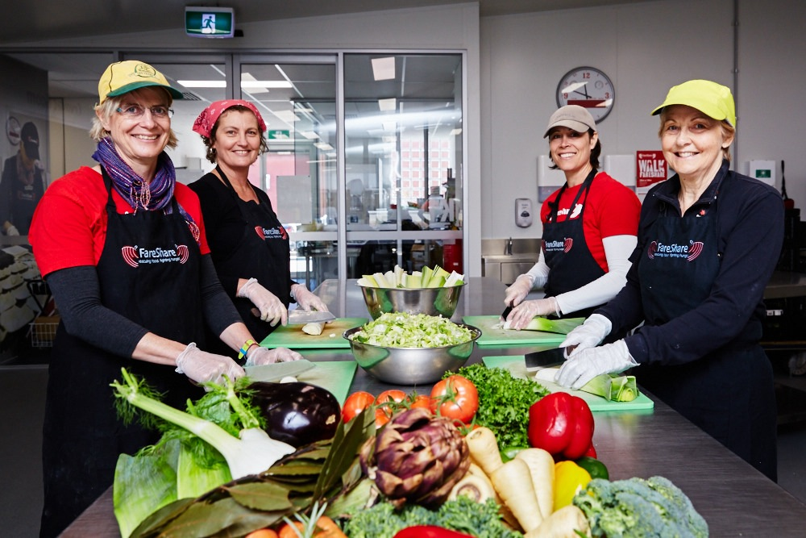
FareShare Kitchen
Approx. 80% FareShare meals go to Foodbank, direct distribution
It gets harder to access fresh foods:
Farms closing
Increasing consumption
Increased efficiencies
Decrease in fresh food
Increasing need
Notes:
Each year more than 100 businesses provide us with perfectly good food that would otherwise end up in landfill. These include Fonterra (dairy), Kinross Farms (eggs), Woolworths (meat), Boscastle (pastry) and Costa Farms (fresh vegetables).
FareShare accepts food that may be:
Product close to ‘Use By’ date
Product no more than 8 months past ‘Best Before’ date
Products with damaged packaging
R&D products or finished/deleted product lines
Sample size or bulk produce
Products that fall outside the manufacturers specifications
Over/underweight or mislabeled products
Foodbank Victoria’s Yarraville warehouse, however we also deliver meals to some agencies and schools.
What we cook depends on what businesses donate and we can rescue. We cook two types of meals: “wet meals” such as casseroles, pastas, curries, tagines, and savoury pastries such as egg and bacon pies, quiches and vegetable and meat sausage rolls.
We endeavour to make our meals as nutritious and tasty as possible. The majority of our meals are frozen once packed for longevity and safety. Our “wet meals” are vacuum-sealed in 1.2kg pouches.
Our meals are distributed to hundreds of charities across Melbourne and regional Victoria. These agencies run soup vans, homeless shelters, support groups for single mothers and school breakfast programs. They include large groups like St Vincent de Paul, the Salvation Army, the Asylum Seekers Resource Centre and Father Bob Maguire Foundation, as well as small community food programs.
Some of them serve up our food, but most groups pack them in parcels for people to take away.
For a small number of charities we prepare meals to suit their needs. Once cooked in our kitchen, we chill them and immediately deliver them for serving within a couple of days. We can only provide this service to charities serving large numbers of meals. For example, we cook and deliver lunch for 160 people at the Asylum Seekers Resource Centre every day.
We provide all our meals to agencies absolutely free of charge, and they must guarantee to give them away for free to the men, women and children in need of support within their communities.

Slide 6
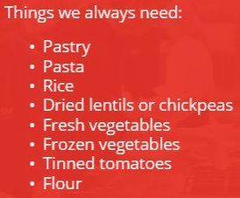
FareShare Kitchen Gardens: Why?
Key aim consistency of supply:
Vegetables
Key factor to continuation:
Contribution to core operation

Slide 7
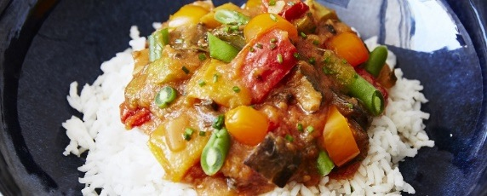
Garden Focus; yield and nutrition
Top Priority | Common name
 | Capsicum
 | Carrot
 | Celery
 | Eggplant
 | Leek
 | Parsnip
 | Pumpkin (Butternut)
 | Silverbeet
 | Squash
 | Sweet potato
 | Turnip
 | Zucchini
Operations Manager and Kitchen Manager (Chefs have input)
Garden Manager
(Shift Supervisors)
Volunteers

Slide 8
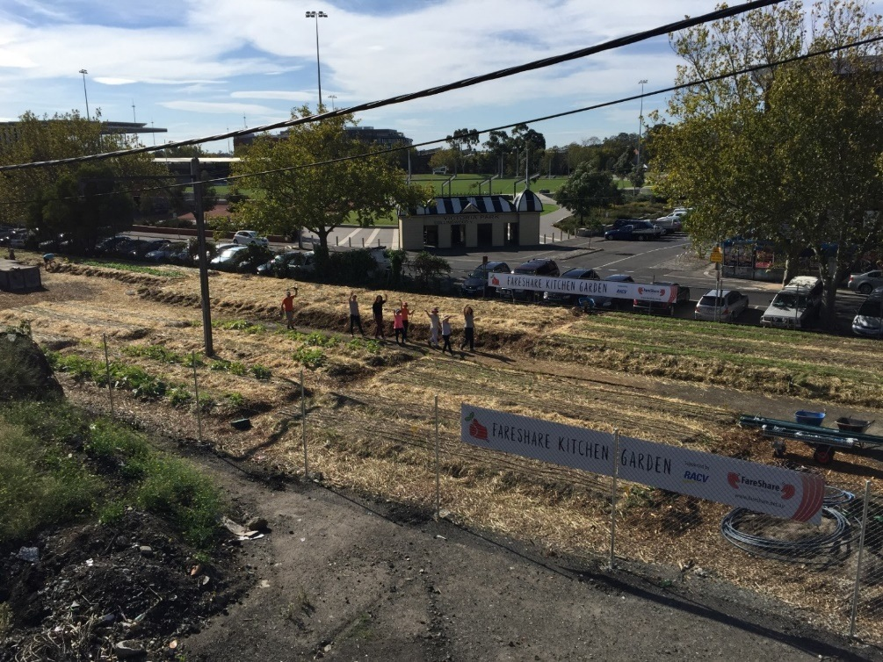
FareShare Gardens 2016
Vic Park, Abbotsford
Moorabbin Airport
Baguley family farm, Clayton South

Slide 9
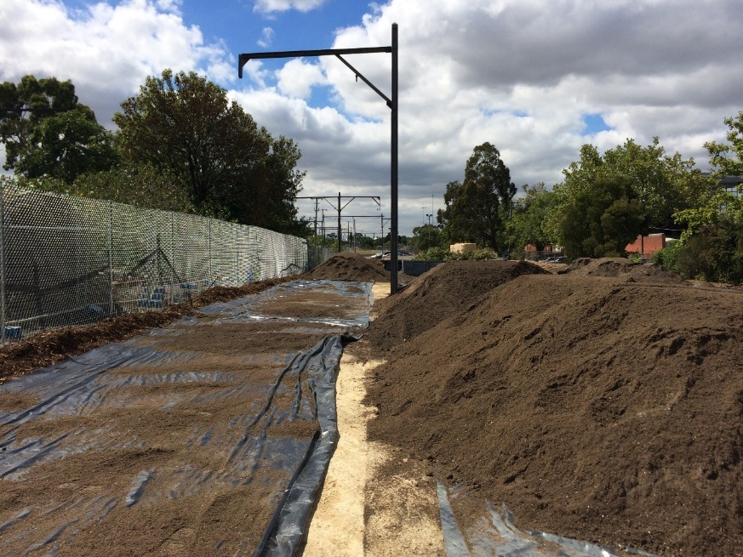
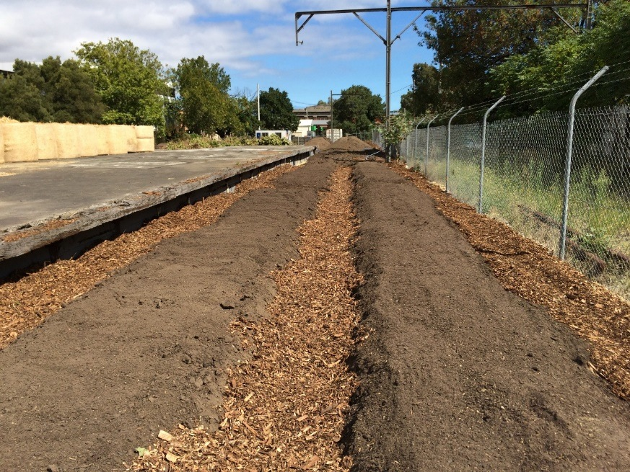
Victoria Park Train Station, Abbotsford
Funding
Professional support:
3000 Acres
City of Yarra, Urban Agriculture Facilitators
Melbourne University, Burnley, design advise
Land tenure: Vic Track land, ¾ acre, 2 year lease

Slide 10
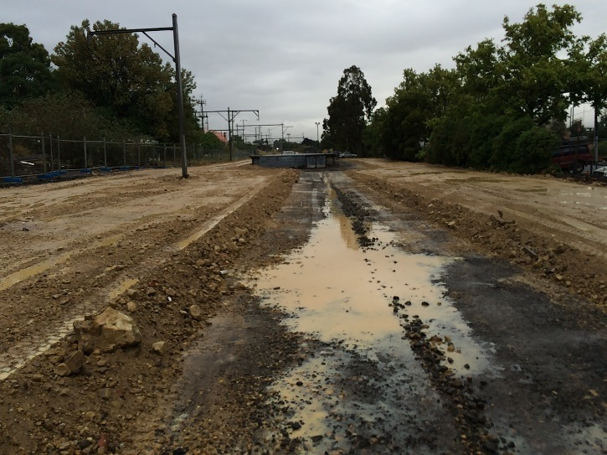
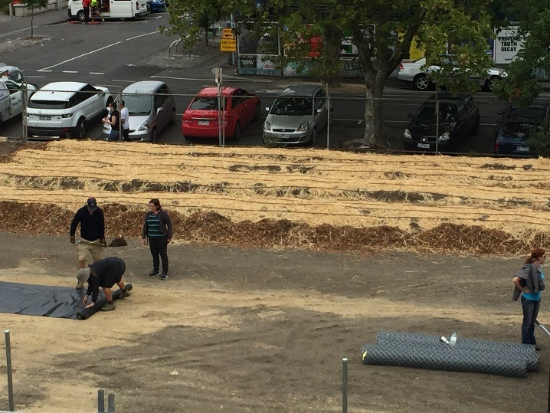
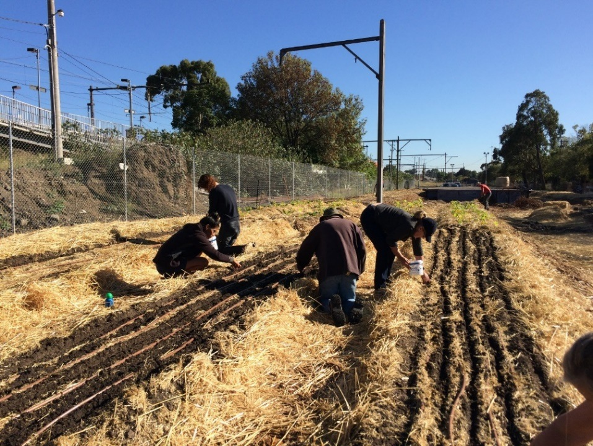
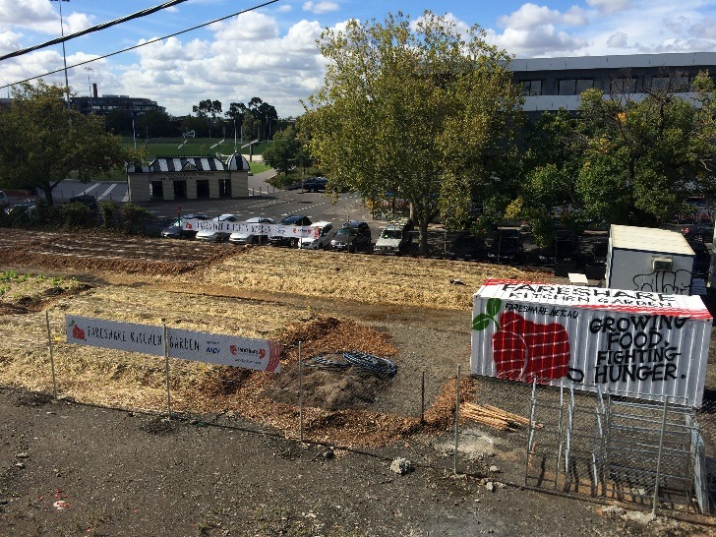
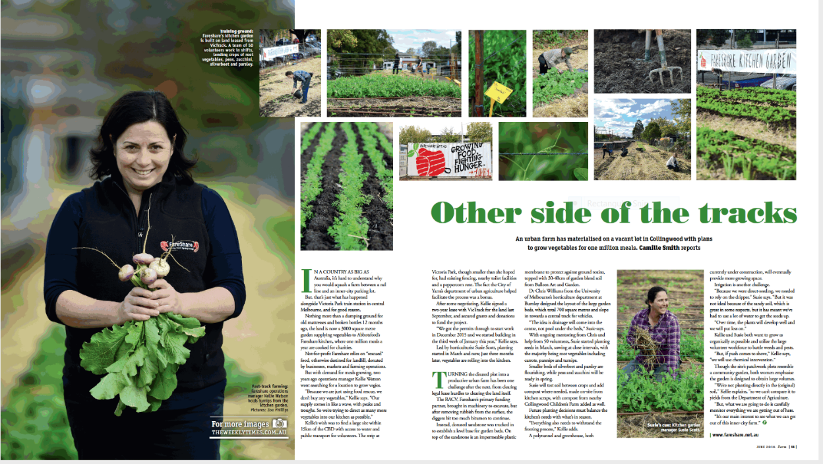
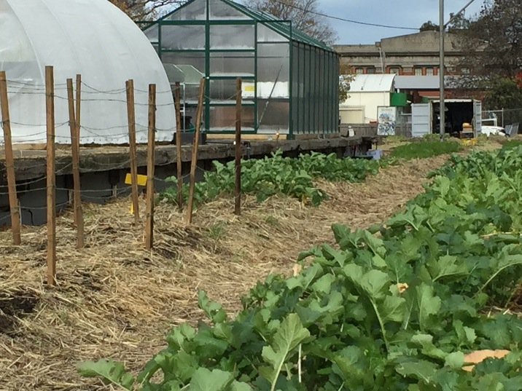
Victoria Park Train Station, Abbotsford

Slide 11
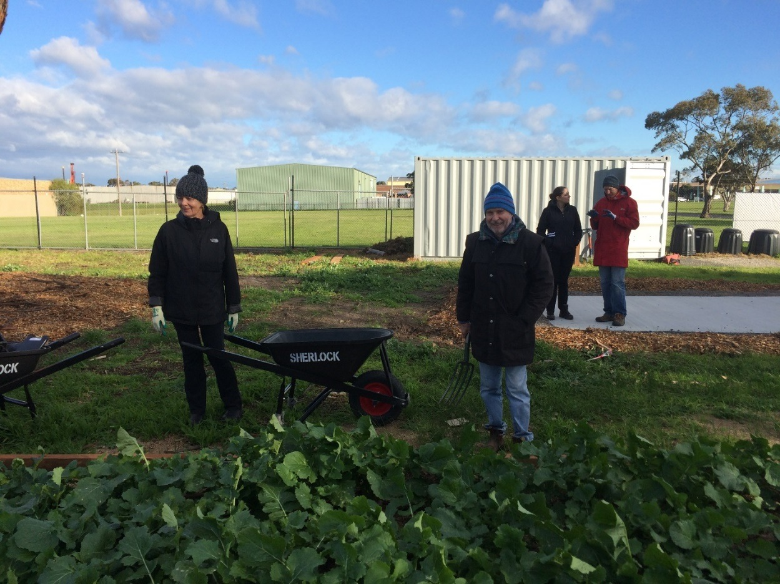
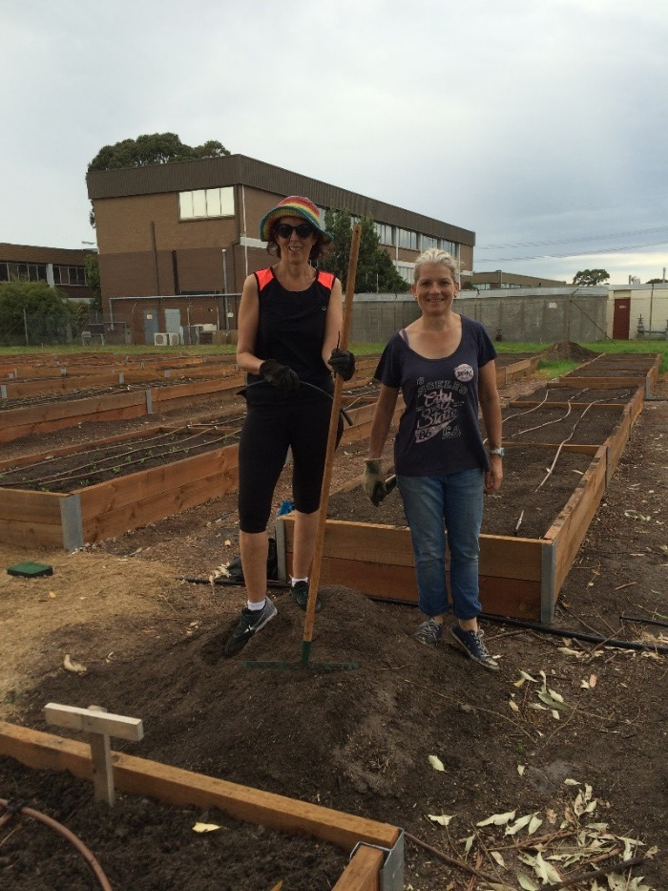
Moorabbin Airport
Funding
Professional support:
-Garden infrastructure
-Design
Land tenure: Goodman own lease of airport
Site ¾ acre, >30 year lease

Slide 12
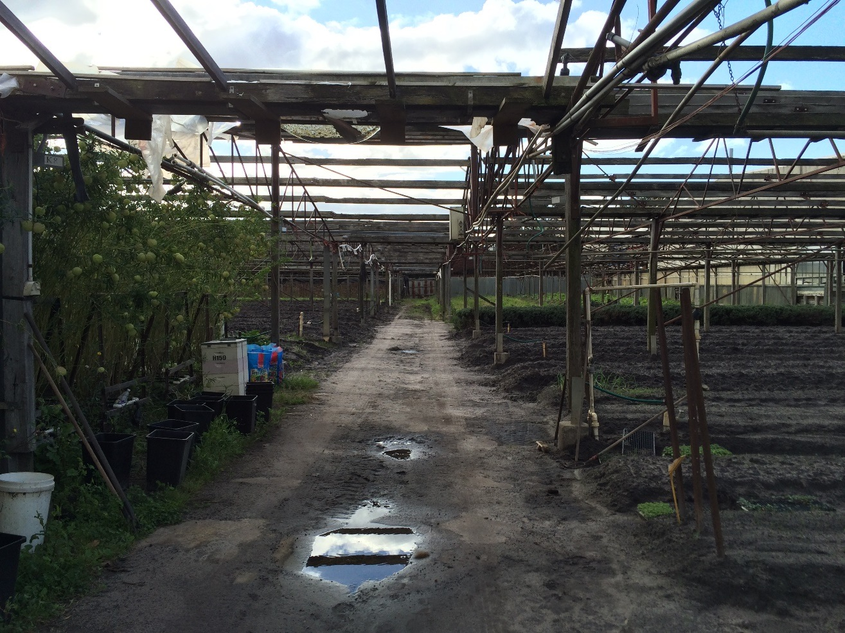
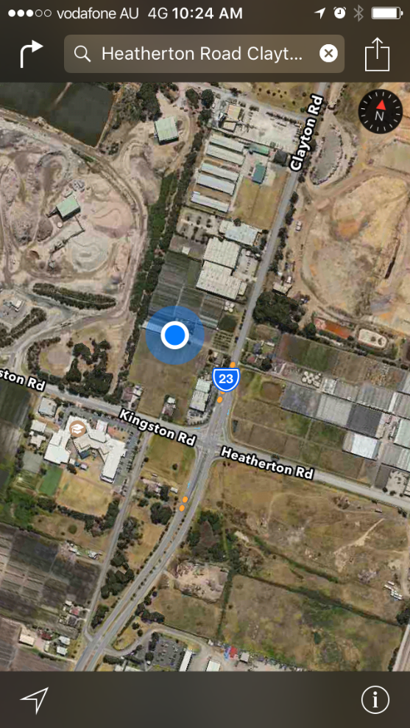
The Baguley Family Farm, Clayton South
Funding? Not yet
Frank
Les: Sacred Heart Mission in St Kilda FareShare
-Advice
-preparing garden beds
-use of land

Slide 13
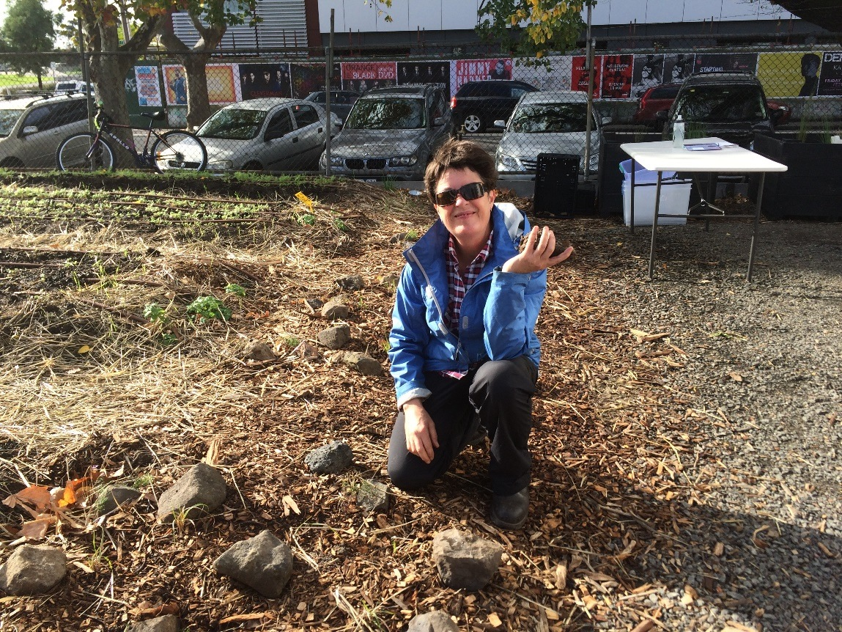
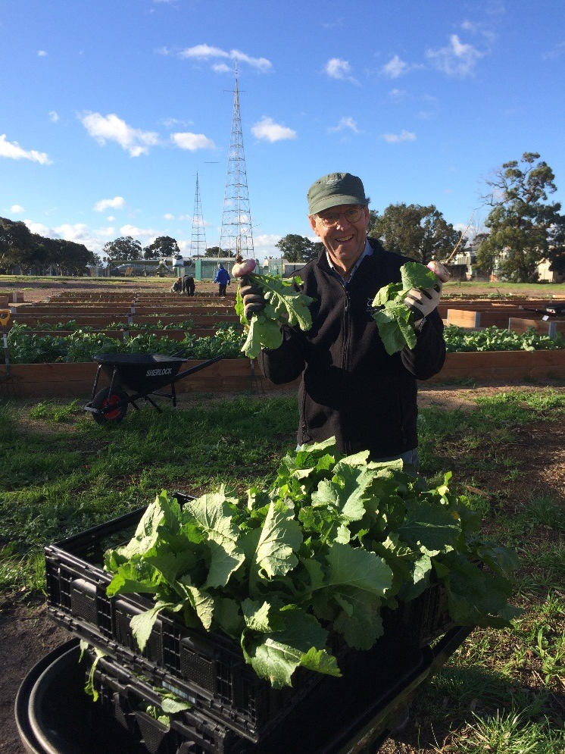
FareShare Volunteers
Garden >100
Increase knowledge and skills within the garden
Increase responsibility
Limiting factors to NFP urban ag: funds, access to land, knowledge skills resources (Hickman 2015)
Enabling factors for FareShare gardens: funds, professional and local government support, existing relationships and volunteers (Hickman 2015)

Slide 14
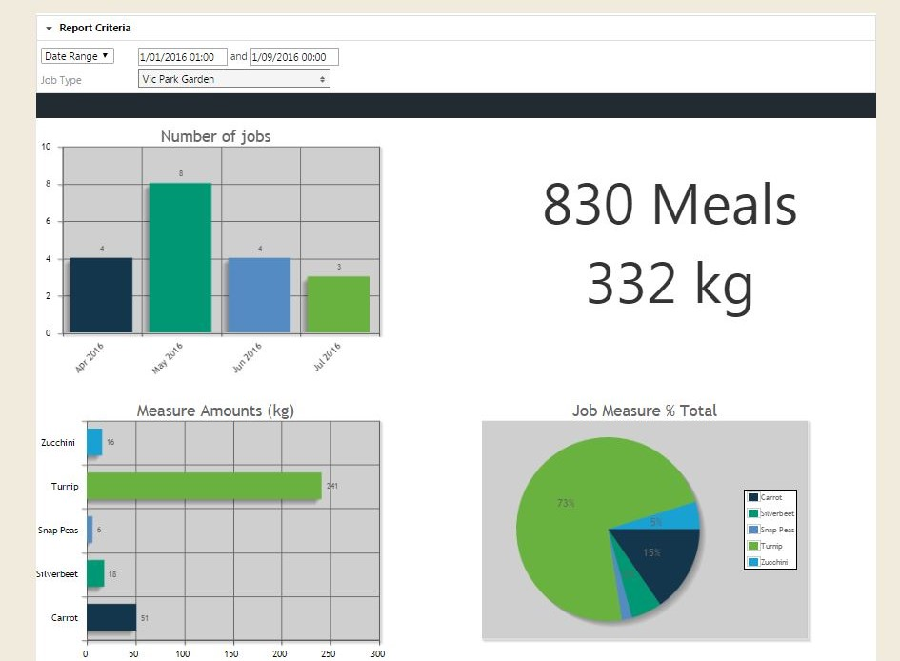
Monitoring and Evaluation Yield; Volunteer engagement; Garden (rotation, area…)
Key factor for continuation: Yield
1st August 2016

Slide 15
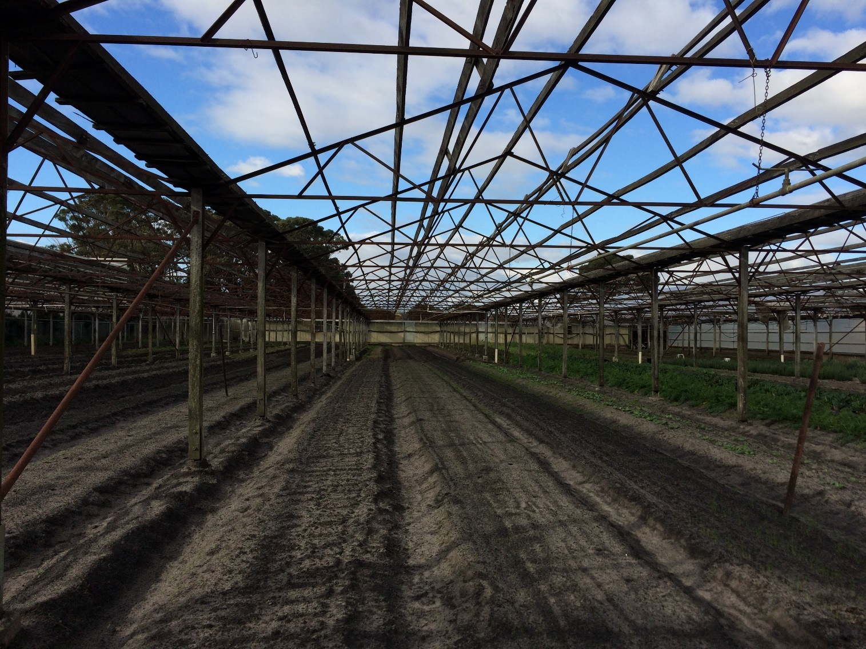
Three Contexts
 | Vic Park, Abbotsford | Moorabbin Airport | Baguley Family Farm
Cost | High | High | Low
Land tenure | Insecure Government land, 2 year lease | Secure Corporate land, >30 year lease | Insecure Private freehold, no set time
Volunteers | Approx. 70 (90 interested) | Approx. 20 (29 interested) | About to start with 15 people
Stakeholders | High number | 2 | 2
Growing methods | Organic (not certified) | Organic (not certified) | Synthetic and organic fertilizers
Capacity to produce food, contribute to FS core operation | Low approx. 700m2. 1 person (FAO 2015) | Low 600m2 | High

Slide 16
References:
FAO, 2015. The state of Food Insecurity in the World. FAO.
FAO, 2016. Images in, Royte an Finke, 2016. National Geographic, March 2016.
Mifsud and Valle, 2015. Australian vegetable growing farm businesses, An economic survey, 2013–14 and 2014–15. Research by the Australian Bureau of Agricultural and Resource Economics and Sciences. Research report 15.10.
Sheridan, J., Larsen, K. and Carey, R. (2015) Melbourne’s foodbowl: Now and at seven million. Victorian Eco-Innovation Lab, The University of Melbourne.

Slide 17
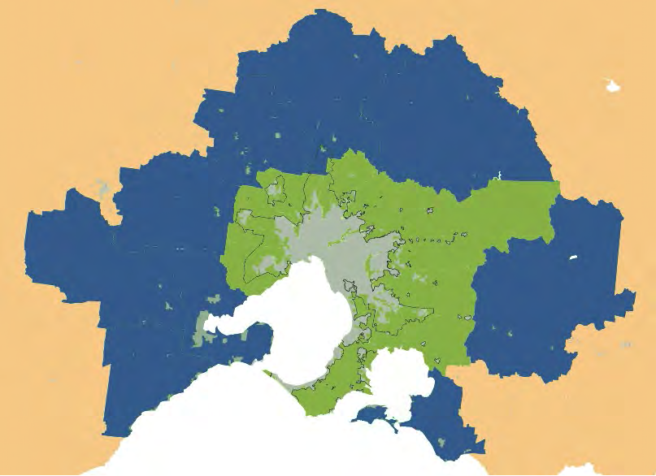
Small-scale Food Production
Global: 90% <5 acres (FAO 2011)
Australia: 2014-15 25% lowest rate of return averaged – 11%, many rely on off-farm income (ABARES 2015)
Melbourne: Produces enough for 41%; 2050 reduced capacity, estimated 18%- 77% loss from inner, 59% loss of vegetable growing (Sheridan et al 2015)
Limiting factors to NFP urban ag: funds, access to land, knowledge skills resources (Hickman 2015)
Enabling factors for FareShare gardens: funds, professional and local government support, existing relationships and volunteers (Hickman 2015)
Melbourne inner and outer food bowl (Sheridan et al 2015)
Notes:
The key findings of this research include:
• Melbourne’s foodbowl includes multiple relatively small areas of food
production scattered around the city fringe
• Melbourne’s foodbowl produces a wide variety of fresh foods, particularly
fresh fruit and vegetables, but also eggs and chicken meat, and some
beef, lamb, pork and dairy
• Melbourne’s foodbowl produces around 47% of the vegetables grown in
Victoria and around 8% of fruit
• Highly perishable foods, such as leafy greens and berries, are typically
grown in the inner foodbowl, close to the city. The outer foodbowl
produces a more diverse range of foods that includes fewer perishable
foods, such as fruit and vegetables, but more livestock products and
some oilseeds
• Melbourne’s population is predicted to grow to at least 7 million by 2050,
and Melbourne will require 60% more food to meet the population’s
needs
• By 2050, around 16% of the farmland in Melbourne’s foodbowl could
be lost if current urban density trends continue, including up to 77% of
farmland in the inner foodbowl
• Melbourne’s foodbowl currently produces enough food to meet around
41% of the food needs of Greater Melbourne’s population, but by 2050
urban sprawl could reduce the capacity of the city’s foodbowl, so that it
can only produce enough food to meet 18% of the city’s food needs
• Melbourne’s foodbowl currently produces enough vegetables to meet
82% of Greater Melbourne’s needs, but by 2050, urban sprawl could
reduce the capacity of the foodbowl to meet Greater Melbourne’s
vegetable needs to around 21%
• If Melbourne is able to accommodate the predicted population increase
in a way that contains urban sprawl and retains the city’s capacity for
peri-urban food production, Melbourne’s foodbowl could contribute to a
more resilient city food supply in the face of increasing climate pressures
on food production
4.1 How much food will be needed to feed
Melbourne in 2050?
Melbourne is Australia’s fastest growing capital city33, and Greater
Melbourne is projected to reach a population of around 7 million by 205034.
The population in the outer foodbowl is also likely to increase by 80%,
reaching almost 900,000 by 2050 (the population of the outer foodbowl is
not included in the estimate of Greater Melbourne’s population).
If Melbournians eat the same diet as they currently consume35, and a similar
amount of food is wasted through the food chain, Greater Melbourne will
require 60% more food to feed its population by 2050 – around 24,132
tonnes of food per day, at an average of 3.45 kg per person.
4.2 Land loss in Melbourne’s foodbowl
By 2050, Melbourne’s population is likely to grow by at least an additional
2.63 million people to reach a population of 7 million. This analysis
models the possible impact of the predicted population growth on loss
of agricultural land and productive capacity in Melbourne’s foodbowl, if
population growth is accommodated at the current rate of urban density.
That is, it models the potential impacts of maintaining the current trend.
Density rates approved by the Metropolitan Planning Authority37 were used,
closely validated against Melbourne’s urban growth trend from 1946 to now.
If the current rate of urban density is maintained, population growth will
likely continue to displace farmland to provide the houses and infrastructure
needed to support 7 million people by 2050. At the existing rate of
urban density, Melbourne’s Urban Growth Boundary (UGB) is also likely
to continue to be exceeded. The current Victorian state government
has indicated that it intends to maintain the existing UGB38. However,
Melbourne’s UGB has been moved four times since it was instituted as
a permanent boundary in 200239. There is ongoing pressure for further
expansion, and the State Planning Policy Framework currently lacks
effective measures to prevent further loss of productive agricultural land40.
Sheridan, J., Larsen, K. and Carey, R. (2015) Melbourne’s foodbowl:
Now and at seven million. Victorian Eco-Innovation Lab, The University of
Melbourne.
Vic and hort production
Vegetable production: 7 per cent ($3.8 billion)
Since 2006-7 average annual rate of growth <1%
The estimated average rate of return (excluding capital appreciation) for top performing vegetable growing farms (that is, the top 25 per cent of farms ranked by their rate of return on capital) was greater than 10 per cent in 2014–15. These farms were typically large and had a high level of capital investment. Top performing vegetable growing farms are also high-cost, high-return producers compared with bottom performing farms.
The estimated average rate of return (excluding capital appreciation) for bottom performing vegetable growing farms (that is, the bottom 25 per of farms ranked by their rate of return on capital) was –11 per cent in 2014–15. These farms were typically small and reported below average seasonal conditions, and farmers were more likely to retire or leave the industry in the next five years.
The Australian vegetable growing sector is an important source of food. It supplies most of the fresh vegetables consumed in Australia
Several factors have contributed to the increased gross value of vegetable production in Australia, including substantial structural adjustment. Historically, a large number of small farms accounted for the majority of the population. However, between 2011–12 and 2013–14 13 per cent of farms accounted for around 71 per cent of the total value of vegetables produced. The increase in average farm size, and ongoing capital investment in new technologies, has contributed to increased productivity on vegetable farms. Productivity growth is key to agricultural industries remaining competitive and farmers maintaining profitability to ensure long-term viability.
In 2013–14 the number of Australian vegetable growing farms with an estimated value of agricultural operations (EVAO) greater than $40 000 decreased by 3 per cent to 2 595 farms (Table 1). The majority of this change was attributable to changes in the number of small farms (farms that planted less than 5 hectares of vegetables), which decreased by 25 per cent to 805 farms. Unlike larger farms, the population of small farms changes markedly from year to year in response to seasonal and market conditions. Farmers can enter and exit vegetable production relatively easily compared with other agricultural industries because of the lower capital requirements.
The vegetable growing industry makes an important contribution to regional economies. The wide range of climates and soils in Australia enables many types of vegetables to be grown in various parts of the country. The main vegetable producing regions include:
• parts of the Murray–Darling Basin
• close to Brisbane, in south-east Queensland
• Bundaberg, north of Brisbane
• Bowen, in north Queensland
• the Mornington Peninsula, Bacchus Marsh, the Clyde and Werribee regions close to Melbourne
• Lindenow, in the far east of Victoria
• south-east South Australia and Virginia, close to Adelaide
• northern Tasmania
• south-west Western Australia
• areas close to Perth, including Gingin.
(ABARES 2015)

