Slide 1
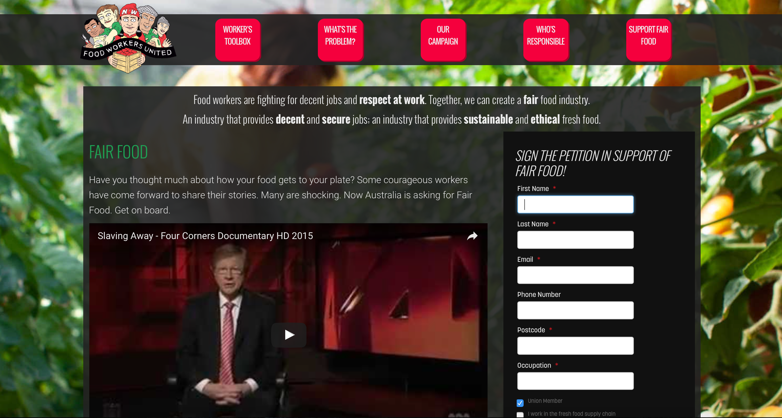
Fair Food Australia
fairfoodaustralia.org
A campaign for workers, by workers, in the supermarket supply chain

Slide 2
fleurieupoultry.com

Slide 3
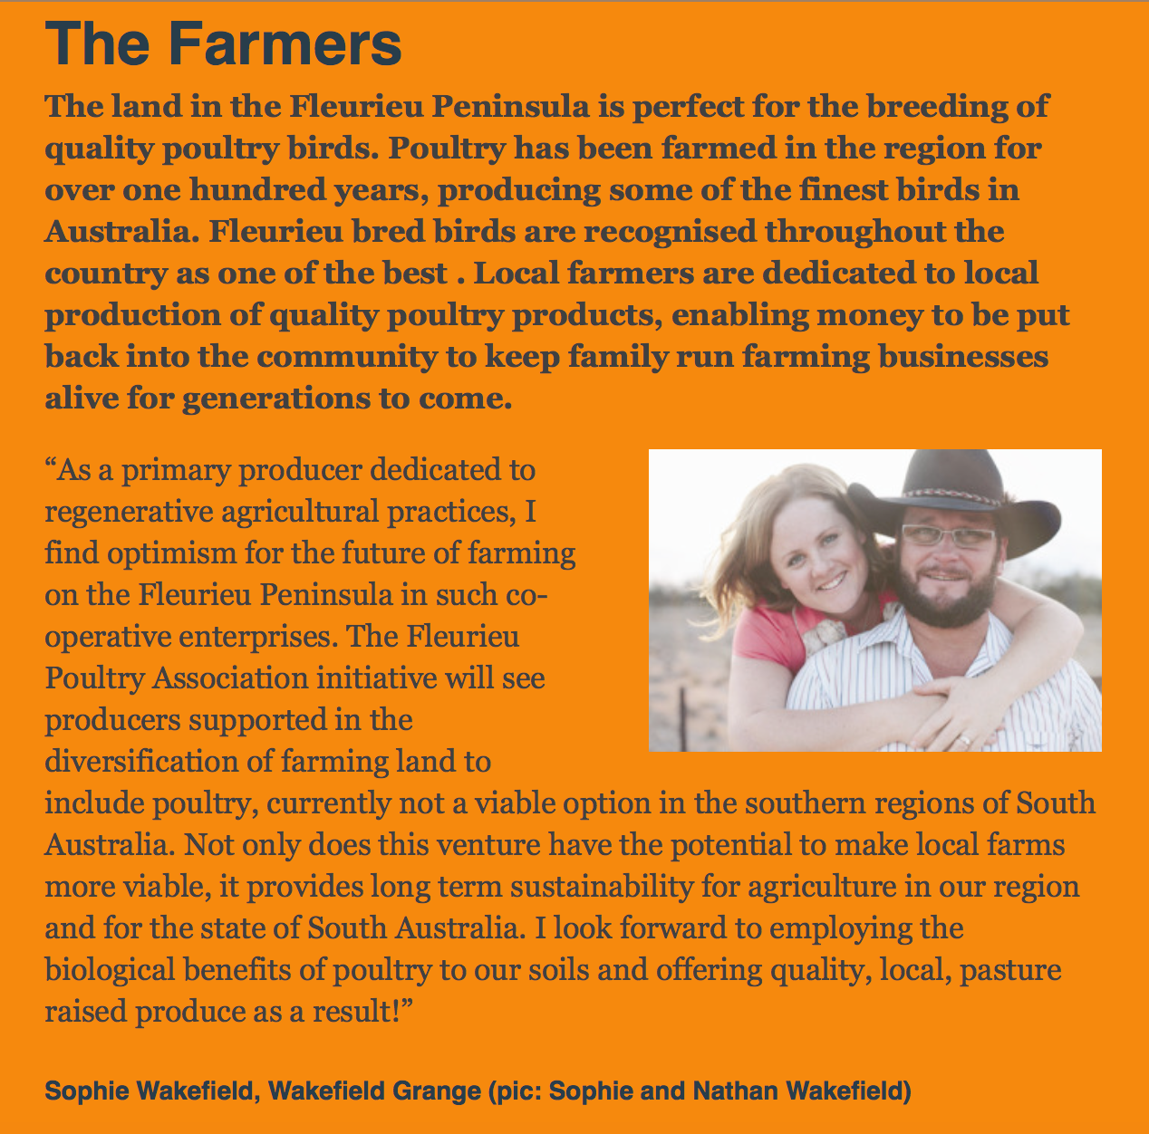
fleurieupoultry.com

Slide 4
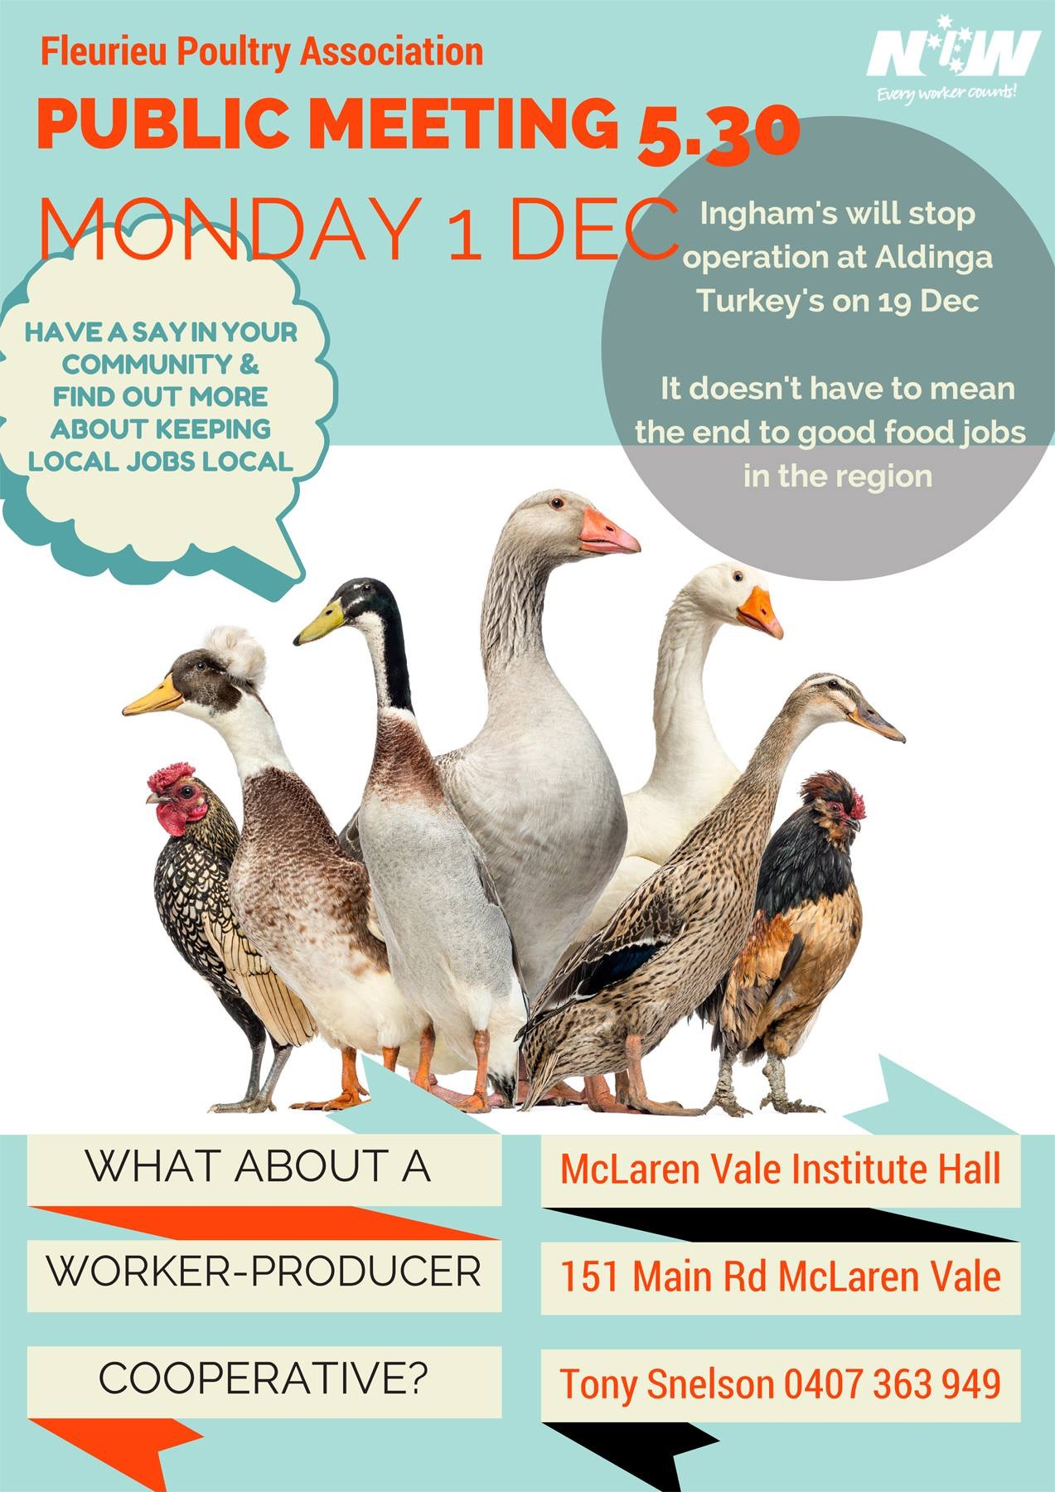
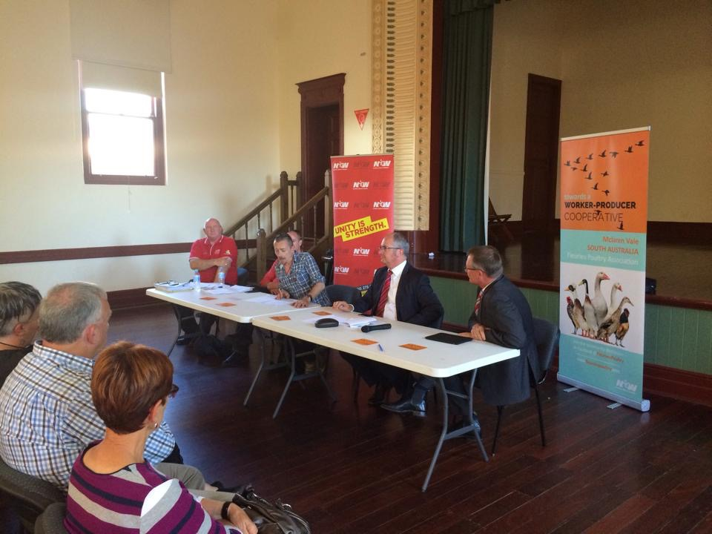
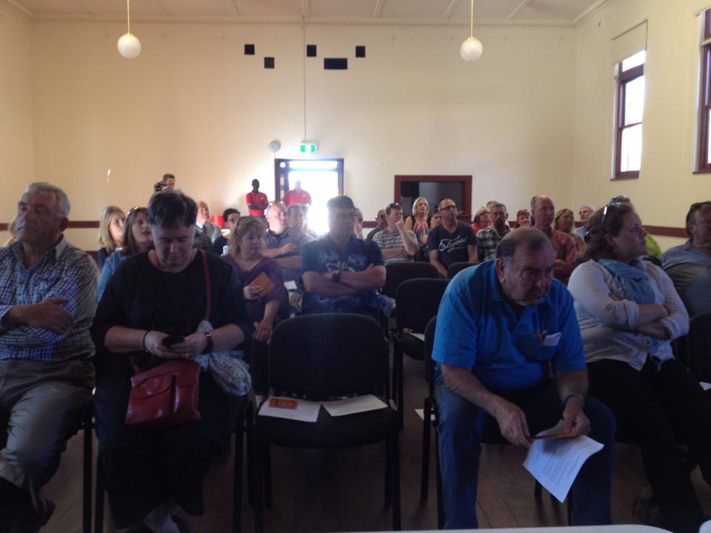
Community meeting with Simon Bryant and Leon Bignall up the front

Slide 5
Rick Duke
Fleurieu Poultry Project Officer

Slide 6
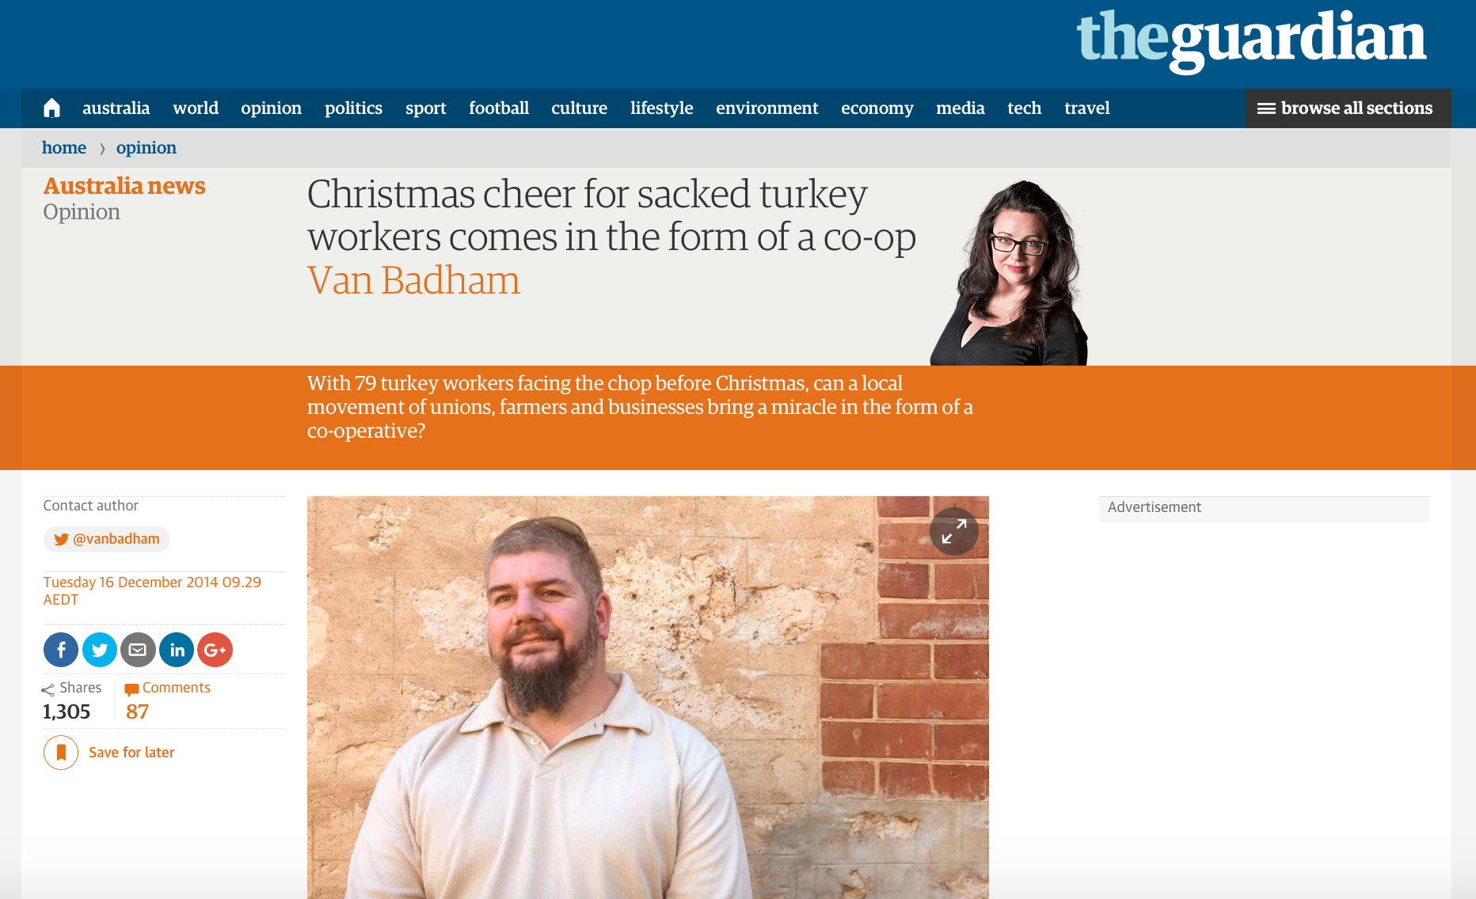

Slide 7
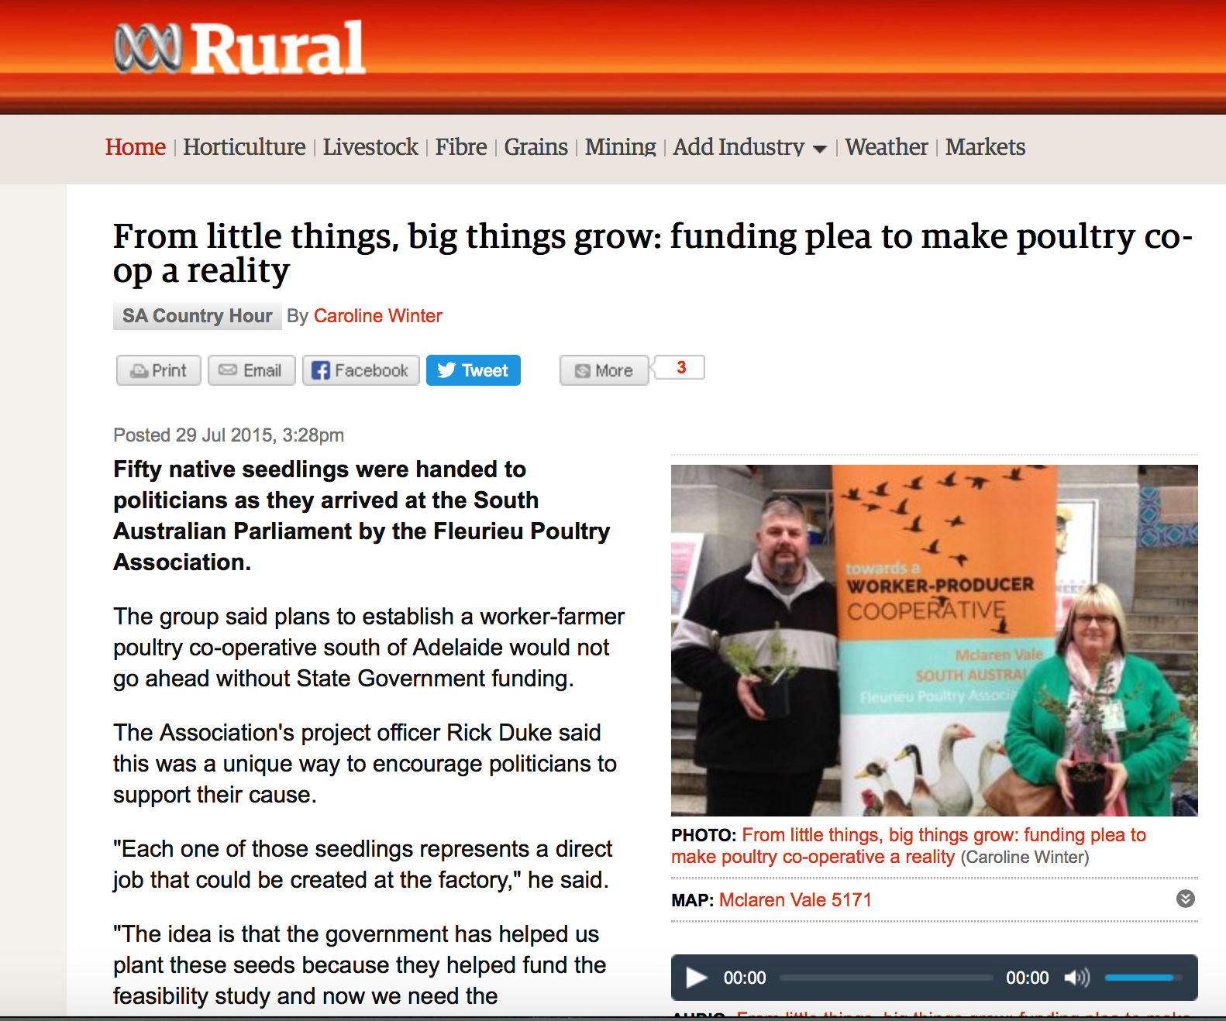

Slide 8
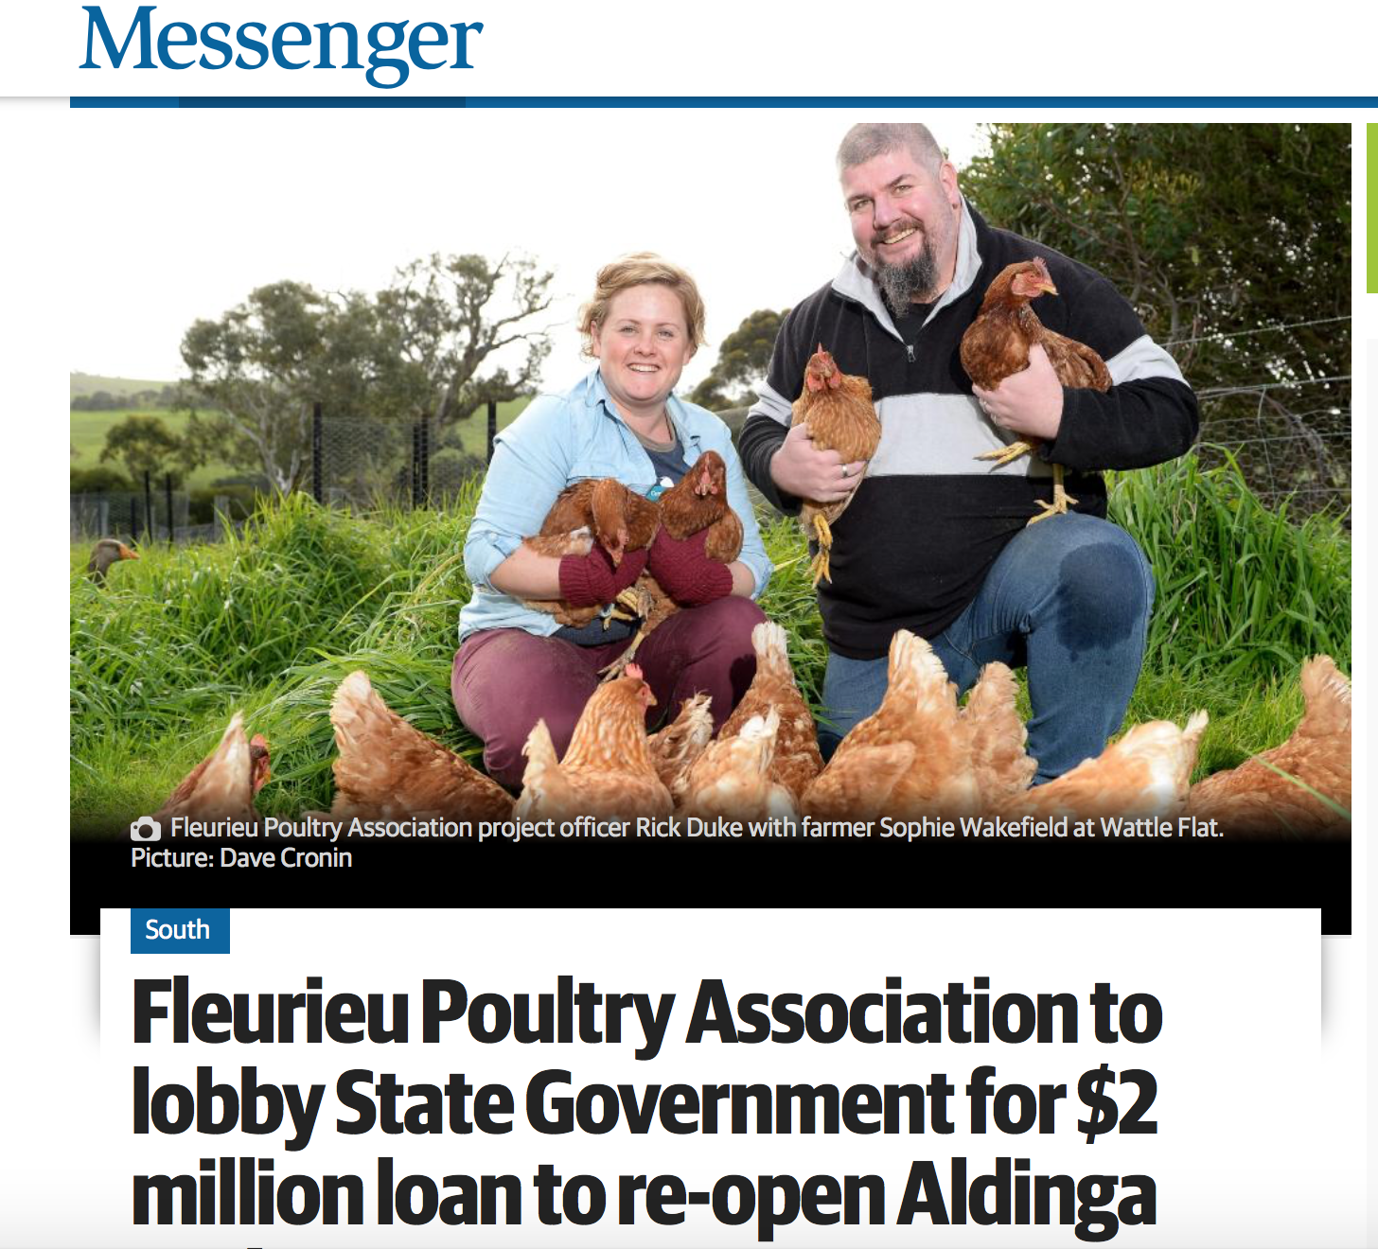

Slide 10
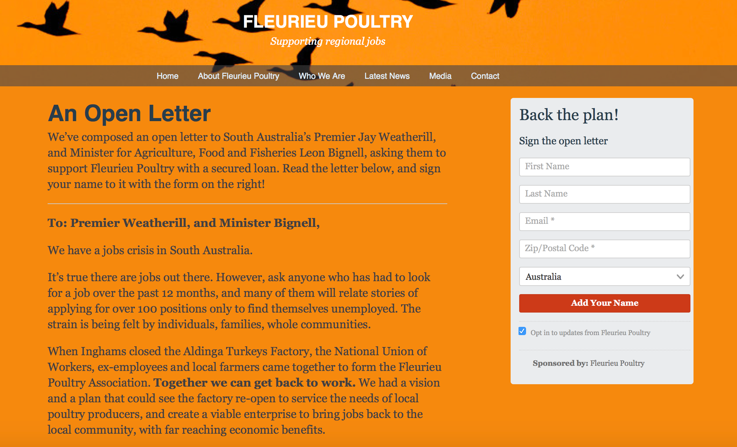
fleurieupoultry.com

Slide 11
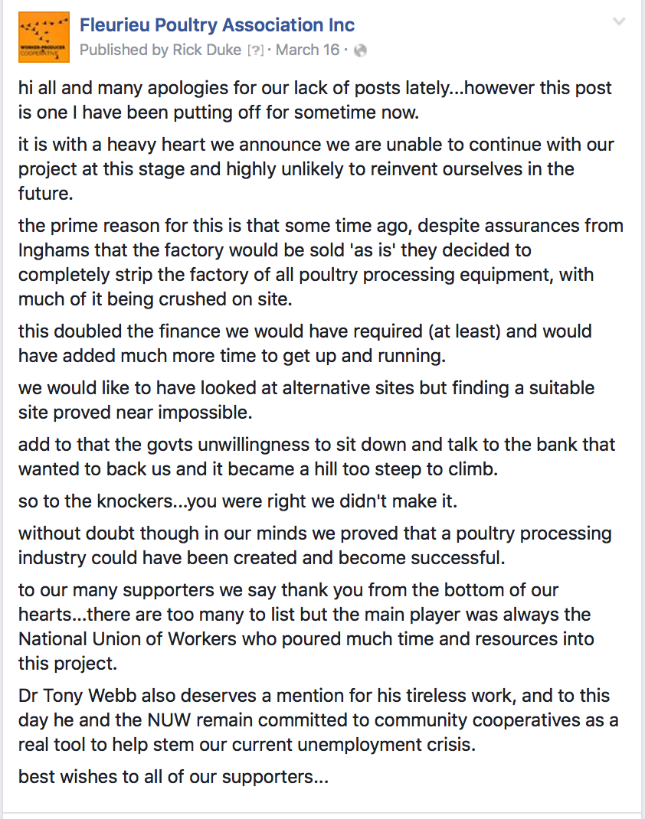
Rick Duke shares the news on Facebook

Slide 12
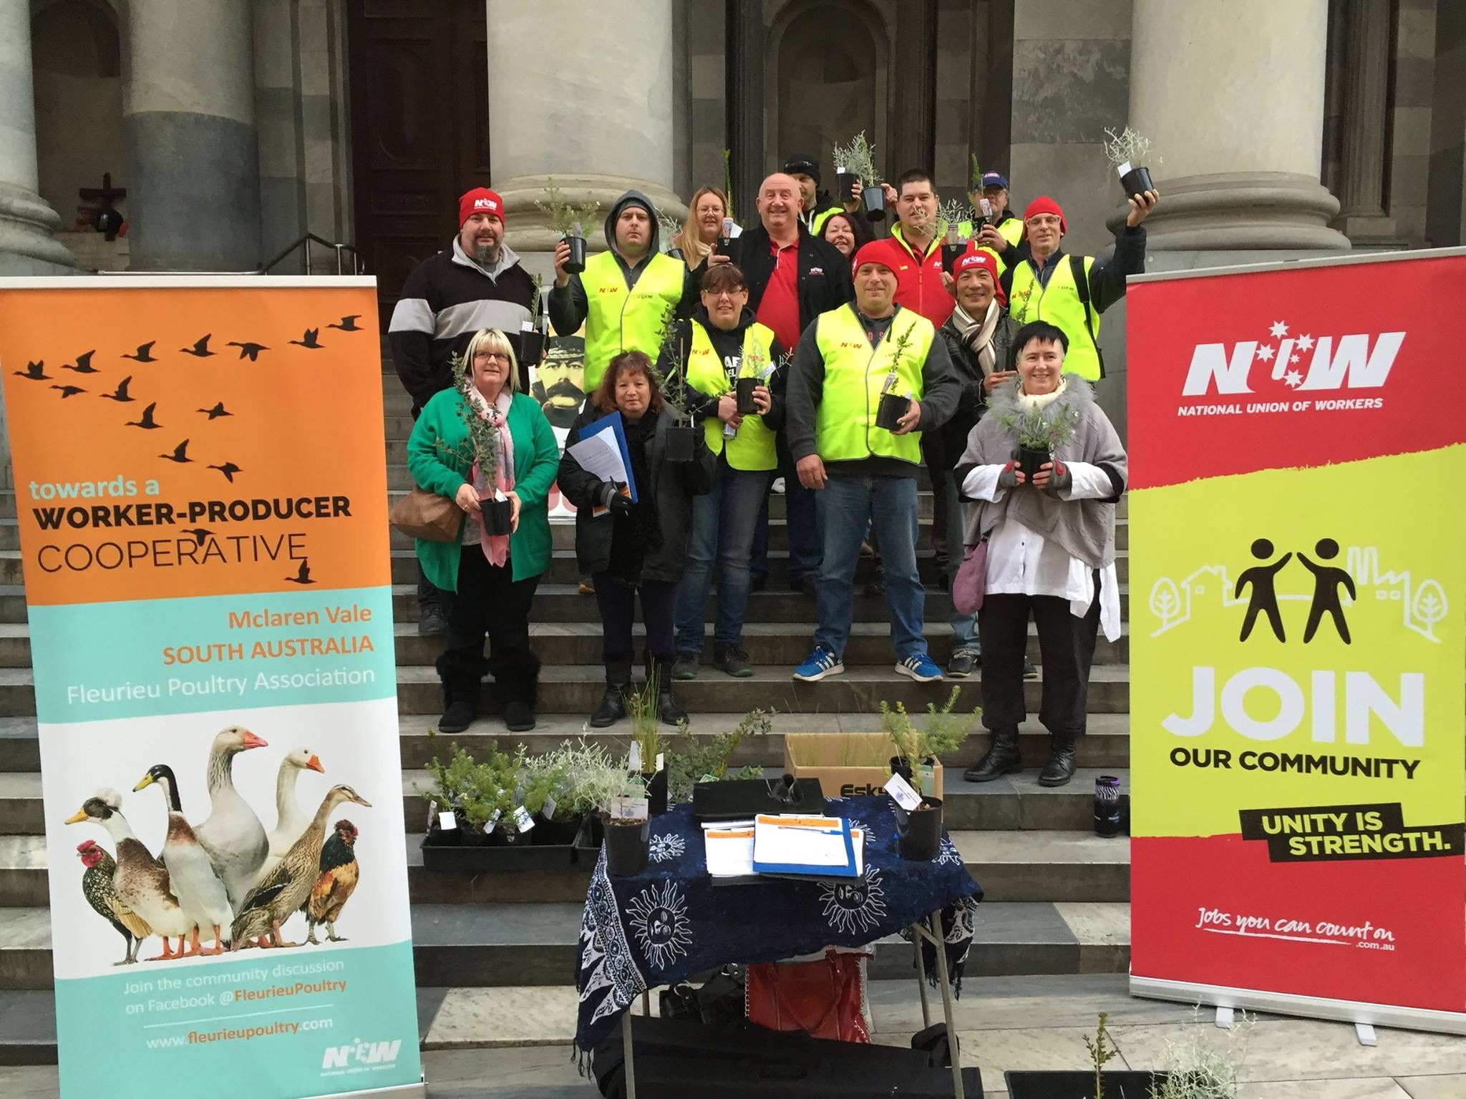
Union members and supporters at an action at State Parliament in Adelaide

Slide 13
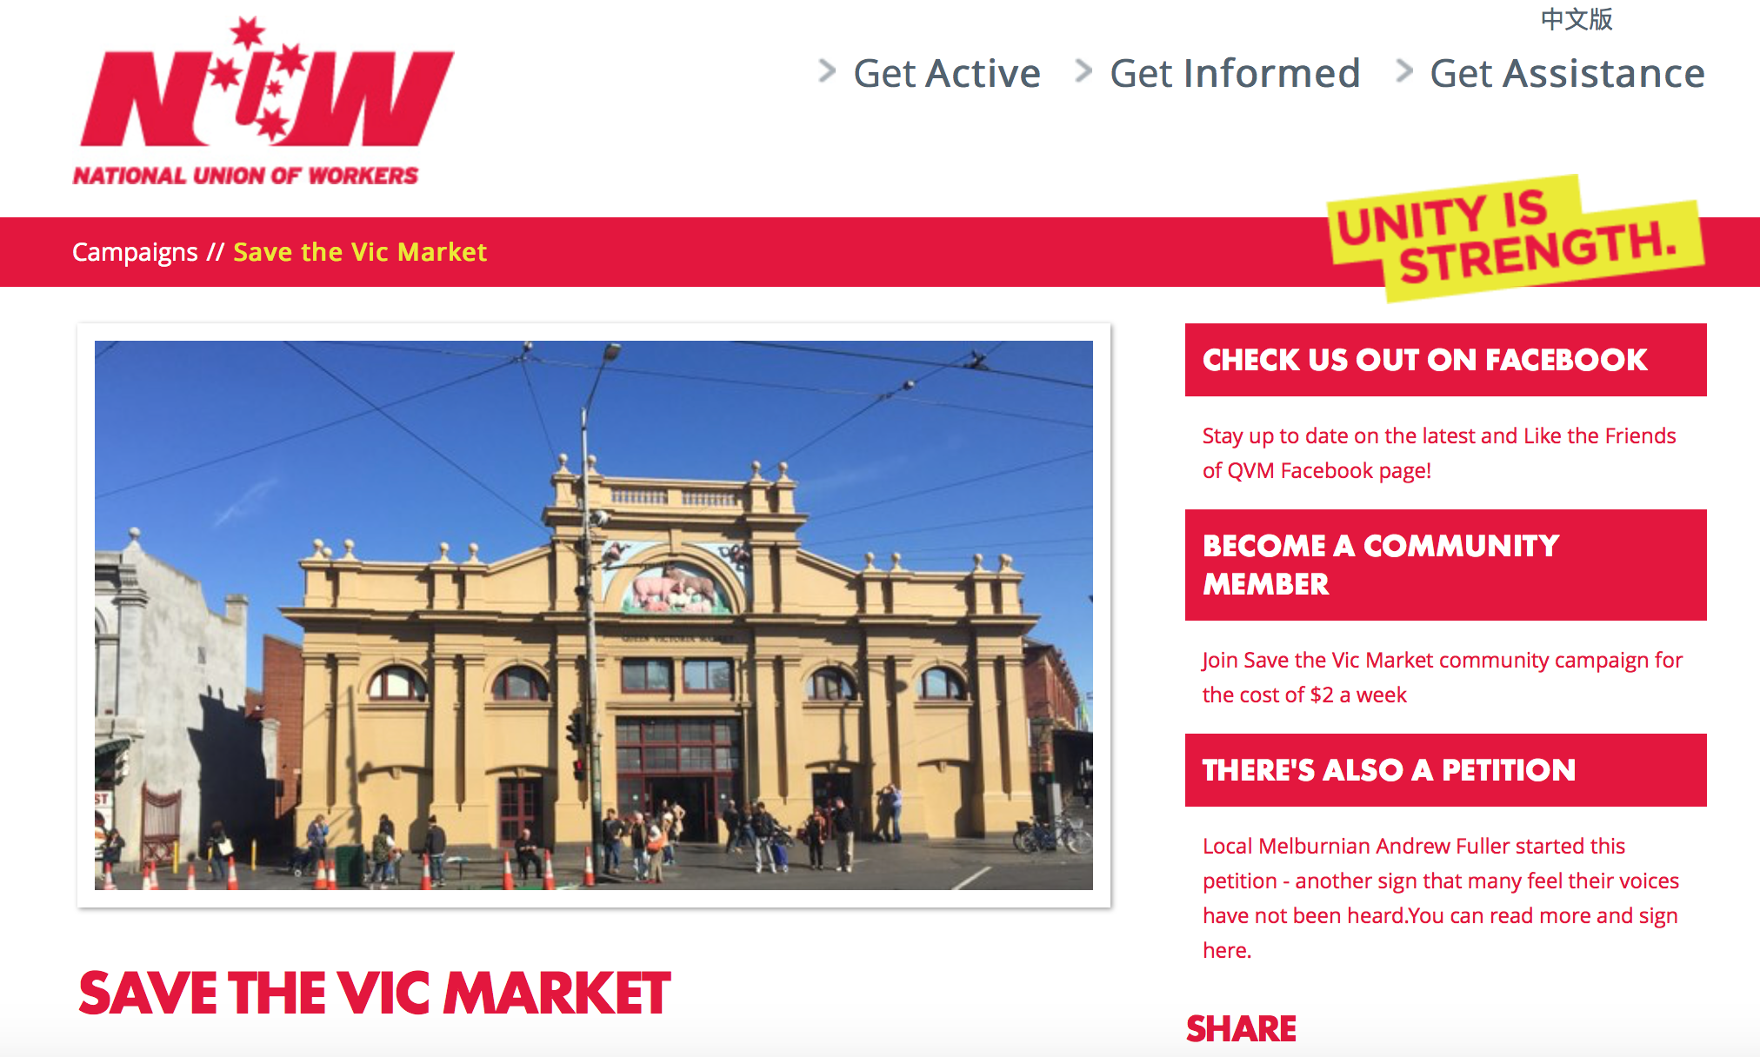
Save the Vic Market community-union campaign

Slide 14
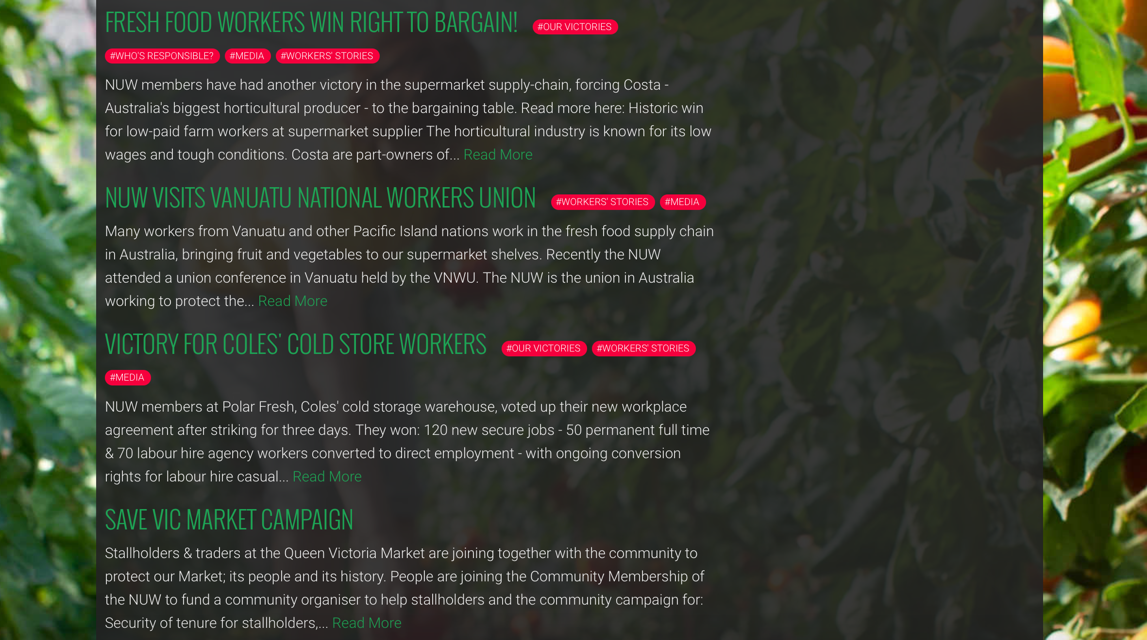
fairfoodaustralia.org
National Union of Workers &

