Slide 1
The Philanthropic Landscape in Australia

Slide 2
Philanthropy in Australia Charitable Donations
Sponsorships
Individuals (tax deductible, excl. ancillary funds)
Corporates (excl. sponsorships)
Other charitable trusts
Individuals (not claimed as tax deductions)
Public ancillary funds
Private ancillary funds
Source: ABS, JBWere Philanthropic Services
Bequests
Notes:
Each Charity needs to know their pie and how to tackle each area
$1 spend on fundraising generates $4
Individuals – Red Cross example, most of Charities spend a lot of time
Indiv (not tax) sausage sizzle and raffles
$1 = $1.58 black tie events for example
Bequests significant $’s often from Charities people don’t know
PAF’s started 2001
PCT – like Myer (Vic dominated)
Corporates – Sophistication of CR programs related to corporate strategy

Slide 3
Philanthropy & Impact Investing
1986 was Australia’s most generous year – 40% made a donation
2 out of 3 people do not make a tax donation
The High Net Worth (HNW) market in Australia involves over 200,000 people with a value of more than $674 billion (2013)
Intergenerational wealth transfer in Australia & New Zealand will exceed $600 billion over the next 20 years
There are over 25,000 Financial Advisers in Australia & New Zealand with additional Bank-related and other advisers who support the pipeline with HNWI
Combined donations into PuAFs & PAFs now represent 36.4% of tax-deductible giving
Total estimated corpus assets of all charitable trusts & foundations is around $12b – with Impact Investing – this opens up 20X the amount they currently distribute ($600M pa)
58% of Australian adults have a Will – and of those only 7.5% include a charity in their Will
Sources: QUT, Koda Capital, JBWere
Notes:
Key points:
The next 20 years is a significant opportunity in the wealth market
Impact Investing can unlock 20x the available funds into social and environmental impacts
Estate Planning services – are also a core as the baby boomers (with signifant assets) – transfer this wealth

Slide 4
Major Philanthropic Trends
Collective Impact (Place-based)
Multi-year 5,10, 15+ year grants
Neutral facilitator
Collective Impact
(Interest Area)
Impact orientation
Focus – evidence-based
Impact Investment
(Unlocking the corpus)
Social enterprises
Social impact bonds
Impact driven
Donors
Democratisation of Giving eg Donor Circles, Fundraising Participation, Crowd Funding, International Giving
Community Development Model

Slide 5
Impact investing
20X
Agnostic
Ethical
Impact
Mission
Grants
Source: Impact Investing Australia

Slide 6
Profit V Impact
Max Profit
Profit First
Investors
High
Impact First
Investors
Profit
Max Impact
Low
Low
High
Impact
Source: Impact Investing Australia/Alan Tyndale

Slide 7
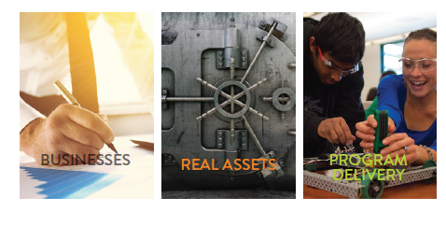
Where can you find Impact + Profit?
Source: Impact Investing Australia

Slide 8
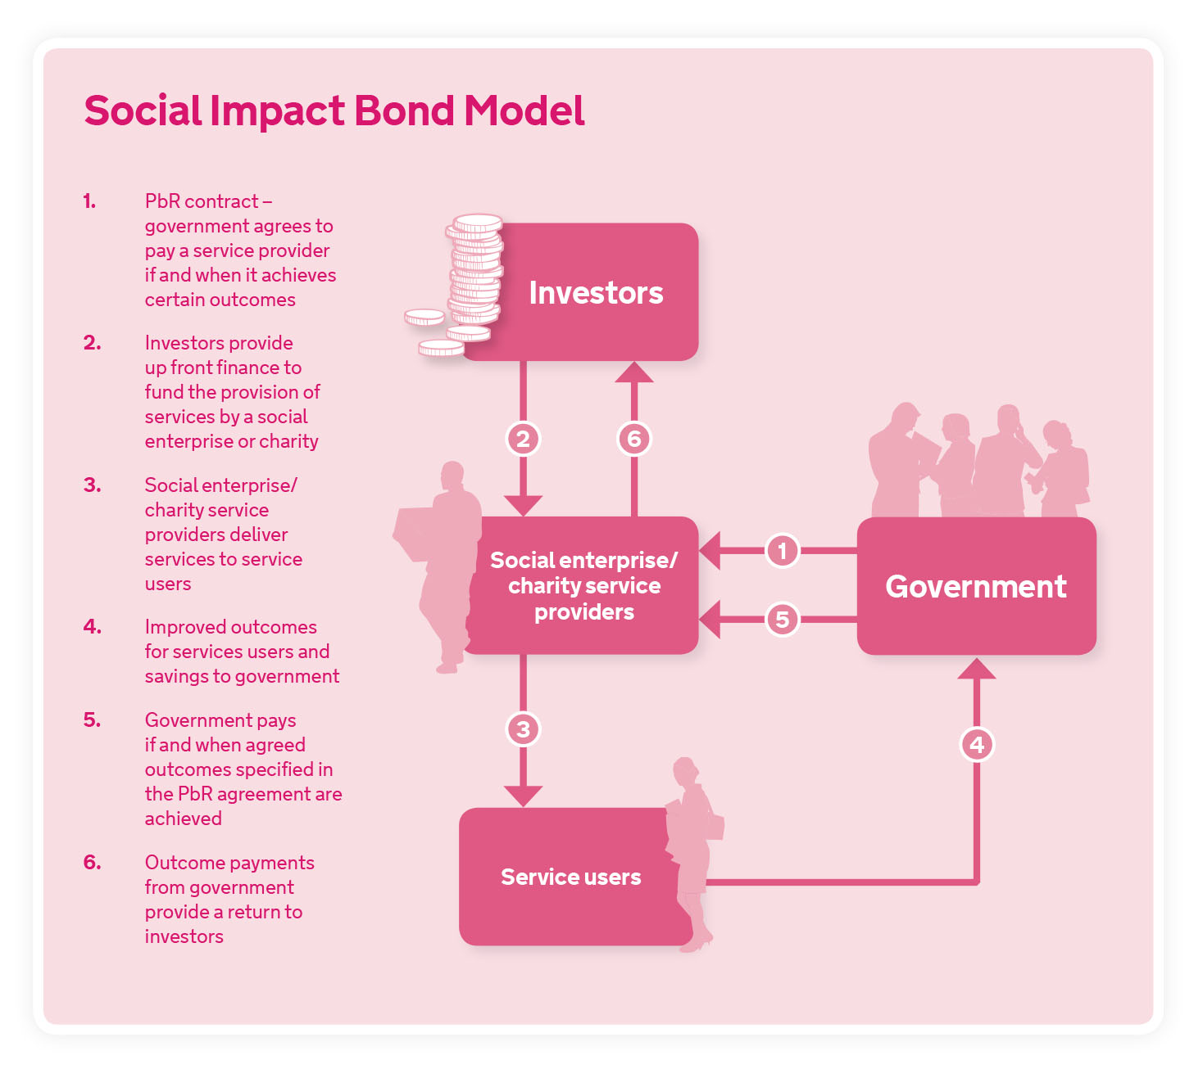
Social Impact Bonds?
Source: JBWere

Slide 9
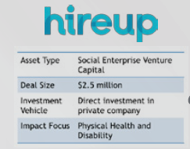
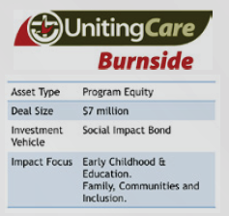
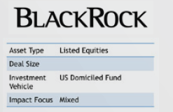
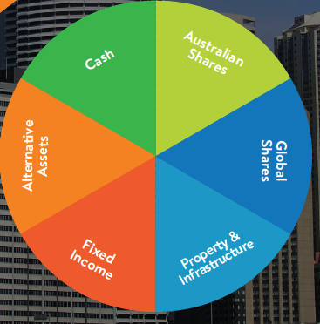
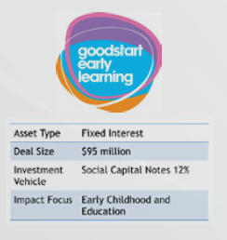
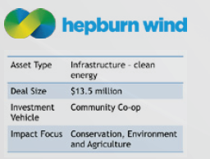
Some examples
Source: Impact Investing Australia

Slide 10
Further contact information:
Chris Wootton
Philanthropic Services Manager
Philanthropy Australia
cwootton@philanthropy.org.au
www.philanthropy.org.au
0422 654 424

