Slide 1
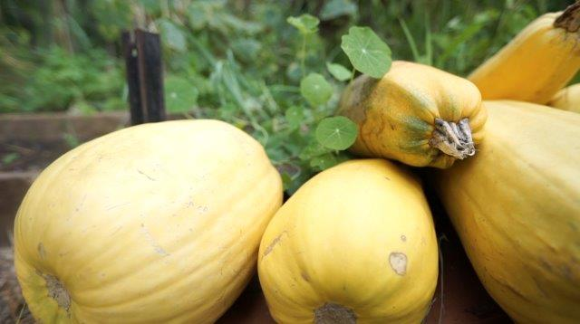
The role of TAFE & training providers in pathways to a future career in food

Slide 2
Contemporary understandings of vocational education
A mode of hands-on, practical education that leads to employment
Industry and trade focus
Training for skills and employment
“Jobs and growth” → economic outcomes
Notes:
QUESTION THAT IS NOT ASKED: what kind of economy?

Slide 3
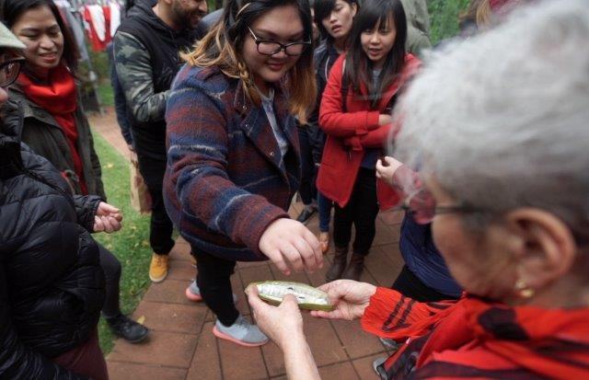
Re-imagining vocational education: a old/new way of thinking about it
Latin: vocare (to call)
Spiritual calling: to be drawn by one’s particular gifts, talents, interests and passions
A call to community engagement and social change through food?
Notes:
Anthony: spiritual awakening in our food system (this is the call to be part of the REVIVAL)
Also need the REPENTANCE that leads to CHANGE

Slide 4
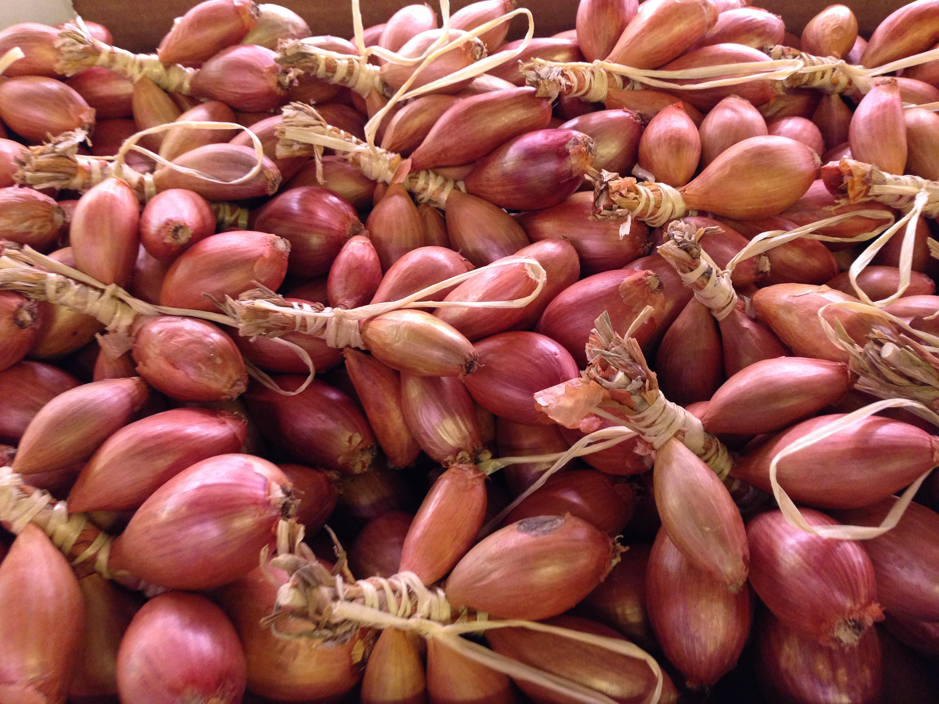
Two new programs
Bachelor of Food Studies
(February 2016)
Master of Food Systems
& Gastronomy
(February 2017)

Slide 5
What is Food Studies?
Not just the study of food, but the study of society, culture, history, environment, politics and economy through the lens of food
Predominantly social science and humanities/arts focused, with links to natural sciences, agronomy and sciences

Slide 6
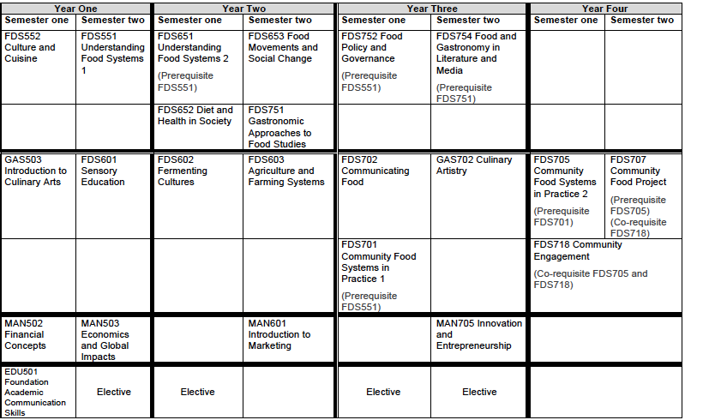
Bachelor of Food Studies
Notes:
Conceptual: food systems, food and culture, diet and health, gastronomy, food policy and governance, food/gastro in literature & the media
Embodied: sensory education, fermentation, culinary arts and artistry
Management: economics, finance, marketing, entrepreneurship and innovation

Slide 7
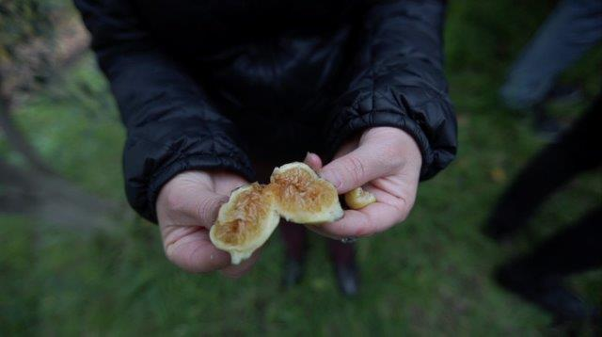
Master of Food Systems and Gastronomy
Food Systems Theory and Practice
Gastronomic Discourse and Culture
Transformations in Agriculture: Theory and Practice
Food Systems Policy and Governance Frameworks
Politics of Gastronomy
Food and Urbanism: Past, Present and Future
Creating Food Systems Stories
Research Methods
Taste, Terroir and Place
Community Food Security and Public Health
Knowledge and Knowing
Decolonising Food Systems
Urban Agriculture: Practice and Policy
Notes:
The Master of Food Systems and Gastronomy will provide the theoretical underpinnings and conceptual frameworks to enable graduates to generate positive change within the food system. Students will apply their deep understanding of food production, distribution, policy and consumption to issues of contestation within the food system including social inequity, concentration of power, urban and regional land-use and planning, local economies and citizen health and wellbeing. This will be complemented by a gastronomic lens which allows students to gain an integrated understanding of food systems from historical, cultural, material and philosophical perspectives.
Graduates of this program will possess the critical and analytical skills to engage with shifting gastronomic discourses as they intersect with the politics, ethics, aesthetics, cultures and ecologies of food system change.

Slide 8
a
Notes:
AESTHETIC, EMOTIONAL, SOCIAL AND ETHICAL VALUES OF FOOD
Feeding people with dignity with a physical space that is beautiful and respects people
Joy, empathy and deep sense of connection
Culinary arts to process food → knowing how to prepare food well
Fun, sharing and creativity in cooking
Developing the palate of local communities

Slide 9
Gastronomy & food systems
Notes:
Bruce Burton: small-scale, free-range new-breed chicken farmer
Former aviation management consultant turned farmer who is fluent in the language of entrepreneurship and market segmentation
Bruce recognises he needs to be profitable to stay in business but his commitments are to a ethical relationship with his birds.
Giving his chickens “fun and interesting” lives, feed has a range of grains to acknowledge that different birds have different tastes
Pleasure of both the farmer and the animal

Slide 10
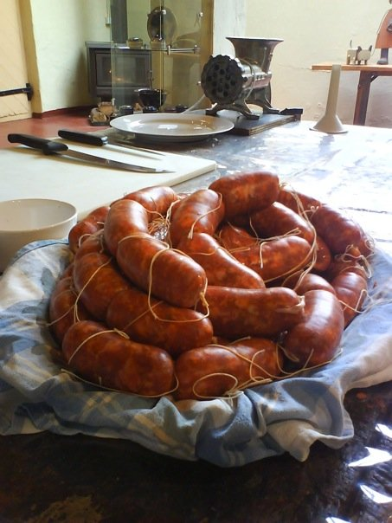
What is a critical food artisan?
An interdisciplinary thinker-doer who is theoretically ‘crafty’
Someone who can bridge the gap between conceptual and material understandings of food and apply these in a range of real-world settings.
Someone who can imagine new ways of crafting a better world through food

Slide 11
Questions?
kellyd@angliss.edu.au

Slide 12
What do community food hubs need?
Understanding how to build connectedness within communities through food
Knowledge of the dominant food system and local and global strategies to subvert or change it
Strong communication skills
Some business acumen
A commitment to feeding people well
It’s the “soft” skills that produce change.

