Slide 1
Farm to Food Victoria
Food and Fibre Centre of Excellence
Notes:
Thanks for the opportunity to speak today and provide some insight for youin relation to the direction of Bendigo TAFE in the Food and Fibre area , but more broadly, regional TAFE in supporting the Food and Fibre sector
Today I will explore with you our role and purpose as Bendigo TAFE , PART OF THE MERGED Bendigo Kangan Institute
I also want to touch on the current context in the state of Victoria , particularly government initiatives to support regional Victoria
I will share with you some details in relation to the exciting development of the Bendigo TAFE Food and Fibre Centre , and the emerging directions for that centre
I will also talk about the collaboration of regional TAFES , working together to better support individuals and enterprises in the food and fibre sector

Slide 2
Community Food Hubs Conference
Together we are exploring innovative ways to create greater value for local producers and entrepreneurs, revitalise regional and rural communities and enhance access to healthy food for all.
What is the role of TAFE in creating pathways to a future career in food and fibre ?.
Notes:
The conference purpose is clear and the key note speakers this morning have provided great insight into the critical role of active citizens in spurring change and igniting action .
in Bendigo , the regional food alliance and the Bendigo Food Hub are exciting developments and this gathering provides a great opportunity for the sharing of ideas across a wide spectrum of stakeholders ,education and training being one critical element .At Bendigo TAFE, through the research and planning phase of the Food and Fibre centre, we realised that we need to be much closer to and more engaged and involved with our industry colleagues – and across our business this is a key objective of our 2020 strategy - our sponsorship of this conference is a reflection of our commitment to do just that
All TAFE Institutes play key roles in their communities but Role of regional TAFE is quite unique - much closer to community , job connections , community support , resources ,knowledge and expertise that can be shared .
The key challenge , and this word has come up many times today, is sustainability .To support you in your business endeavours, in your search for suitable skilled labour, in your meeting your own skill needs , we must look for innovative approaches to the delivery of education and training
We have set some clear goals for our future and I’d like to share them with you ….

Slide 3
Our purpose…
We empower people and industry with the skills to create a bright future.
Helping people develop in-demand skills and pathways to life-long career success.
Helping industry build a productive workforce to meet today’s challenges and create tomorrow’s opportunities.
Inspiring each other to deliver outstanding customer experiences and a sustainable future.
Working with our partners and community to enable learning for all.
Notes:
MERGER 2014 better, stronger together more able to meet the challenges facing industry and education equally
things are changing business models are being disrupted , this creates opportunities as well as threats. The evolution and the development and growth of the food hubs model will disrupt the status quo . New technologies for marketing and distribution support this disruption .Technology is challenging old models of education – knowledge is more widely and freely available than at any time in human history - We have a clear agenda to ensure that we utilise learning technologies to provide greater access to education and training to our regional and metro learners
From jobs to pathways
Our current focus on helping people find a job will be less relevant to a growing number of our customers.
our industry partners.-Spotless, Toyota and Renault.
Also, think about students who aren’t seeking a new job. They may, for example, be training to improve their ability to do their current job.
From student-led to industry-led
The courses we teach, and the way we teach them, have largely been defined by the student market. In the future, industry will need to have more of a say in our content and practices. By allowing this, we will help to increase industry productivity while creating more real jobs for our students… just like we have with Spotless, Toyota and Renault.
From teaching to engaging
Historically, teaching has been seen as a ‘one size fits all’ activity. Not any more. Students aren’t satisfied with a classroom and certificate. They want flexibility in content and the way they’re taught.
From steady to disruptive
The world we now operate in is changing at a rapid pace. Technology is changing the game over and over again. This is a challenge, but also a great opportunity, if we embrace technology and change while becoming adaptable and agile in the way we operate. Over the next five years, we will see e-learning, MOOCs and virtual classrooms become truly prominent, while emerging manufacturing technologies, such as 3D printing, will reinvent the trades we teach and the way we teach them.
From diverse standards to a consistent experience
It is a key goal of our strategy to create a common, high standard experience for everyone we work with. Our goal is to find and embed best practice in everything we do and make sure our customers feel that best practice every time.
From transactions to relationships
The shift to learning for life and industry partnerships lifts the imperative on maintaining long term relations with everyone we deal with.

Slide 4
Our vision…
In 2020, Bendigo Kangan Institute will create 100,000 pathways to the future.
We’ll help 100,000 people take the next step in their careers.
And we’ll help industry plan and build the workforce of the future.
Notes:
It’s a strong statement about our role in the economy and in individuals lives - but it is based very strongly on who we are and what we can do……
RETAIL BAKING EXAMPLE- Our role in the supply chain , responding to a growing industry sector – needing to upskill existing workers and grow the work force to meet production demand – meet with key players , determine demand , develop a business case, upgrade facilities and equipment to provide state of the art training . From no students in this area at the start of 2015 – to over 200 hundred currently , the majority of them upskilling while on the job
Integrated land management example

Slide 5
Food and Fibre Centre of Excellence
Future industries fund $200m
Regional skills and training package $34m
Food source Victoria $20m
Food and Fibre strategy
TAFE rescue fund $7.8m
State government agenda
Notes:
After a few very difficult years, The context in which we are working has become incredibly supportive of TAFE, and as a public provider of vocational education and training we work in tandem with government to achieve objectives across a broad policy spectrum – Looking specifically at the Food and Fibre sector this slide gives an overview of current investment in both the sector specifically and regional and rural victoria -
Central to Bendigo TAFE has been the award of a grant of 7.8m to facilitate the development of the Food and Fibre centre
The food and fibre strategy released in March of this year with 5 key focus areas – most pertinent to our work is the focus to Help business innovate and grow – key goals
Equip business with the skills to innovate and grow
Support business to adopt technology, add value and create jobs
the establishment of nine new Regional Partnerships across the state, with representatives from community, business and all three levels of government.
This new approach recognises that every region is different, and that government needs to change how it operates to respond to the needs of our rural and regional communities – not the other way around.
Developing a $34 million Regional Skills and Training package that will help local communities, particularly disadvantaged groups and areas, access the training they need to get the jobs they want
Skills and jobs centre here in Bendigo – as well as a Back to work project – in partnership with Spotless focused on the training and upskilling of workers in the Allied helalth industires
Grants to develop a growth plan (planning grants)
Grants for an alliance of food producers and businesses to create jobs or boost exports (growth grants)
Funding for short study and training courses to boost your businesses' growth and exports (scholarship program) 2 million $$$ available to people like yourselves to support you to develop skills and grow your business

Slide 6
Food and Fibre Centre
Our purpose
Notes:
In this context we have undertaken research and developed our approach to Food and Fibre .As this diagram illustrates food and fibre is a very diverse sector and reaches into many many disciplines and fields .The ones you see here are just those disciplines represented in the delivery areas of Bendigo Kangan TAFE . We needed through the develop phase, to understand where our efforts are best focused and where we can provide the most needed support

Slide 7
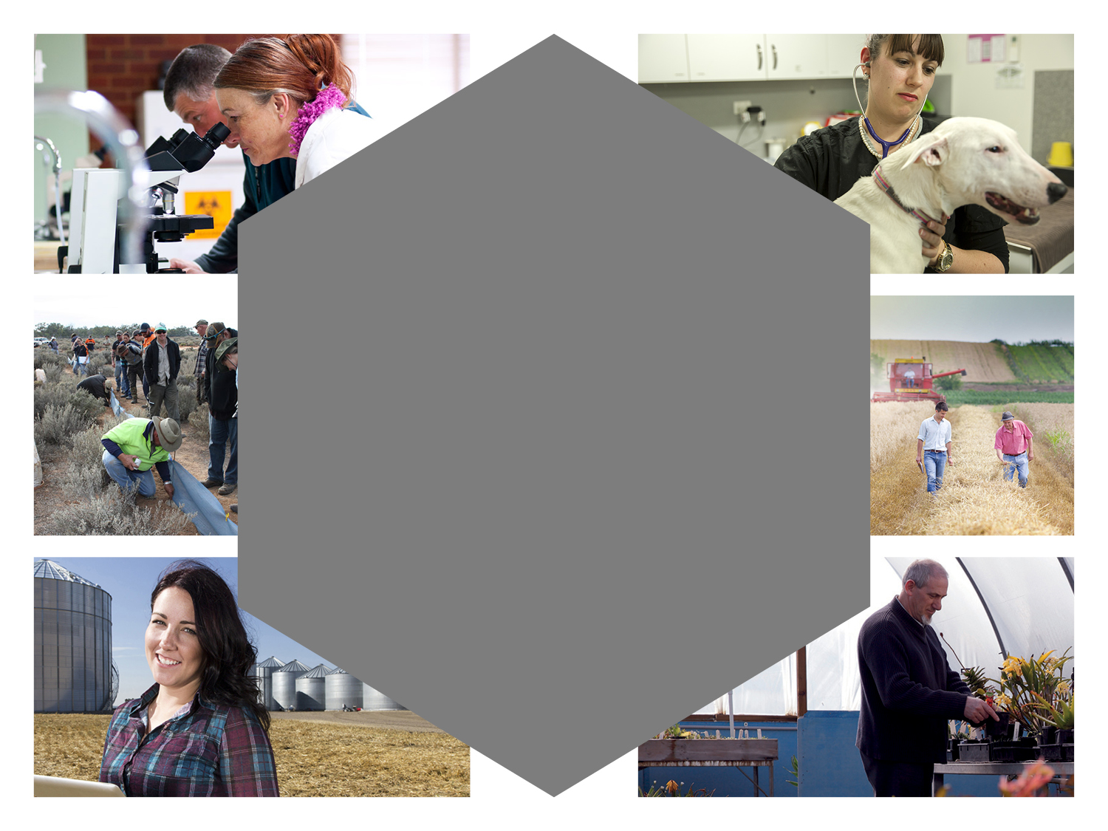
Fibre production
Animals
Plants & landscapes
Environment & natural resources management
Related applied sciences
Six key areas
Food production
Notes:
Food production (agriculture)
Fibre production (woolclassing)
Animals (vet nursing, companion animals, animal studies)
Plants & landscapes (horticulture and landscaping)
Environment & natural resource management (conservation and land management)
Related applied sciences (laboratory operations, farm chemicals).
The blue inner circle represents our primary focus of work building on existing expertise and adding food production and Animals to traditional activity undertaken by BT
3 KEY PROBLEMS IN THIS AREA
OUR REARCH AND COLLABORATION WITH OTHER TAFES – SMALL REGIONAL ATEFS TRYING TO PROVIDES A VERY WIDE MENU OF TRAINING TO LOW NUMBERS THIN MARKETS, LACKING IN SOME CASES EXPERTISE – NOT SUSTAINABLE
1.2.1 Problem 1: Low-value, uncoordinated and duplicated Food and Fibre training means the industry is not getting the skilled people it needs1.2.2 Problem 2: Food and Fibre as a career is misunderstood and unpopular, leading to low enrolments and labour shortages1.2.3 Problem 3: TAFE has not met industry training needs viably so industry has not engaged with TAFEs, diminishing the VET sector’s contribution to the economy

Slide 8
Notes:
Victoria is already Australia’s food and fibre capital and the major gateway to international markets. We account for a quarter of national primary production, 30 per cent of processed food output, 27 per cent of sector exports, and around one third of the freight task. We can aspire now to be the Asia- Pacific’s food and fibre capital – drawing more ideas, people and capital to our state to support growth. Labour supply to a growing sector is a challenge – and as I have just outlined , attracting school leavers and career changers to the sector has been problematic .A key role for the food and fibre sector will be to raise the profile of the sector as a career destination through closer relationships with schools, strong VET pathways from school to TAFE and on to Higher Education. High quality course content and practical learning experiences refecting current workplace standards and technologies are central features of the centre .Utilisng modern learning technologies and making programs available through a blend of on line and hands on learning will improve accessibility to training and development , particularly for in work learners and business owners for whom time is a precious commodity.

Slide 9
Helping industry build a productive workforce to meet today’s challenges and create tomorrow’s opportunities
New and emerging areas for program and course delivery
Sustainable food production and supply systems
Animal welfare
Biosecurity
Organic production (plants and animal systems)
Sustainable resource management
Public amenity
Agribusiness, business and workforce management
Notes:
6 key areas On top of our business as usual these are key areas that have come out of our research into the Bendigo Region which would make up part of our food and fibre centre of innovation and excellence.
As Australia is seen to be one of the most food secure nations in the world it is essential that education and training models adapt to meet the existing and future demands of a complex market.The Food and Fibre centre will support new and emerging programs identified here – commencing with a focus on Organic production
As I outlined earlier one of TAFES PROBLEMS IS THAT IS HAS TRIED TO BE ALL THINGS TO ALL PEOPLE AND THIS IS NEITHER DESIRABLE NOR SUSTAINABLE AS WE PROGRESS.IT IS THIS REALISATION THAT HAS LED TO THE REGIOANL TAFE FOOD AND FIBRE COLLABORATION.

Slide 10
How?
Notes:
How can we do this so that we are able to provide quality training and education in a sustainable timely and responsive way ?Each tafe has areas of specialisation , moving toward a sharing of knowledge and skills across those specialisations to supports our regional industries Partner Institutes William Angliss , south west tafe the Gordon Suni tafe ,wodonga TAFE Federation training , melbourne poly GOTAFE LATROBE UNI
A collective agreement reached that we must work together to share expertise and resources to support our industry prtners .our aim is to consolidate best practices in innovative teaching and learning by working together to produce and share high quality teaching and learning resources in our respective fields of expertise

Slide 11
Key objectives of the regional collaboration
Increase skilled labour supply
Grow the provision of education services
Raise the profile of the sector
Strengthen and build industry partnerships
Utilise learning technologies
Notes:
Increase skilled labour supply into Victoria's growing Food and Fibre markets
Grow the provision of Food and Fibre Education services for Victorian , national and international markets
Raise the profile of the Food and Fibre sector as a career destination to school leavers and career changers
Utilise learning technologies to provide high quality, accessible education and training
Strengthen and build our industry partnerships and connections to meet emerging skill needs
Our belief is that by working strongly together we have a much better chance of helping the food and fibre sector to meet its growth potential

Slide 12
The Victorian picture
SuniTAFE
Soils & water
Bendigo TAFE Food & Fibre Centre
Agribusiness, intensive animals & organics
GoTAFE
Dairy & fruit production
Wodonga TAFE
Transport, logistics & machinery
Melbourne Polytechnic
Large animals & dry land farming
Federation Training
Production horticulture, forestry & fisheries
South West TAFE
Fibre production & aquaculture
William Angliss/
Gordon
Food processing systems & fibre production
Chisholm
Amenity horticulture
Notes:
A snapshot of the fields of expertise across the state and how specialisations might be agreed, with each specialisation owner becoming the expert in that particular discipline developing deep realtionships with ndustry and developing programs that meet current needs and respond to changing industry environments
While it is early days yet for the collaboration there is strong commitment to the concept and a clear realisation that in order to remain relevant and to add the value to the supply chain, well resourced, industry respected and relevant traiing is essential
Some innovative ideas have emerged in relation to a Farm to Food Victorian package for an international market -

Slide 13
BKI Victorian Food & Fibre ‘International’ Strategy
Content – AQF 5+
Topic examples:
Agribusiness
Livestock/animal welfare
Plants/cropping
Water management
Soil/resource management
Bio-security/QA
Organics/Permaculture
Renewable energy
Food & Fibre Study Tour
Partnership between Reg TAFE/Govt/Ind
Topic 1 Content
Topic 2 Content
Food & Fibre Industry Experience
Reg TAFE sector specialist – partnership with Govt/Ind
Topic 1 Content
Topic 2 Content
Food & Fibre Skill Sets
Reg TAFE sector specialist – partnership with Govt/Ind
- with assessment (BKI led)
Topic 1 Content
Topic 1 Assessment
Topic 2 Content Topic 2 Assessment
Topic 3 Content Topic 3 Assessment
Food & Fibre Qualifications
BKI led - partnership with Govt/Ind
- with assessment. Links to TAFE Collab Articulated Pathway to Higher Ed
Topic 1 Content
Topic 1 Assessment
Topic 2 Content Topic 2 Assessment
Topic 3 Content Topic 3 Assessment
Topic 4 Content Topic 4 Assessment
Futures Conference
Futures Conference
Futures Conference
Indicative time frame – rolling enrolments
1 month
3 months
6 months
12 months
18 months
Topics = 1 or more units of competency
Notes:
Regional TAFE Collaboration could facilitate this Victorian experience for International delegates , study tours ,industry groups and for International students aiming at a Diploma or Advanced Diploma level qualification
A full time student would gain insight into a range of environments, economies and have a genuine interaction with Australian cultures , workplaces and way of life – a truly differentiated product in the international education market.

Slide 14
Teaching and research laboratory
Animal studies and vet nursing
All weather practical training
Horticulture and landscaping
Hydroponic and aquaculture
Innovative multi functional learning centre
Food and Fibre Centre
Notes:
Food and Fibre Centre
Innovative multi functional learning centre (teaching, industry forums, conferences and seminars)
Teaching and research laboratory (current industry standard)
Animal studies and vet nursing
All weather practical training
Horticulture and landscaping
Hydroponic and aquaculture

Slide 15
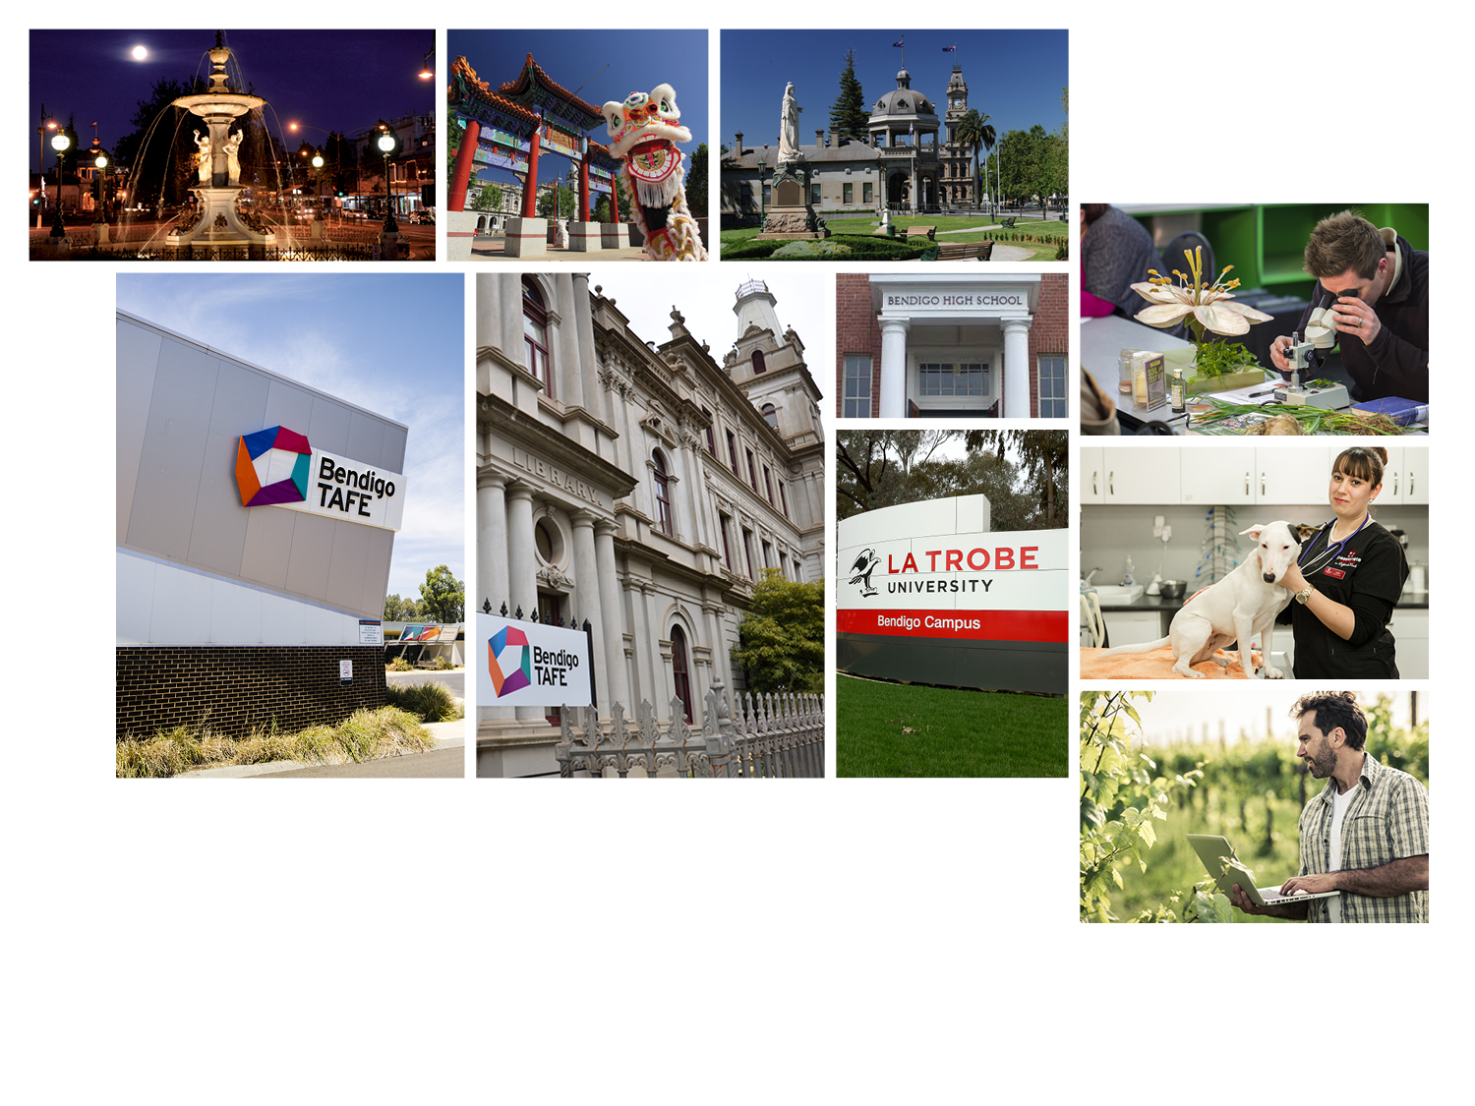
Bendigo the education city
Notes:
A new building and the extension of Building H will incorporate teaching classrooms, laboratories, open plan offices and hot desks for teaching staff and guest lecturers. The laboratories will cater for animal, plant, soil and water testing. This would include plant and animal tissue testing, soil and fertiliser analysis, water quality testing and for animal/plant pathogen identification. It will also include veterinary consulting rooms with service and reception, clinical teaching space, surgery room and adjacent animal holding facilities. The classrooms and learning commons will be used by students as well as provide a space for industry seminars, product launches and engagement activities.
This building will also house the new Innovative Learning Centre-digital learning hub, which will house an open space, flexible learning centre. This Centre will house facilities which will enable face to face and on line visual teaching, demonstrations, product launches and promotions. This Centre will enable learners to use state of the art technology for a range of existing and new learning modalities. Learners will be able to access high quality industry relevant training. A new “all weather” covered practical demonstration is required to ensure that students can acquire core practical hands on skills. This undercover facility will cater for students across all program areas as it will allow for a range of practical activities, including fencing demonstration, small agricultural ride on vehicles, bob cat/skid steer loaders, basic and preliminary landscaping activities. The facility will have attached storage facilities and will allow students to undertake relevant activities in an all-weather space. The facility will be available for industry demonstrations and product launches.
New igloos and a greenhouse will be built to the north of the undercover facility. These will include raised wicking garden beds and associated propagating facilities for students across all of the program areas where growing and the maintenance of plants is a core element. The greenhouse will include the latest technology in plant growth including hydroponics and aquaponics.

